Slide 1
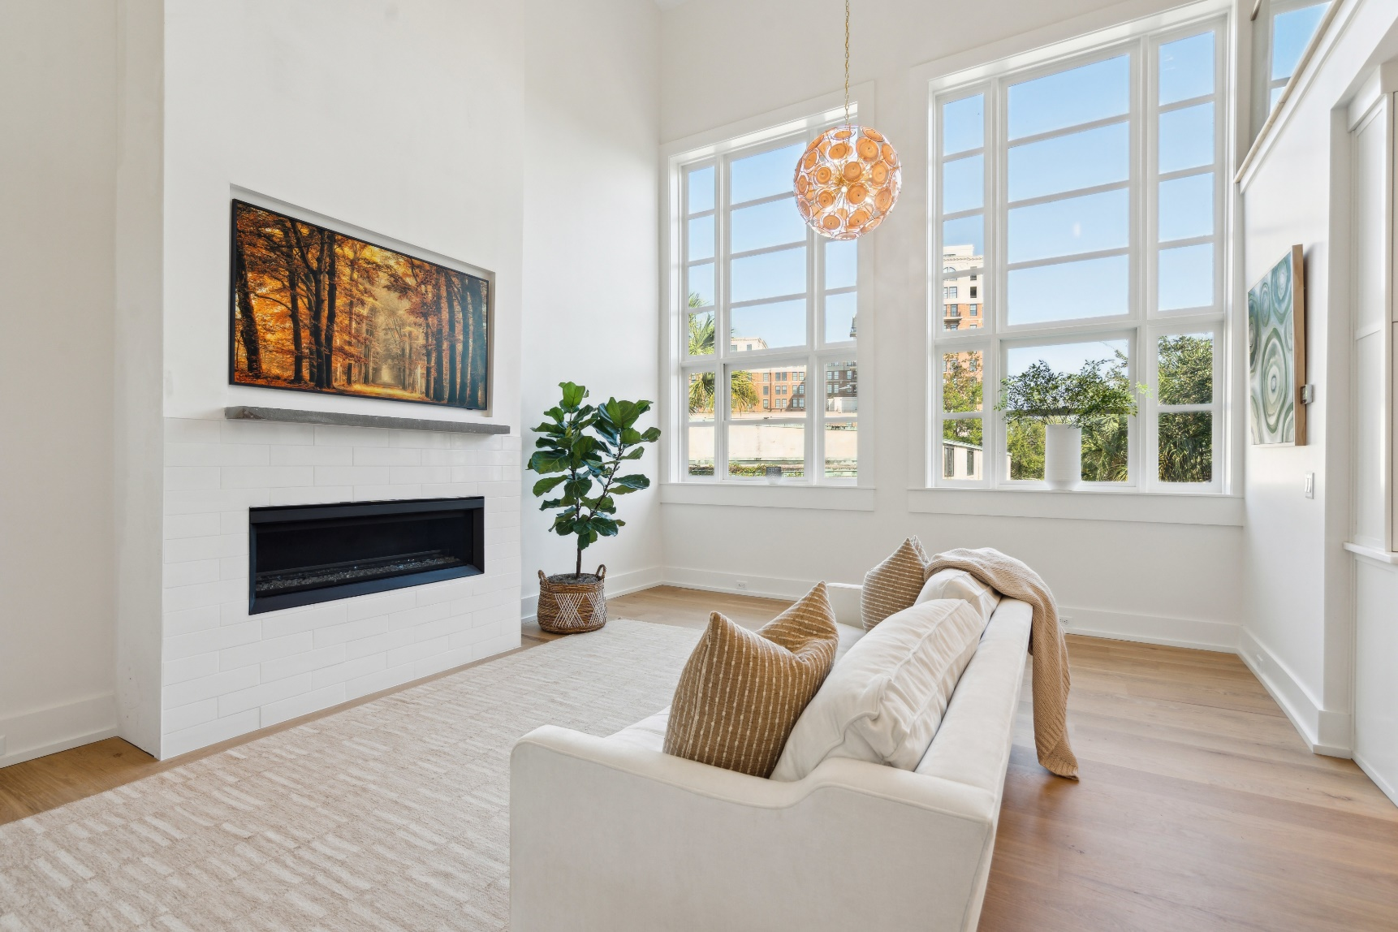
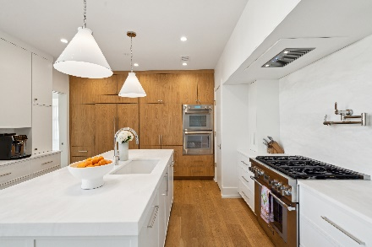
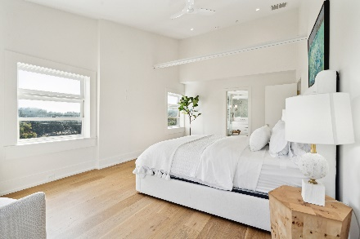
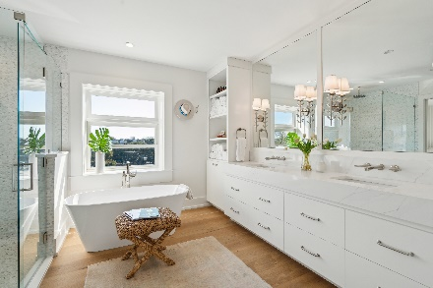
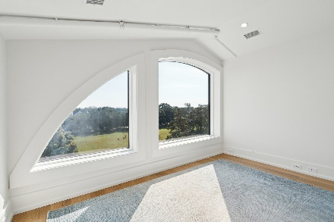
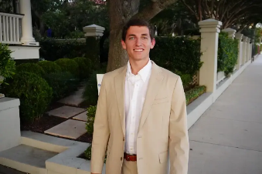

3 Chisolm Street 402
South of Broad · Charleston, SC 29401 · MLS# 24026172 · $2,100,000
Open House 11-1 Sunday 10/13
1920 Square Feet · 32ft High Ceilings · 3 Bed · 3.5 Bath · 2 Private Parking Spots
Video Tour | Matterport Tour
Bo Meuse
540-316-7252
bo@oysterpointgroup.com
oysterpointgroup.com
Oyster Point Real Estate Group
72 King Street
Charleston, SC 29401

