Slide 1
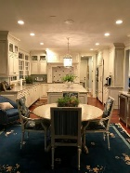
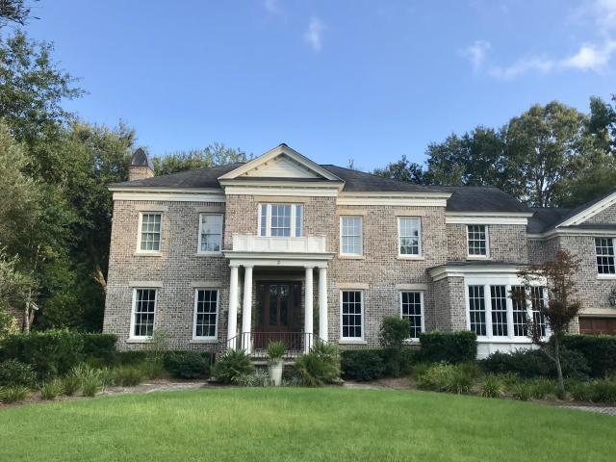
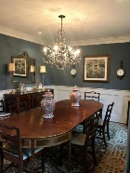
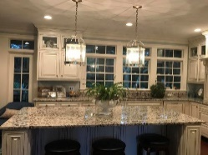
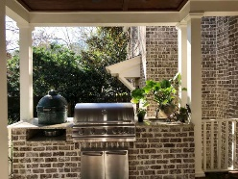
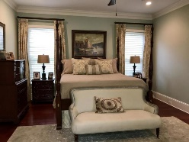
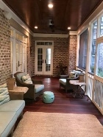
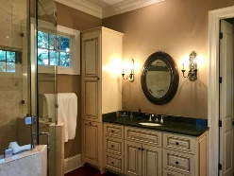
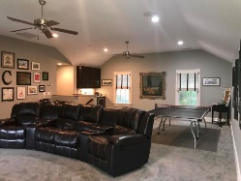
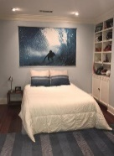
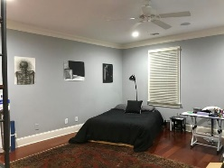
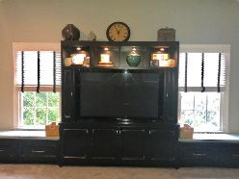
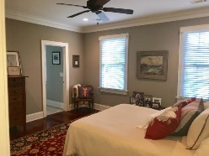
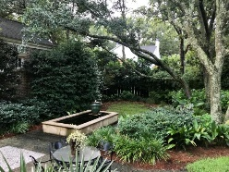
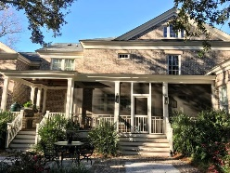
NEW PRICE in The Crescent!
3 Cochran Court
Charleston, SC 29407 | MLS# 19024065 | $2,645,000
5,042 sf | 4 Beds | 4 Full & 2 Half Baths
Located in the highly desirable neighborhood of The Crescent, this stately, fully-renovated brick home on a quiet cul-de-sac boasts a well manicured yard with four olive trees, landscape lighting and irrigation, additional off street parking & tremendous curb appeal. The private backyard is designed for entertaining with landscape lighting, a large screened back porch with built-in grilling station with new gas grill & Big Green Egg & beautiful hardscape with large fountain. Inside, you'll find 9+ceilings, Brazilian cherry hardwood floors throughout, formal dining room, study, eat-in kitchen with large island, wet bar with ice maker & wine cooler & custom built-in appliances and cabinetry. The large family room has built-ins and a coffered ceiling & gas fireplace. Very large Master bedroom and bath with 10' ceilings, walk-in closets, built-ins, granite and large shower and whirlpool tub. The first floor also has two lovely half baths, a laundry room with a pocket door and great storage, and a catchall storage room with pocket door.
The tremendous carpeted frog has built-ins, and a wet bar with sink & beverage cooler. The two car garage has two additional storage rooms. The second floor has 3 large bedrooms each with en-suite bathrooms with granite countertops and built-ins and a sitting area that overlooks the two story foyer. The second floor gives access to a very large, full walk-up attic with large cedar closet.
The backyard is private and fully fenced with gate. The crawlspace is encapsulated with a dehumidifier. Flood zone is AE. Agent is owner. Some light fixtures may not convey.
Heather Coleman
heather@heathercolemansc.com | (843) 864-9054 | www.heathercolemansc.com
Brand Name Real Estate | 4 Carriage Lane, Suite 106 | Charleston, SC 29407

