Slide 1

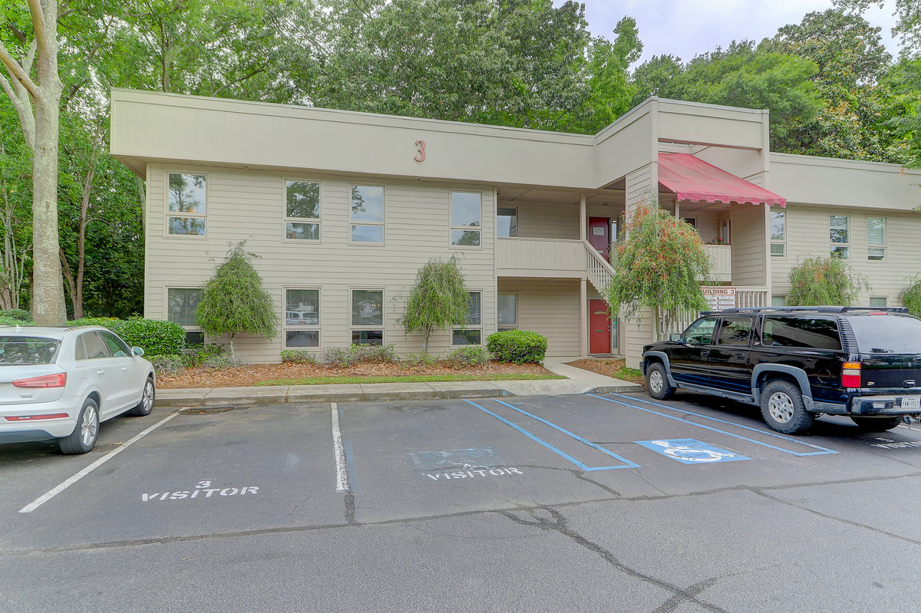
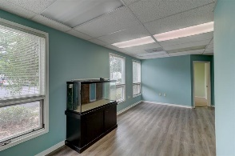
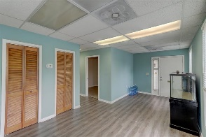
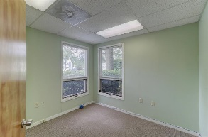
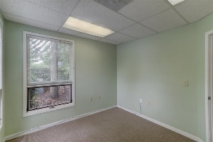
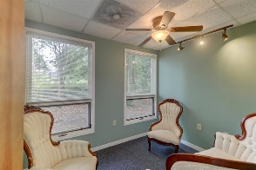
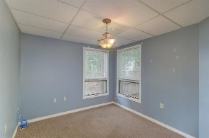
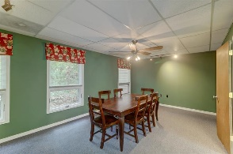
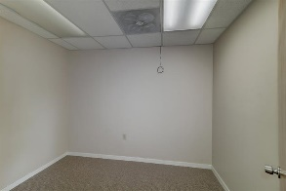
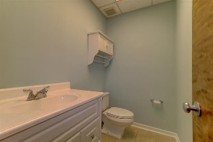


3 Gamecock Avenue, Bldg 3 Unit 301 Charleston, SC 29407 | CMLS# 30407004 | $159,000
West Ashley Ground Floor
Office Condo
Well located Ground Floor West Ashley office condominium. Great for a law Firm or any professional office use. As many as five offices can be laid out in this space as currently configured. Easy to show Combo Lockbox at front door.
CSA Real Estate Services 339 Cabell Street
Charleston, SC 29407-6928
Charlie Smith
(843) 813-0352
csmith@csarealestate.com
www.csarealestate.com

