Slide 1
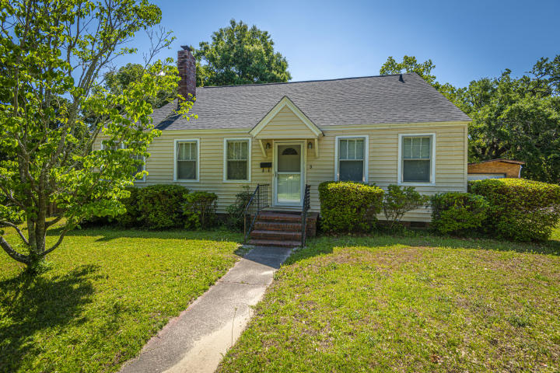
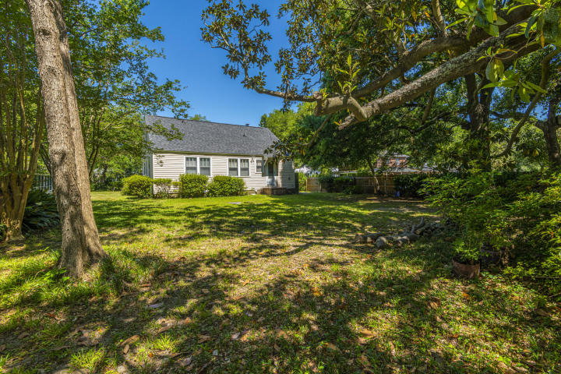
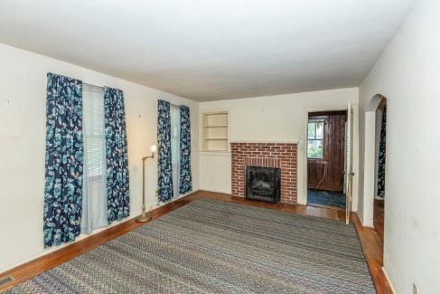
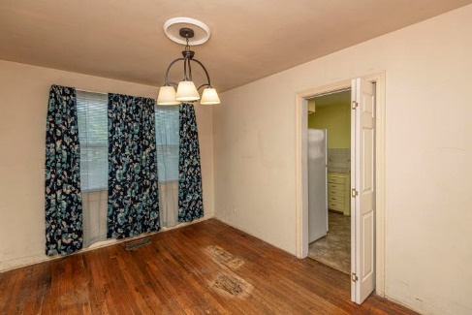
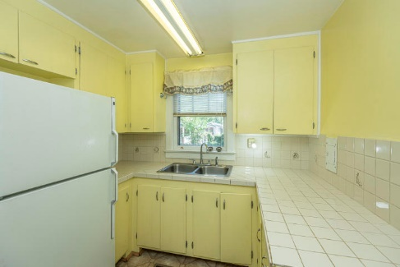
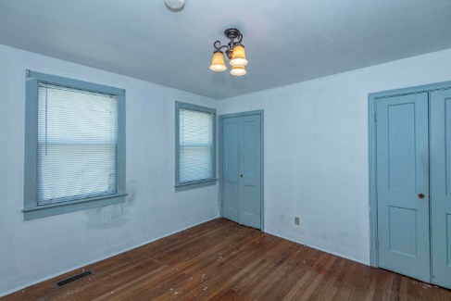
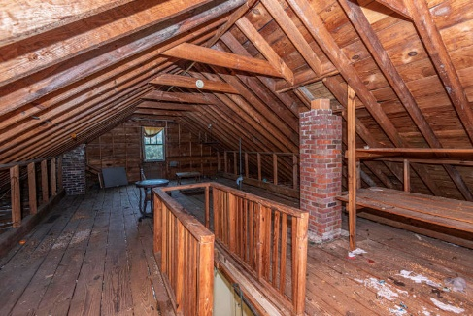
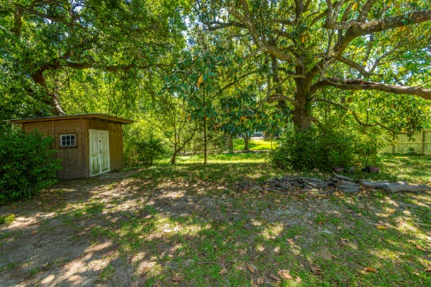



Why wait for new construction?
This Park Circle area home is LESS THAN 2 YEARS!
Avondale Gem
3 Penn Avenue
Avondale ~ Charleston, SC 29407 ~ MLS# 20012329 ~ $300,000
Welcome to 3 Penn Avenue. This 3 bedroom, 1 bathroom ranch is in an ideal location. It is less than 2 miles from downtown Charleston! This house has great bones and sits on a huge 0.32 acre lot one house over from the Ashley River. Other great characteristics are the hardwood floors, roof, HVAC and the blank slate that is the attic. Not only are you close to downtown but you are also close to Mex1, Home Team BBQ, Spanglish Cocina+Bar and others. Such an amazing opportunity. Schedule a showing today at your convenience!
https://my.matterport.com/show/?m=TzJqV6fVE7s
Del Shaffer
843.408.6821
dshaffer@carolinaoneplus.com
2713 Highway 17 North
Mt. Pleasant, SC 29466

