Slide 1
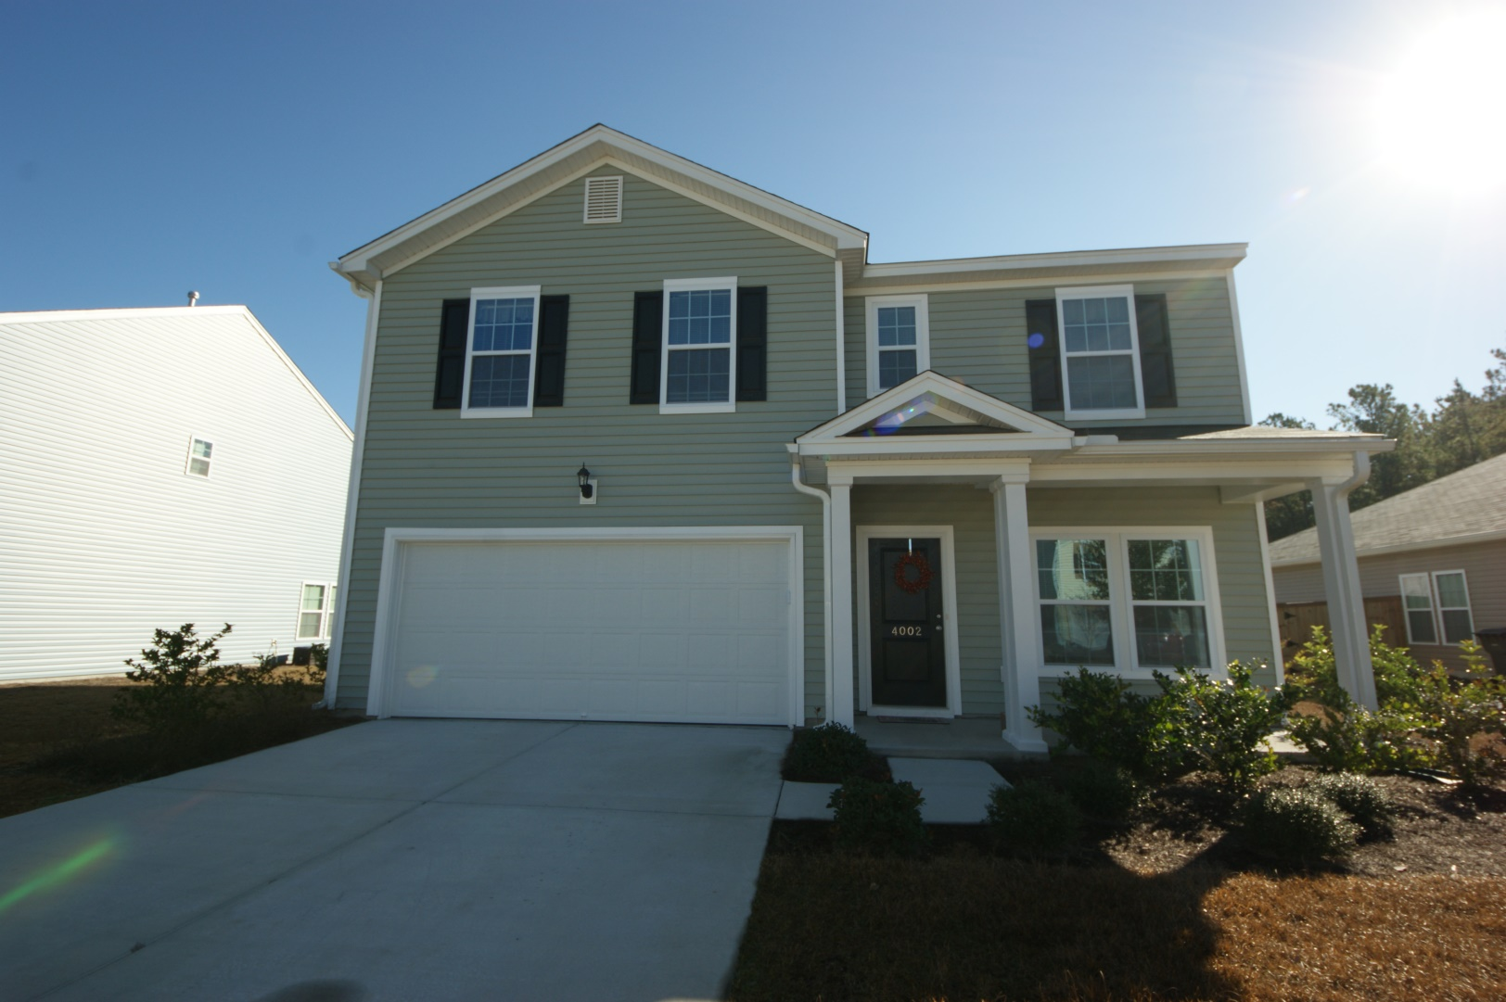
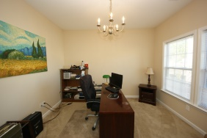
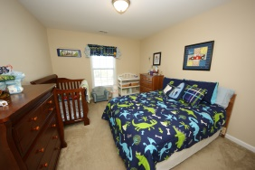
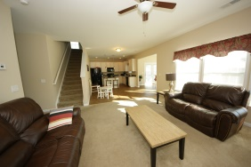
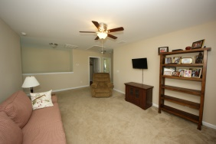
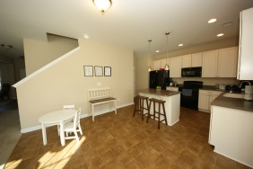
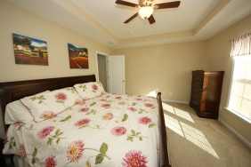
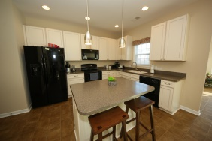
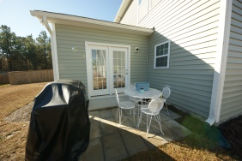
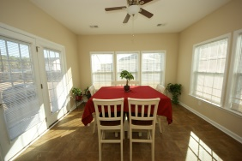
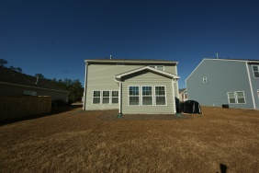


$2,000 Selling Bonus on Full Price Offer Through 3/31/15!
Price Reduced!
4002 Chadford Park Drive
Victoria Pointe ~ Summerville
MLS# 14030560 ~ $209,900
Gorgeous 3 bedroom, 2.5 bath home in Dorchester District II school district! Located in the newer-sought after Victoria Pointe subdivision and priced well under recent sales in the neighborhood! This home is only one year old with many upgrades and a large open floor plan. Downstairs is a nice size formal dining room, and a half bath near the foyer for easy access. The large kitchen with island, eating area, great room and bright sun room are completely open to each other, perfect for entertaining friends and family. Upstairs is a loft large enough to serve as a second living room. The master suite with tray ceiling features a full bath with double vanity, linen closet and huge walk-in-closet. Two more nice size bedrooms, another large full bath and a laundry room complete the upstairs. Outside is a patio for grilling and a large yard. The neighborhood also offers two large community play areas and a fishing pond available for use by all residents! Both ponds, as well as the two large open play areas, are maintained by the HOA. This neighborhood provides a great sense of privacy yet is conveniently located just off Hwy 61, just a few minutes from Hwy 17!
Sandra Siegling CRS GRI
843-343-1119
sandy.siegling@gmail.com
ERA Wilder Realty, 125-F Wappoo Creek Dr, Charleston, SC 29412

