Slide 1
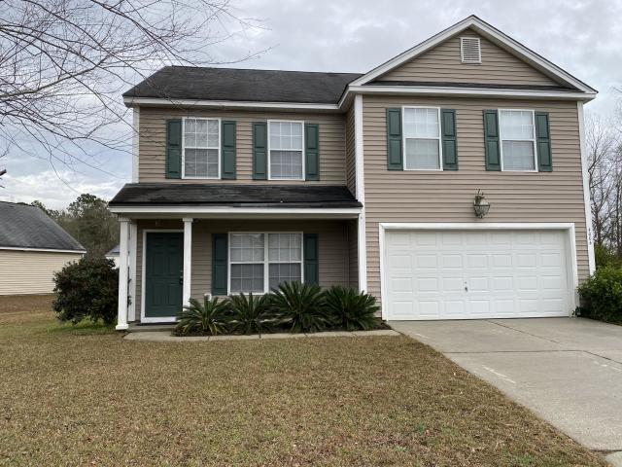
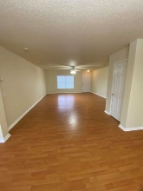
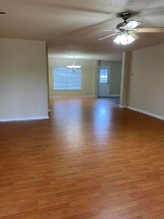
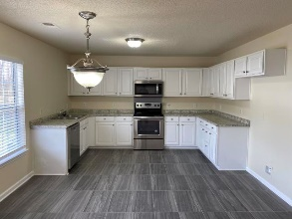
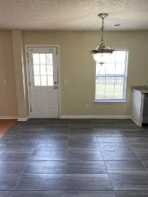
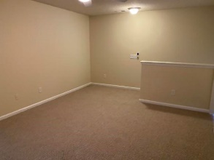
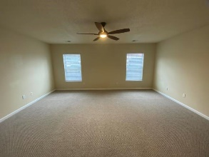
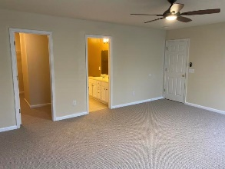
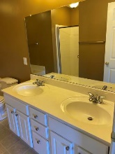
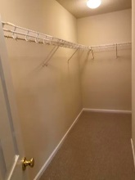
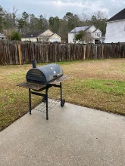
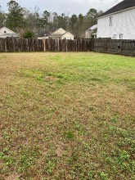


4004 Carolina Bay Drive Oak Hill Plantation · Moncks Corner · MLS# 20001337 · $229,500
Open House Saturday
12:00 until 4:00
Get Ready For Springtime With This Beautiful Spacious Home
Open House Saturday 8/24/19
12:00 until 4:00
Beautiful Home, Move-in Ready. Gorgeous Updated Kitchen, with new stainless steel appliances, new tile kitchen flooring. New carpet in all upstairs rooms and the loft area. Lovely spacious master bedroom with walk in closets, and master bathroom has a garden tub, shower and dual vanities. All of the family bedrooms are nicely sized.The backyard is perfect for barbecues and family fun. Moncks Corner is growing and is close enough to Charleston to enjoy everything it has to offer. There are are plenty of opportunities here for a new business or for employment. Some of the companies in Berkeley County are Volvo Cars USA, Google, Nucor Co, CR Bard, and many others. This is a perfect Home for new beginning. Make an appointment to see it today.
James Hopkins
(843) 708-5930
James.Hopkins@AgentOwnedRealty.com
AgentOwned Premiere Group
1800 Trolley Rd
Summerville, SC 29485

