Slide 1
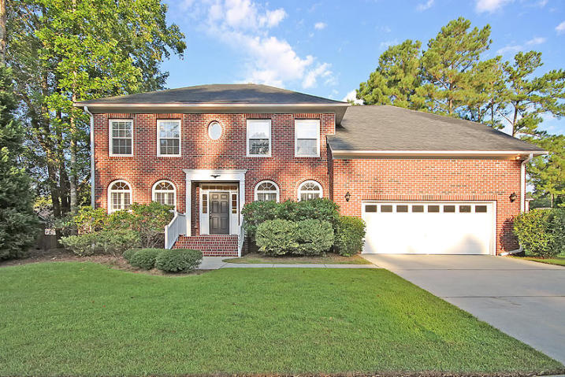
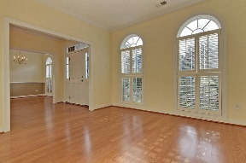
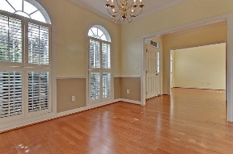
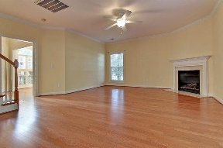
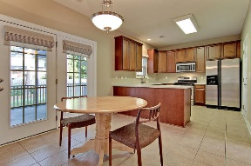
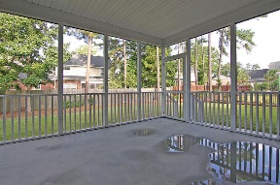
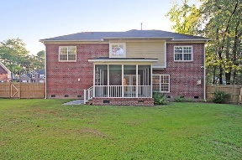



Dorchester Dist 2 Home Is Ready For You
4004 Hunley Place
River Birch
Summerville, SC 29485
MLS# 16023194
$329,400
5 Bedrooms | 2½ Baths | 2,664 sf
Spectacular 5-Bedroom BRICK home in a safe, sidewalk community in Summerville! Near the end of a peaceful cul-de-sac street, this perfect family home is zoned for Dorchester District 2 schools - including top-rated Ashley Ridge. Gleaming hardwood floors reflect ample natural light. Enjoy a formal living room (or office) & separate dining room with chair rail & crown molding. When it's cold out, curl up around the gas fireplace. When it's warm, enjoy the screened porch and patio. There's plenty of room in the back yard to run, play & even install a pool! The kitchen boasts ceramic tile flooring, gas cooking & solid surface countertops. The master bedroom is spacious & luxurious with dual walk-in closets, tray ceiling, dual vanities & separate shower/tub. There's even extra storage with easy access off of one bedroom. Plus, there's still a little more storage space available from the pull-down attic access.
Five total bedrooms can be put to great use with a larger family and/or guests. Or, turn an extra bedroom into a home office or media room! The garage is over-sized and ready to store your boat, 3 small cars or 2 cars with room left over for lawn equipment and a great work space. Or, use the extra space for even more storage! The back yard really is a bonus with plenty of space for relaxing, playing, cooking or partying.
When it's time for a jog, walk, ride or a stroll, enjoy the neighborhood sidewalks and go in peace knowing the neighborhood is tranquil and safe. This is a great location for many jobs as it has easy access to the likes of Bosch, Boeing and even the new Volvo plant - all while remaining close to the family life of Summerville.
Come See Your New Home Today.
Larry Mazalatis
843-693-0529
mazteamrealty@gmail.com
Jim Brantley
(843) 412-7647
brantleyjim@gmail.com
AGENTOWNED PREMIERE GROUP | 1800 TROLLEY RD | SUMMERVILLE, SC 29485

