Slide 1
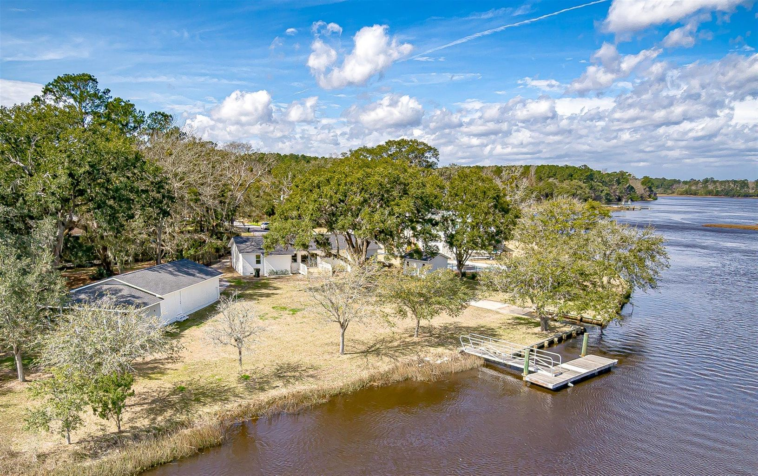
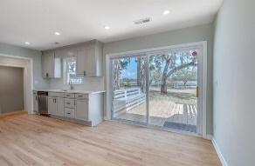
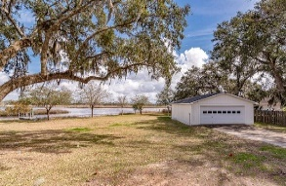
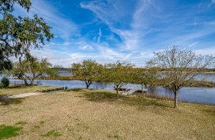
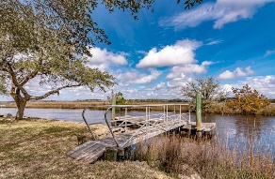
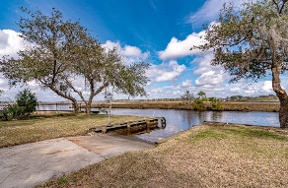
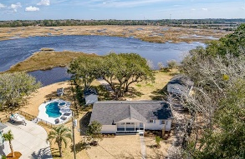


Deep Water Renovated Home w/ Dock
Private Boat Ramp & No HOA
4004 Rantowles Court
Rantowles Shores ~ Ravenel
MLS# 21005412 ~ $995,000
Deep Water Renovated Home with Dock, Private Boat Ramp, Large Outbuilding, and NO HOA under $1M! Expansive 180° Lowcountry views and encompassing more than a half an acre of stunning deep water access, this serene setting offers an unparalleled amenity, a private backyard boat ramp. Walk from the backyard to step onto your floating dock, or just launch directly from your own boat ramp in the backyard. This is a unique set up that is rarely found, and this location keeps you off the Johns Island and James Island traffic while maintaining a similar distance to Downtown straight on Hwy 17. An additional detached building makes an incredible 2-4 car garage and workshop measuring 36x24 (approximately 865 sqft) and is the perfect place to pursue your hobbies, store your boat, and extra cars. This building currently has electricity and could also possibly be further improved to make a separate home office with private entrance, additional detached living areas, and even a full mother-in-law suite complete with deep water views. The main house just underwent a complete renovation from top to bottom, inside and out, by a local Charleston builder. New roof on all buildings. Fresh interior and exterior paint with extensive landscaping. Gleaming hardwood floors greet you and run throughout all main living areas. Both Bathrooms were gutted and renovated. Updated kitchen with direct outside access and brand new deck to enjoy the .60 acres of pure waterfront bliss! Don't want to fight the Johns Island or James Island traffic? Looking for something without an HOA? How about a boat ramp in your own backyard, floating dock, and a detached workshop? You just found it all and much more! Conveniently located off Hwy 17 for direct access to West Ashley, Downtown Charleston, and 15 minutes to Roper St Francis Hospital and I-526. Break away from the norm to pursue your passions and live your own lifestyle with this unique Charleston opportunity.
Jerod Coulter, ABR, REALTOR
(843) 513-3741
jerod@realtor.com | www.HomesOfMountPleasant.com
The Boulevard Company, LLC | 35 Broad Street | Charleston, SC 29401

