Slide 1
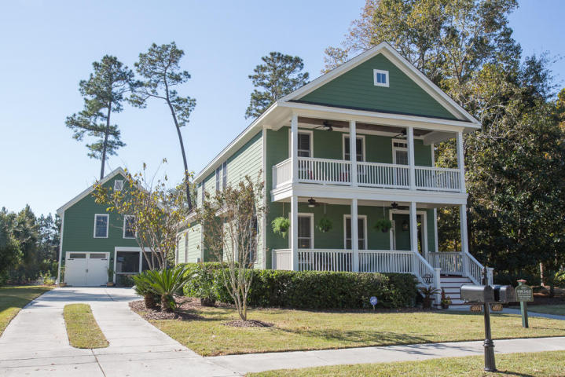
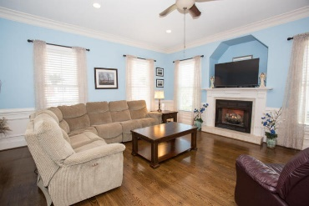
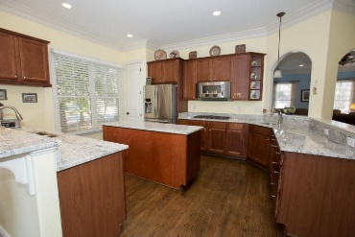
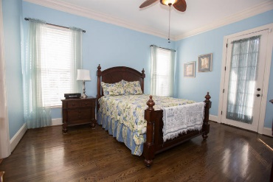
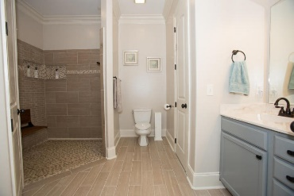
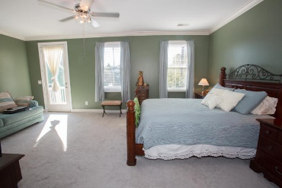
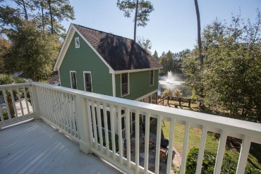
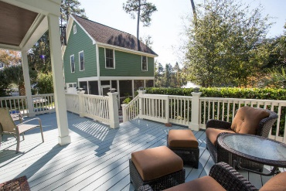
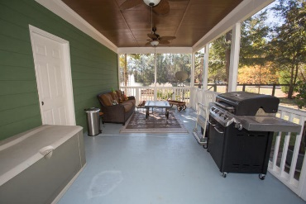
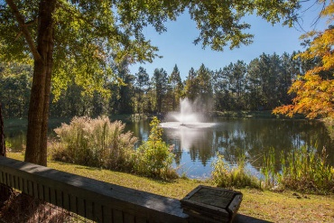


4005 E Amy Lane The Villages In St Johns Woods Johns Island, SC 29455 MLS# 17030810 $534,900
Well Maintained Home with Dual Masters, 5 bed 4.5 bath GEM in the villages in St. Johns Woods. This home is situated on a corner lot in a premium location overlooking a pond on a 0.31 acre lot. Downstairs Master bedroom (15'6"x12'8")has walk in shower which was upgraded in 2016. It has access to a large back deck. Large eat in kitchen has plenty of cabinets, 2 pantries & new granite countertops. Spacious family room with fire place with wainscoting. Hardwood floors throughout the first floor. All new tiled bathrooms except the 1/2 bath. Upstairs Master Bedroom (13'6"x20')has walk in closet and it has access to a balcony that overlooks the pond. This home also features a detached garage with a guest suite with access to a screened porch that overlooks the beautiful pond with dramatic fountain. Garage screen porch is 12'x24'. Large back deck is 28'x15'. It also features beautiful 15'x14' flagstone patio in back yard for your enjoyment. If you are looking for that special home that offers spacious rooms with designer touches and a comfortable floor plan for ease of entertaining and plenty of room for family & guest, This Is It!. The list of recent upgrades and improvement is attached in the listing information document. Thank you for showing.
Cathy Rosenblum
843-817-7869
crosenblum@comcast.net

