Slide 1
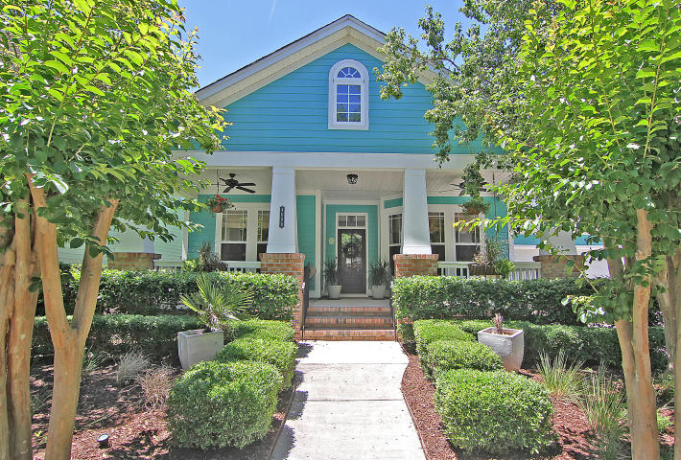
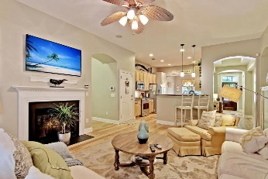
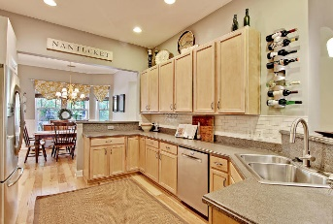
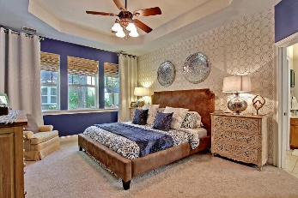
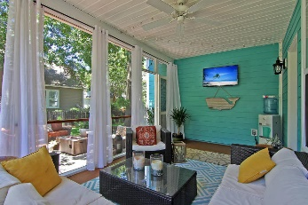
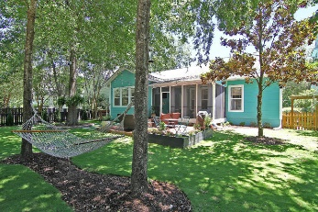


Unreal Deal! Bring All Offers!
4006 Crown Pointe St
Daniel Island
Charleston, SC 29492
MLS# 17015093
$610,000
Welcome Home to 4006 Crown Pointe St! This Beautiful home on Daniel Island located in Center Park has been meticulously maintained. When heading to the front door you will not miss the large front porch that can accommodate full size outdoor furniture. Upon entering the home you will be greeted with a spacious foyer, large den, and formal dining room. The foyer and den both have tray ceilings! The well appointed gourmet kitchen has an abundance of cabinets and counter space with newer stainless steel appliances. The kitchen flows wonderfully into the large family room with the open concept of this home. This home features a split floor plan with the master suite on one side of the home with two guest bedrooms and bathroom on the other. The home also features a finished room over the garage which is currently being used as the 4th bedroom but could serve many purposes. The large master bedroom features tray ceilings, new carpet and views of your back yard. Off of the relaxing Screened-In Porch the back yard is fenced in with a 10 x 12 deck that includes a grilling area and hardwired lighting that is perfect for outdoor entertaining. The back yard has New Drought Resistant sod and has been professionally landscaped! Here is a list of a few of the recent upgrades: Newly remodeled laundry room, New hardwood floors, New carpet in all bedrooms, Newer Kitchen Appliances, New Drought Resistant Sod, New Exterior Paint (Valspar Reserve lifetime fade warranty), Garage floor resurfaced with stain/water resistant epoxy. Age, sqft, taxes, acreage, HOA dues, and schools are approximate buyer to verify any and all information deemed necessary.
Mason Thurber
(843) 709-5109 – C
(843) 576-2699 – O
mason@theeverettgroup.net
RE/MAX Pro Realty, 9209 University Blvd, Charleston, SC 29406

