Slide 1
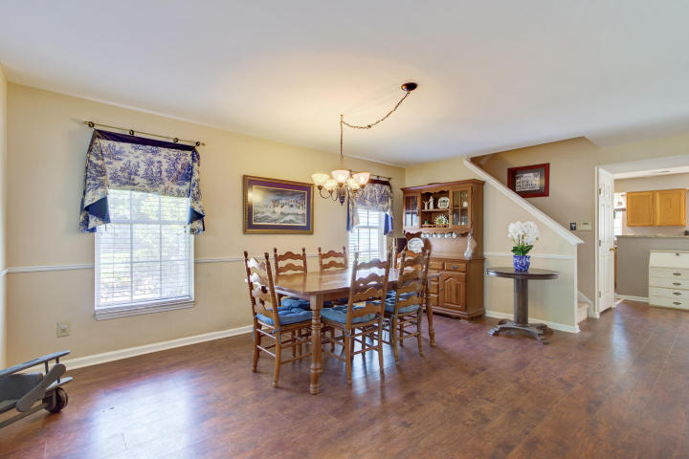
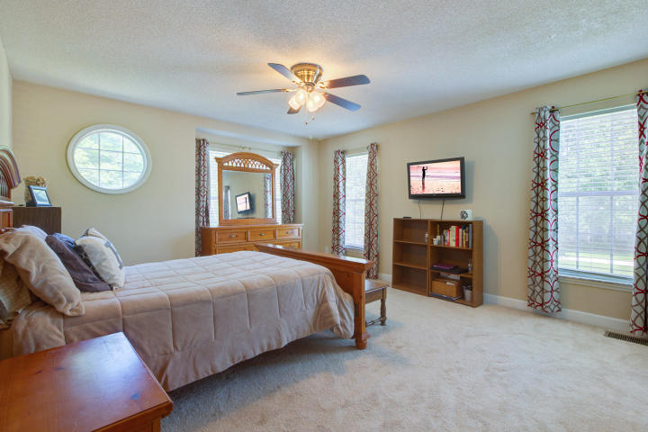
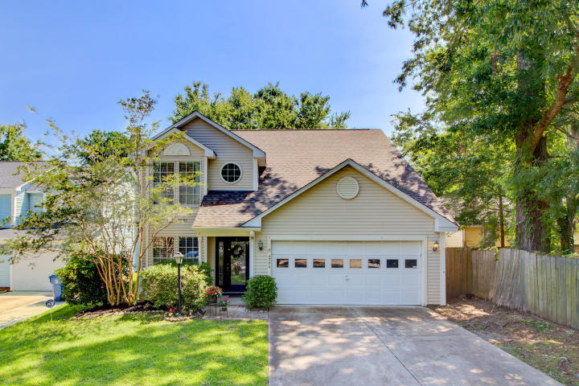
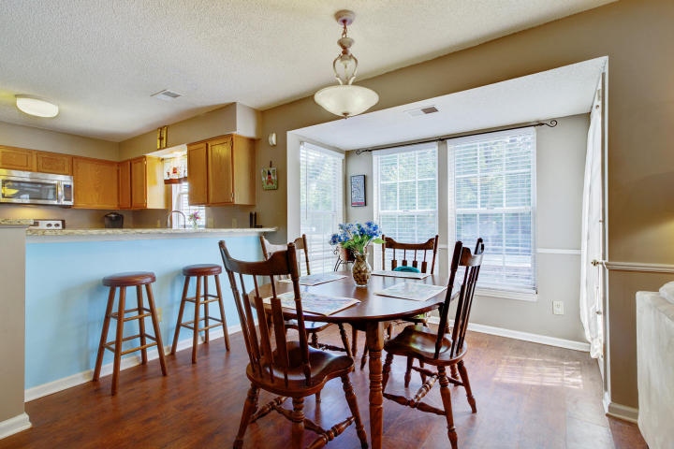
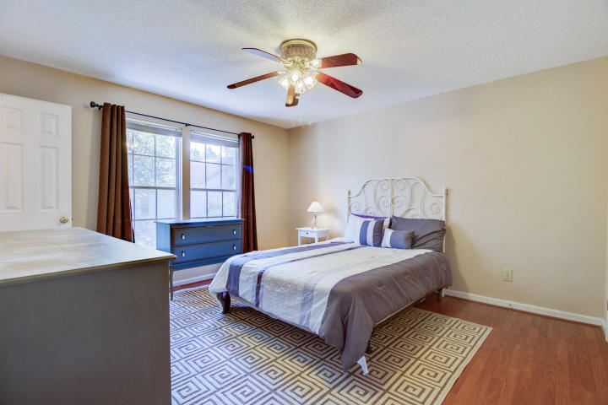
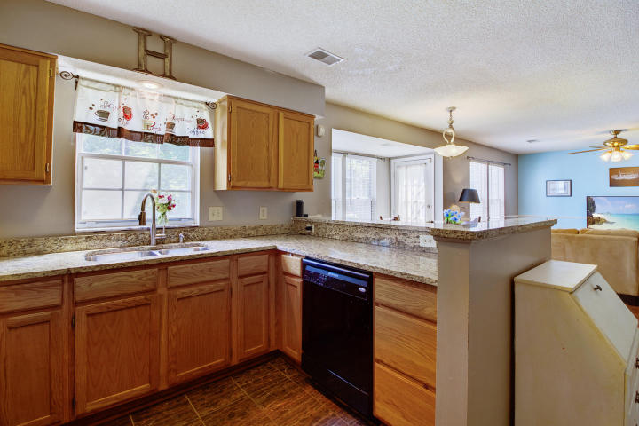
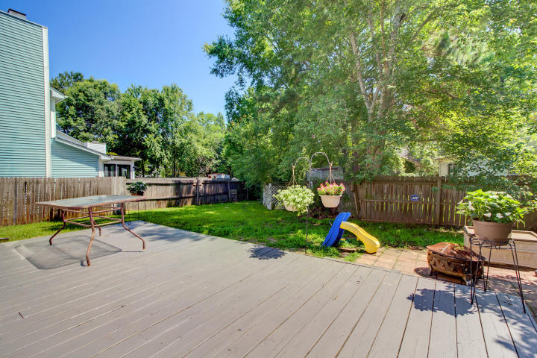
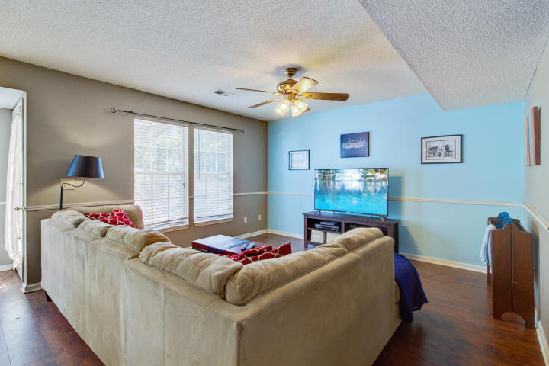
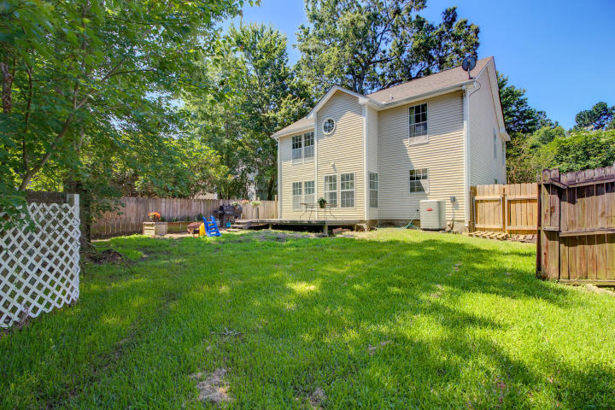


Wonderful Opportunity That You Don't Want To Miss!
4006 Indigo Ridge Dr
Indigo Ridge
North Charleston, SC 29420
MLS# 18016142 ~ $222,500
Check out this beautiful 4 bedroom home in the popular Indigo Ridge neighborhood at Windsor Hill. This floor plan is absolutely amazing! At over 2100 sf, it offers its owners great versatility. Upon entry, you will be impressed with the open and spacious feel of this home. The beautiful wood floors are a standout feature. The formal dining room is large and accommodates numerous friends and family members at social gatherings. If formal dining is not your style, then use this space as a formal living room, an office with plenty of room for a play area, too. When you venture further into the home you will appreciate the open concept where the kitchen overlooks the family room. The kitchen has gorgeous granite counters, and the stainless steel dishwasher and range complement the look beautifully! There is plenty of counter space, perfect for meal preparation, and lots of cabinets in addition to the pantry. While eating, look out over the large fenced in back yard. There is a deck in addition to a patio perfect for a fire pit . This is a large yard, ideal for families with children and / or pets. Notice the mature trees that provide not only natural beauty, but additional privacy from neighbors as well. This home has a true laundry room, not closet. The two car garage is a plus, and there is a large driveway to accommodate additional vehicles as needed. All four bedrooms are upstairs. The master bedroom has his and her closets. Beautiful tile floors add a touch of luxury to the master bath. The large fourth bedroom can easily be made into a second master, as there is the opportunity for a third full bath to be added upstairs over the garage should that benefit the new owners. The current owners have done many upgrades and enhancements within the past five years. These enhancements include the roof with Architectural Shingles, AC replacement, tile in master bath, the addition of a 20 by 16 foot deck on the back of the home, and the 8 by 10 foot patio. Children in this community attend the well respected Dorchester 2 Schools. The location, off Ashley Phosphate Rd., provides easy access to I-26 and Dorchester Rd. This is a great location for commuters to various locations! Historic Downtown Charleston is a short ride and so are the beaches at Folly, Sullivan's Island, and Isle of Palms. This large four bedroom home offers tremendous value and it is ready for its new owners just in time for a summer move! CHECK OUT THE 3D WALK THROUGH TOUR and make time to see this house before it is gone!
3D Walk thru tour on MLS or go to
https://my.matterport.com/show/?m=hiRQFX7ycUU
Ellen O'Neil
Broker/Owner, ABR, e-PRO, CNE
Charleston Realtor of Distinction
(843) 300-8530
www.EllenONeilProperties.com

