Slide 1
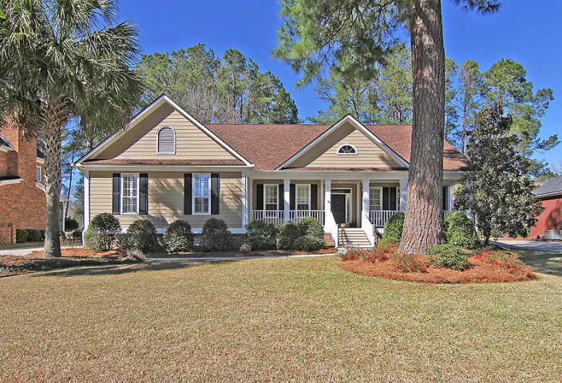
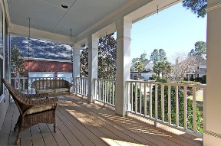
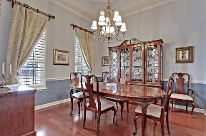
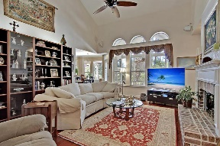
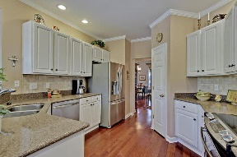
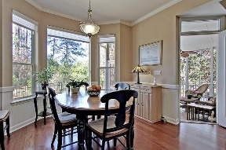
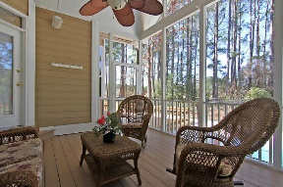
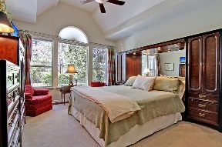
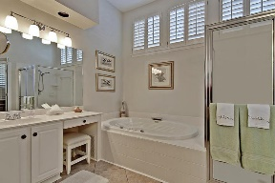
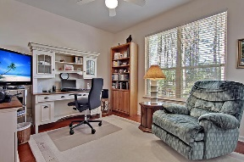
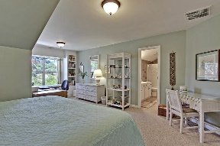
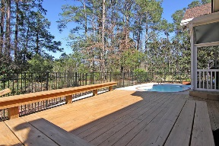
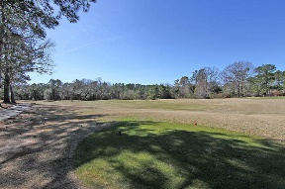


In-Ground Pool on Private Golf Course Lot!!
4006 Plantation House Rd
Legend Oaks Plantation
Summerville, SC 29485
MLS# 17004055
$389,000
4 Bedrooms | 3½ Baths | 2,918 sf
Welcome home to this pristine home located on the 1st Fairway in the gorgeous golf course community of Legend Oaks Plantation! This move in ready home will captivate you immediately with its curb appeal and large, welcoming front porch. Upon entering the home, you will be wowed by the Brazilian cherry hardwood floors. The dining room is the perfect size for entertaining and offers a tray ceiling, plantation shutters and decorative molding. Step in to the living room with its cathedral ceiling, remote controlled gas fireplace, custom shelving and surround sound and you’ll immediately feel at home! The kitchen is a chef’s delight~all new kitchen appliances, tiled backsplash, pantry, breakfast bar and large eat in area. While in the kitchen and living room, you won't be able to help but notice the sparkling in-ground pool!! Step out in to the large screened in porch which will lead you out to the custom decking and gorgeous pool area. This home has the best of both worlds, it's both on the golf course, yet has a very private backyard to enjoy your pool. You'll be blown away by the lovely setting and amazing landscaping. Back inside, you will see the first floor master bedroom, which also has views of the pool and golf course! The master bath has been refurbished and offers dual vanities, jacuzzi tub with water spout, tiled shower, linen closet and water closet. Don't forget to check out the huge walk in master closet! On the other side of the home, you'll find two more bedrooms that share a jack and jill bathroom. Upstairs is another master suite, (which can also be used as a game room, media room, etc) with a sitting area, window seat, large walk in closet, and full bathroom with dual vanities. Never a need to worry about storage in this home! There is a huge floored attic storage space!! Tons of storage as well in the oversized two car garage. This home has it all! New HVAC units, New Roof, New water heater!! All you need to do is pack your bags and move in to your own private paradise! Legend Oaks Clubhouse is just a short walk away and offers tennis, community pool, clubhouse with a terrific restaurant and community events. The golf course is top rated and one of the Low Country's finest! Just a short drive away are some of the areas most beautiful plantations along the Ashely River. Dorchester District 2 schools service this neighborhood and you are just a short drive away from Boeing, Bosch and the Airport. Come see this home today! It is truly one of a kind and won't last long!
Larry & Kathy Mazalatis
Larry Cell 843-693-0529
Kathy Cell 843-693-0159
Office 843-871-9133
AGENTOWNED PREMIERE GROUP | 1800 TROLLEY RD | SUMMERVILLE, SC 29485

