Slide 1
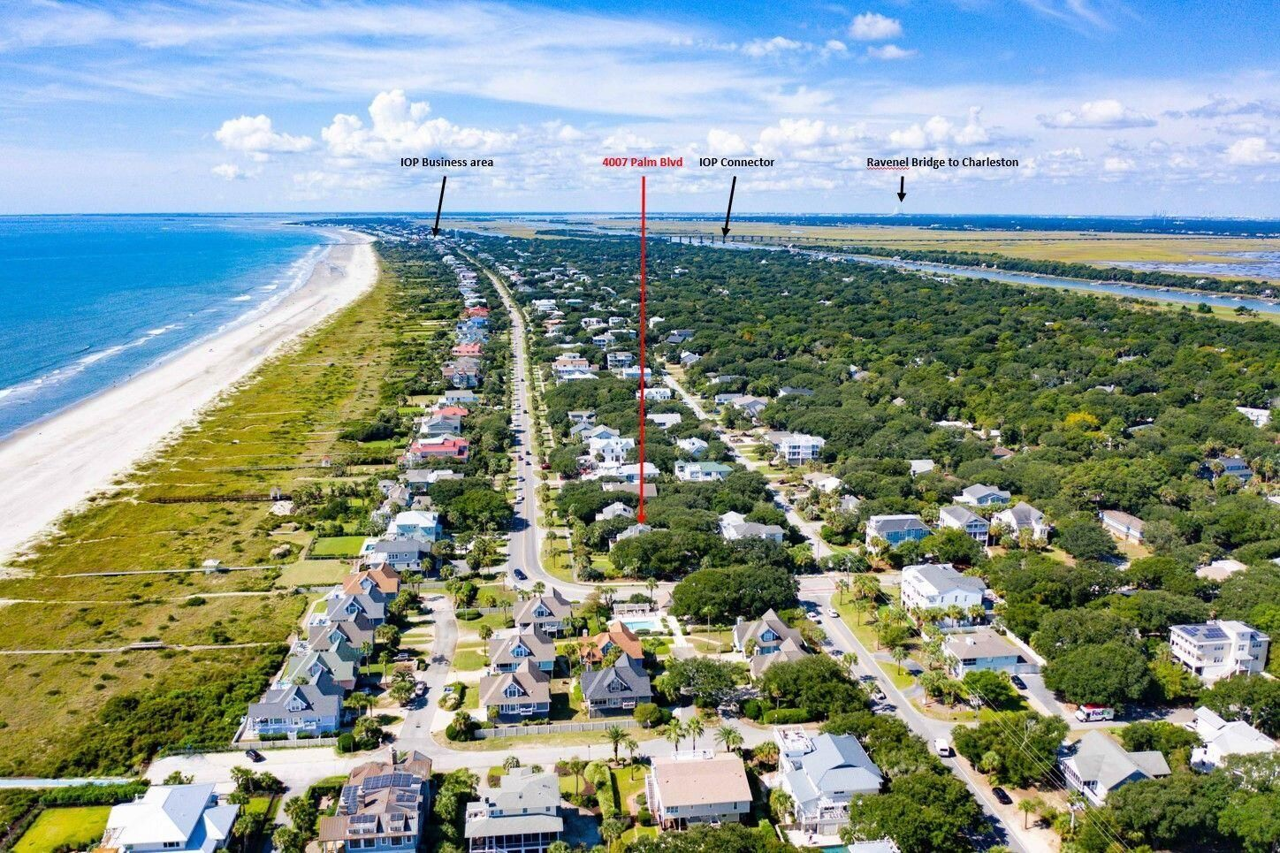
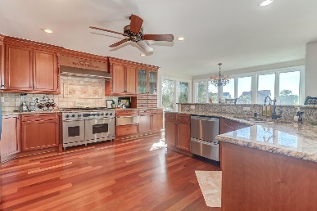
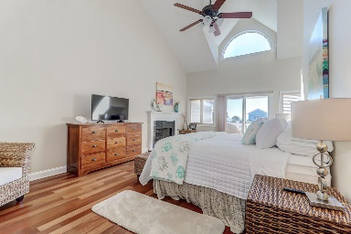
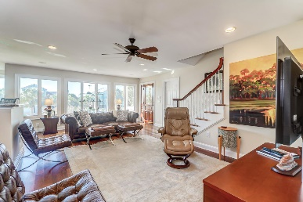
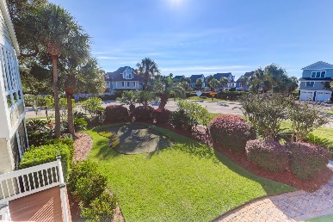


4007 Palm Boulevard
Isle of Palms, SC 29451 | MLS# 21026206 | $3,385,000
Must See Dream Beach House!
Ocean Views | Steps to the Beach | Putting Green | Corner Lot
IOP Business Area
4007 Palm Blvd
IOP Connector
Ravenel Bridge to Charleston
Coastal living at its best!! An exceptional opportunity to own this exquisite beach home on the Isle of Palms, with beach access directly in front of the house. Professionally landscaped property surrounds this beautiful home with lots of indigenous plants and gracious trees. Featuring Brazilian cherry floors throughout the house. Granite Countertops. Top of the line appliances, Dacor Gas Cooktop/Oven/Warming Drawer, Fisher & Paykel / Bosch dishwashers, built-in GE Profile microwave, Arctic refrigerator, trash compactor, front loading washer and dryer. Smart home wired which allows you the ability to control lights remotely. Zoned speakers and sound system. The great room has ocean views with lots of beautiful accents. 4 bedrooms downstairs with a large master bedroom upstairs, which includes a gas custom fireplace and mini wine/coffee bar. This home really has 2 master bedrooms, bathrooms are incredibly beautiful with the master featuring a modern jetted soaking tub, large shower, tile and marble flooring, granite and many other custom features. Anderson windows, lots of large closets and cabinetry for storage. This exclusive home is being sold mostly furnished with some exceptions. Easy to move right in, rent or designate as a second home. Lots of outdoor living space, multiple parking spaces for all your vehicles and boats. Gated entrance to the rear of the home where the garage is located. The front yard features your very own putting green, which could probably be replaces with a pool if desired. Call today for your appointment to preview this one of a kind beach home!! All furnishings convey except for artwork. A $3,000 Lender Credit is available and will be applied towards the buyer's closing costs and pre-paids if the buyer chooses to use the seller's preferred lender. This credit is in addition to any negotiated seller concessions.
Take a virtual tour: https://www.seetheproperty.com/397206
Darlene Smith
Office - (843) 886-8110
Mobile - (843) 696-7824
darlenesmith@carolinaone.com
DarleneSmithTeam.com
Carolina One Real Estate
1503 Palm Blvd Ste
Isle of Palms, SC 29451

