Slide 1

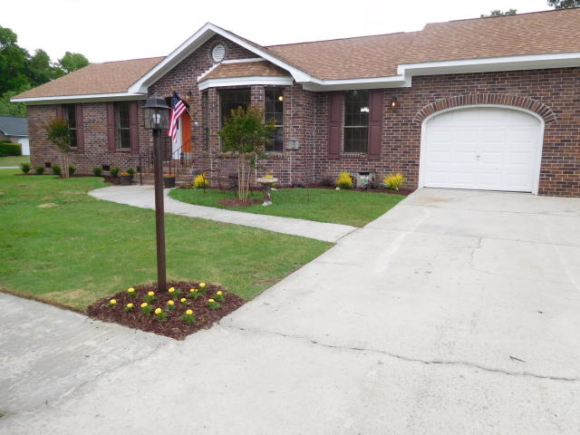
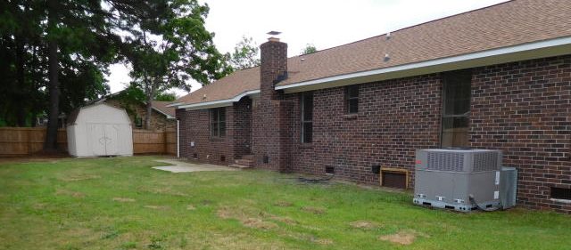
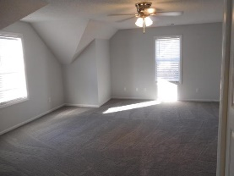
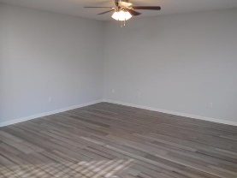
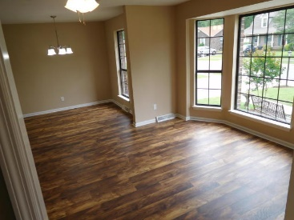
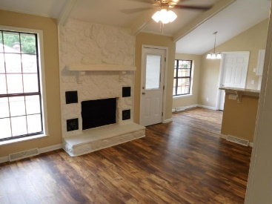
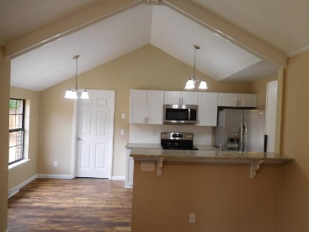
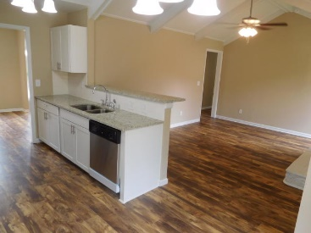
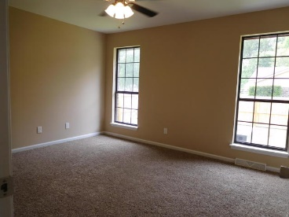
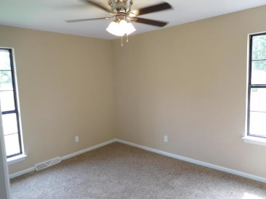
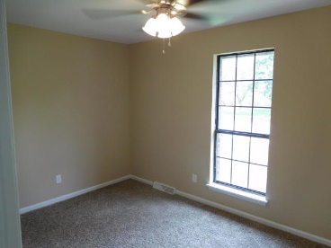
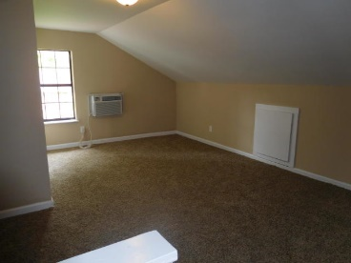
Don C. Mason, CIAS, CNE
(843) 364-9090 nibsc@aol.com
Like New
5 Bed/3 Bath
No HOA
400 Terrier Road
Foxborough
Goose Creek, SC 29445
MLS# 19013026 ~ $252,500
Property Subtypes: Executive Suites, Office Building
Building Size (RSF): 2,400 SF
Sale Price: $379,000
Cooperation Compensation: 3%
Property Use Type: Investment/Professional Office
Usable Size (USF): 2,400
Sale Terms: Cash to Seller
Agency Type: Exclusive Right to Sell/Lease
Like new, Move in ready 5 bedroom 3 full bath all brick home. Large corner lot with a privacy fence. Real brick wood burning fireplace in family room. Cathedral ceilings in the family room and kitchen. Freshly painted inside and out. 12mm Laminate Hardwood floors through out the living room, dining room, kitchen, family room and hallway. A wall was taken out to open the kitchen to the family room. All new white shaker cabinets in the kitchen. Granite counter tops and white sub way tiled back splash. All new stainless steel appliances to include smooth top range, built in micro wave, dishwasher, and a side by side fridge. Large granite bar top open to family room. All new vanities, faucets, tubs, mirrors, toilets in all 3 bathrooms.
All new doors, lights, ceiling fans through out. All new carpet and padding in all of the bedrooms. Smooth top ceilings through out the entire home. large private backyard with a patio and storage building. Brand new glass in all windows. Brand new arc. shingled roof. topped with professional landscaped yard. The 4th bedroom is the room over the garage. the 5th bedroom is enclosed in the garage with it's own bathroom. both the room over the garage and the room in the garage have a window unit that will heat and cool the room. The room in the garage could be used as a rental $650.00 per month or mother in law suite. No HOA Subdivision. Bring the boat.
Real Estate Advocates LC
7613 Hwy 544 | Myrtle Beach, SC 29588
www.realestateadvocates.com

