Slide 1

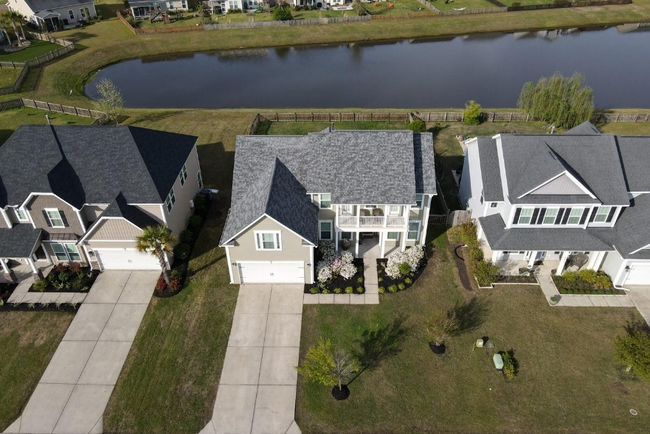
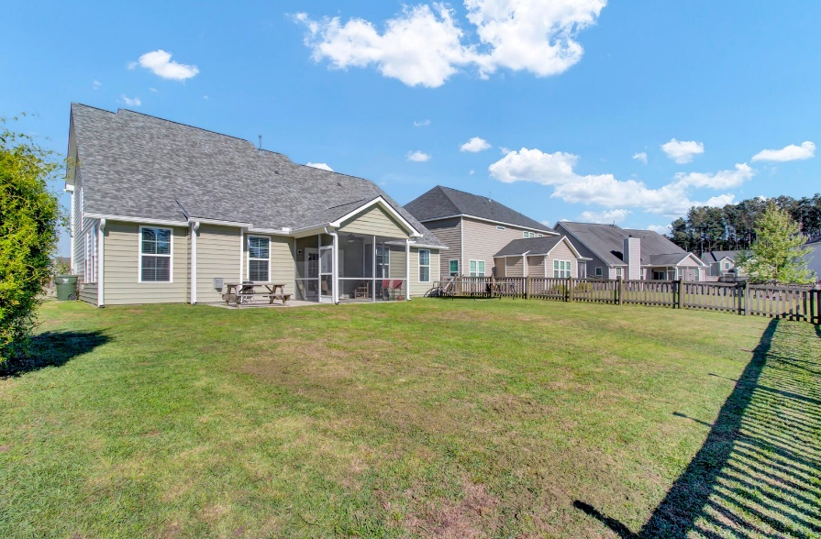
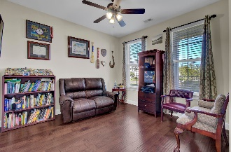
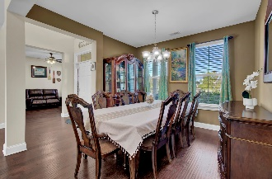
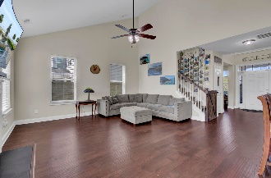
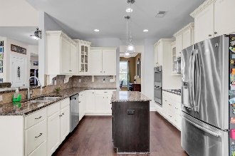
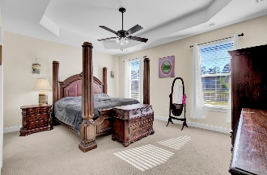

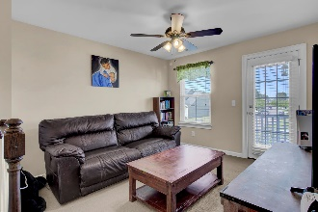
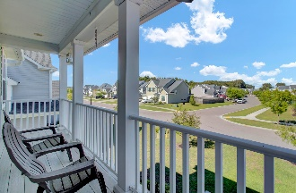
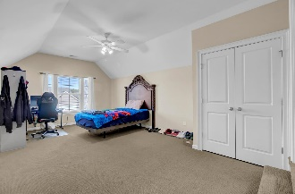
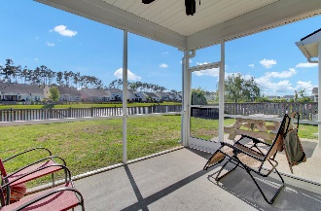
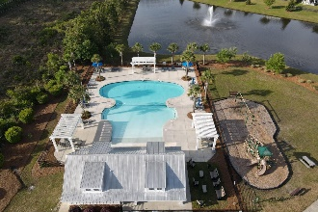
Debbie Cromer
ABR, RSPS, REALTOR, CRS
(843) 437-6342
debbie@debbiecromer.com
www.debbiecromer.com
Assumable VA Loan at 2.875%
400 Spectrum Road
Cane Bay Plantation | Summerville, SC 29486 | MLS# 24013402 | $459,999
This beautiful pond-front home features an open-concept floor plan perfect for entertaining. The elegant formal dining room flows into a gourmet kitchen w/ stainless steel appliances, soft-close cabinets, a wall oven & microwave, & a cozy eat-in area. A versatile flex space can be used as a home office, sitting room, or playroom. The spacious den w/ a gas fireplace offers stunning pond views & access to the expansive backyard. The main floor includes a private owners suite with an en suite bathroom & a conveniently located laundry room. Upstairs, you'll find a loft area, a bedroom w/ a hall bath, & another bedroom w/ a Jack & Jill bathroom connected to an oversized FROG. The large fenced-in yard & two-car garage complete this beautiful home. Take advantage of nearby trails leading to Publix, highly rated schools, restaurants, shopping centers & more!
Century 21 Properties Plus | 1090 Park West Blvd; Ste 103 | Mount Pleasant, SC 29466

