Slide 1
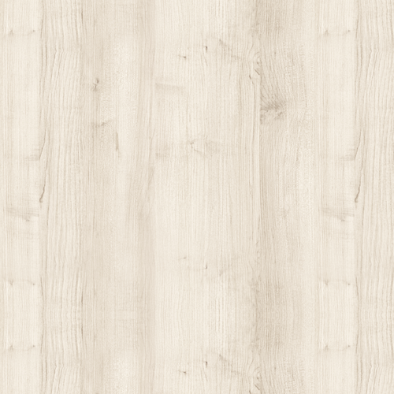
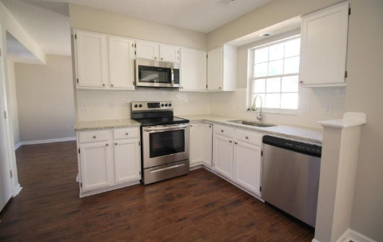
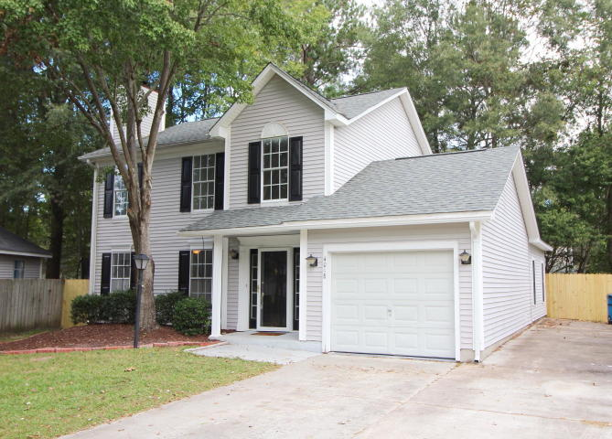
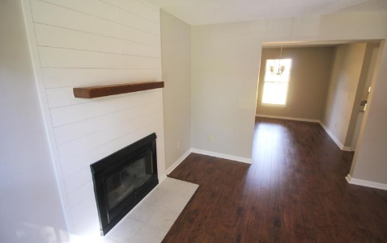
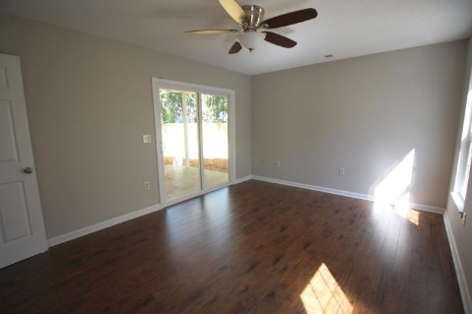
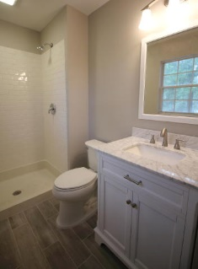


Beautiful Windsor Hill Home Under $200k!
4018 Indigo Ridge Drive
North Charleston, SC 29420 ~ MLS# 17028393 ~ $199,900
Perfect updated home in Windsor Hill. This large 3 bed, 2 and a half bath house has been completely remodeled from the ground up With new 30 yr roof. upon entering you're greeted by a large living room with new shiplap feature fireplace. The dining room separates the well-appointed kitchen with new granite countertops, stainless appliances, single basin sink overlooking your newly fenced-in backyard. This move-in ready home includes all new kitchen appliances! Beyond the kitchen and new half bath is a large bonus room with new sliding door that would be a perfect second den or kids play room. New laminate wood flooring runs throughout the lower level. Upstairs, you have a two beautiful new full baths with hand-lain tile from top to bottom. New carpet runs through the entire second level.
Peter Stanley
M 843-300-8251 | O 843-885-6199
petermstanleyjr@gmail.com
Colony & Craft LLC
716 Meeting St Charleston SC 29403

