Slide 1
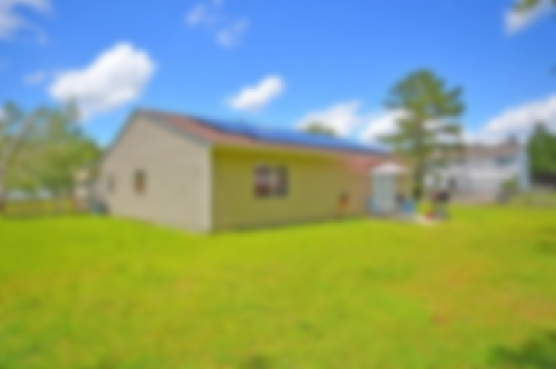
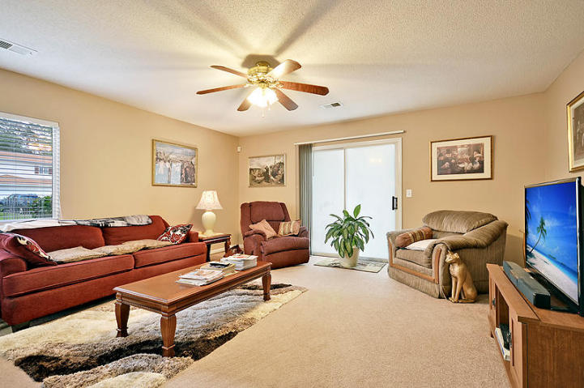
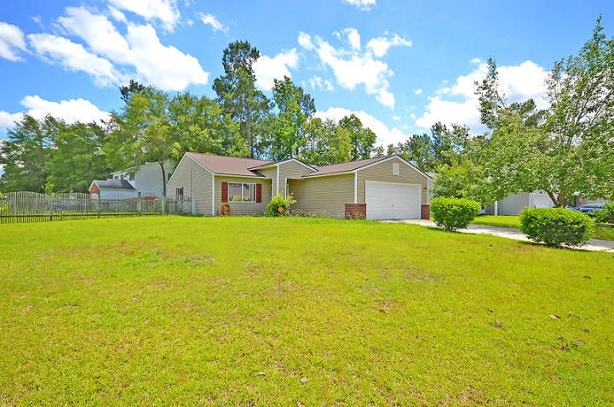
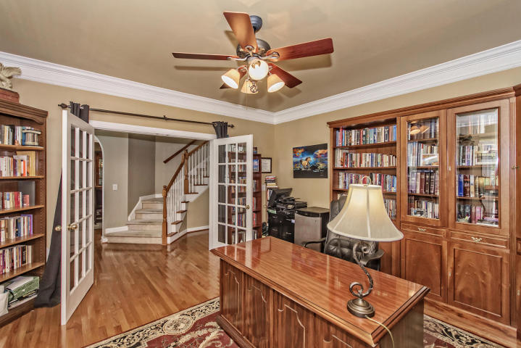
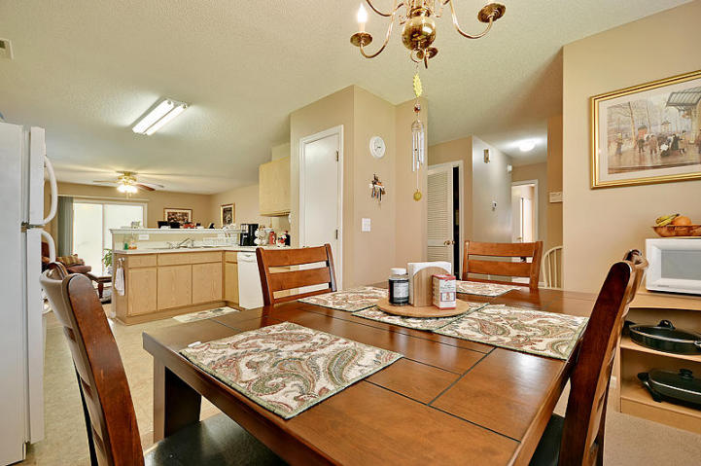
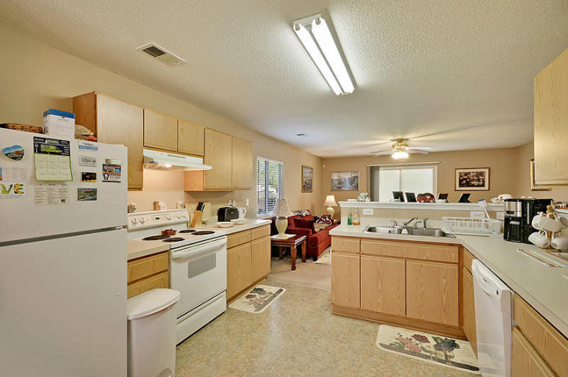
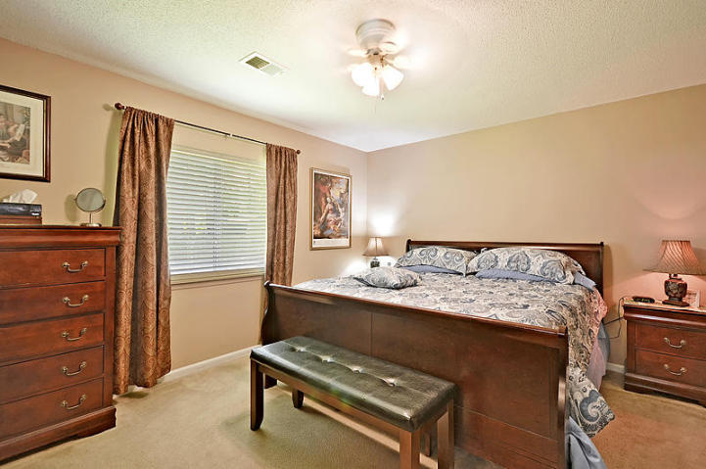
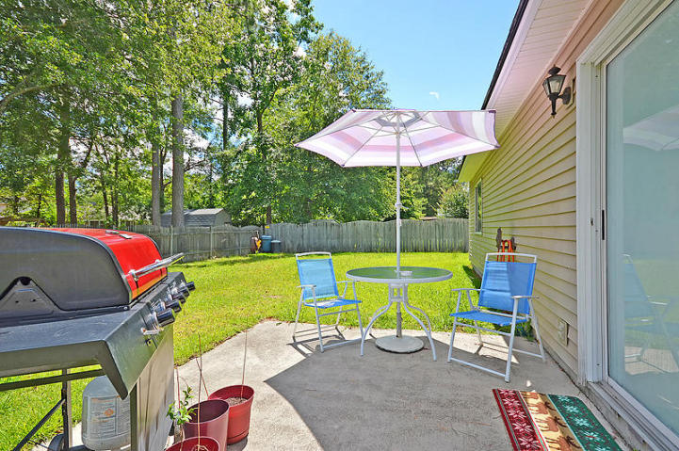


Summerville’s Best Bargain
Is In Indian Springs
401 Catawba Drive
MLS# 17024618 ~ $164,900
3 Bedrooms ~ 2½ Bathrooms
Super energy efficient one story 3 bedroom/2.5 bath home on oversized corner lot in great condition complete with solar panels to keep your utility bills EXTREMELY low. Ultra open floor plan with eat-in kitchen that flows directly into oversized great room. Large Master Bedroom with walk-in closet accompanied by a spa-like Master Bathroom.
This terrific home is in the highly acclaimed Dorchester School District 2 as well as close to Boeing, Bosch, the new Mercedes and Volvo Plants, the airport, a short drive to the sun-kissed area beaches as well as historic downtown Charleston.
All of this can be yours for the BEST VALUE IN SUMMERVILLE!
Chip Walsh
843-822-4663
chipwalsh@gmail.com
The Boulevard Company, LLC
35 Broad Street
Charleston, SC 29401
www.TeamWalshRealEstate.com

