Slide 1
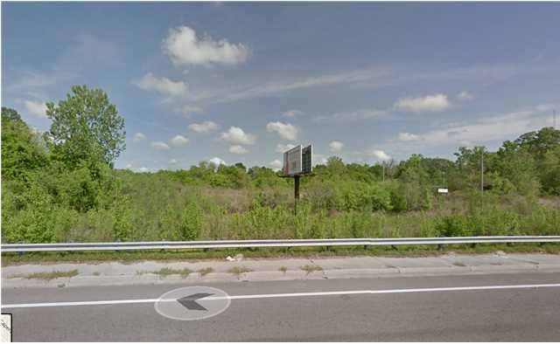
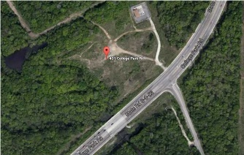
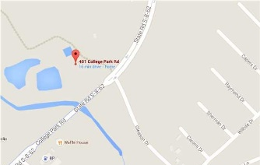
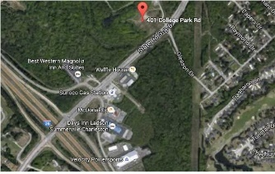

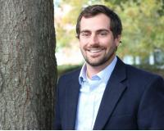
Commercial Development ~ Motivated Seller
Big Price Reduction ~ Ready to Sell!!
401 College Park Rd
Ladson, SC 29456 - MLS #29854238 - $849,000
Two parcels that are side by side zoned General Commercial Development. Parcel 1 and parcel 2, together totaling 19.66 acres.
DIRECTIONS: Take I-26 towards Columbia and exit on College Park Road. Properties will be on the left hand side.
Dan Lorentz, ABR, REALTOR
(843) 532-4653
dan@danlorentz.com
www.dan.charlestonrealestate.properties
The Boulevard Company, LLC | 35 Broad Street | Charleston, SC 29401

