Slide 1
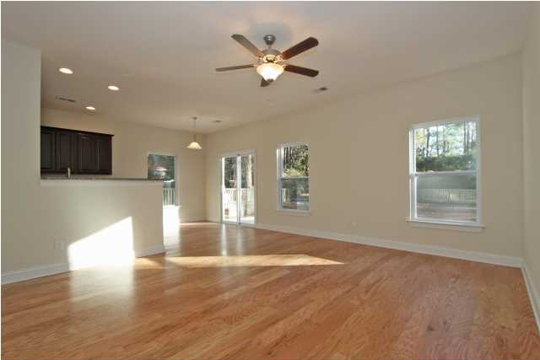
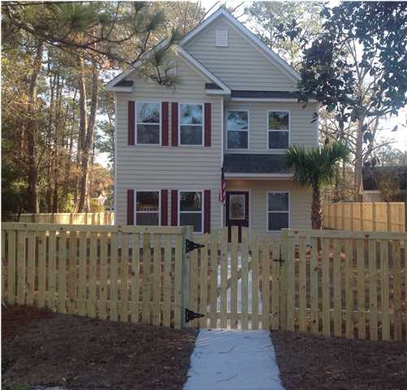
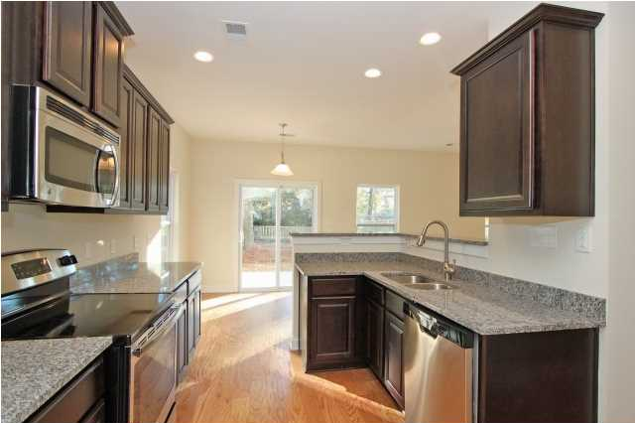
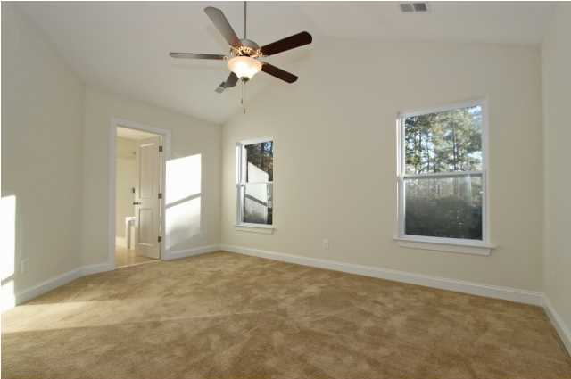
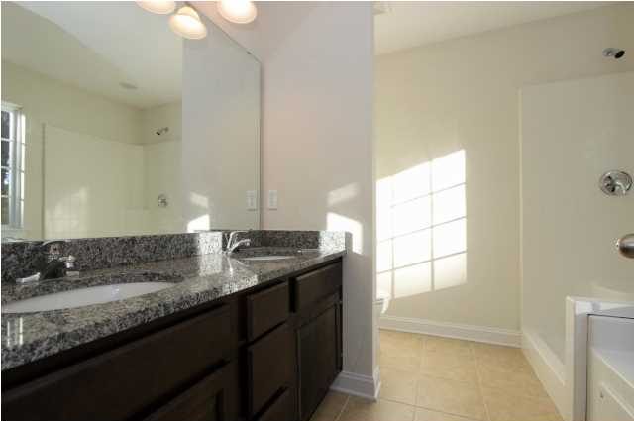
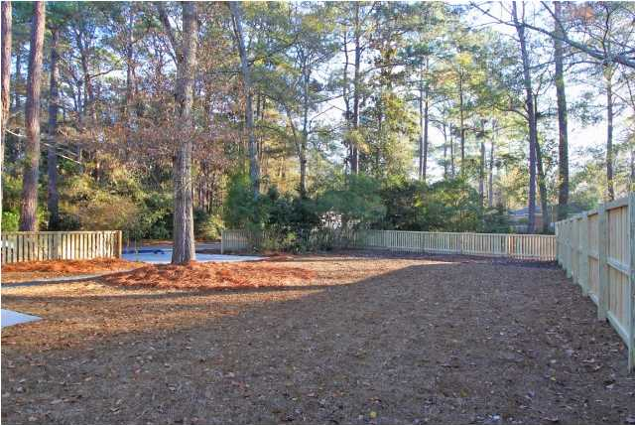
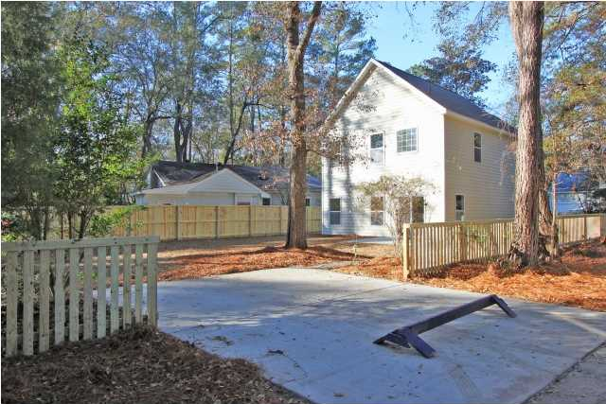
Open House 6/7/14 from 11-2
$4,000 Bonus with Ratified Contract by 6/8/14
401 Simmons Ave · Historic District · Summerville · MLS# 1324487 · Reduced to $189,900
Brand New Construction!
Over $20,000 in bonus features included. 3 bedroom, 2 1/2 bath home in the desired Summerville area near the Historic District. This home is within walking distance or a short bike ride to Downtown featuring stores and restaurants. This open floor plan has a dining room and a large kitchen that flows to the great room. The breakfast area has sliding doors that lead to the huge fenced in back yard. There are custom 42" high cabinets, beautiful granite countertops and real hardwood floors throughout the downstairs. The spacious master bedroom upstairs has vaulted ceilings, a walk-in closet, a luxury tiled bath with a 60" garden tub, a large vanity with granite tops and dual sinks, and a linen closet. Upstairs, the bedrooms are well-proportioned and the main bath is complete with granite counters, and tiled floors. The walk in laundry is also located on the second floor. Designer lighting, fans in living and master, all compliment this well built home. Incomparable, value, quality and opulence in this price point. $1,500 of closing cost are paid if the buyer uses the seller's preferred lender and attorney. This home is a must see and move in ready!
Contact Information:
Sherry Brown
843-478-9266
843-225-7935
The Goodwin Group

