Slide 1
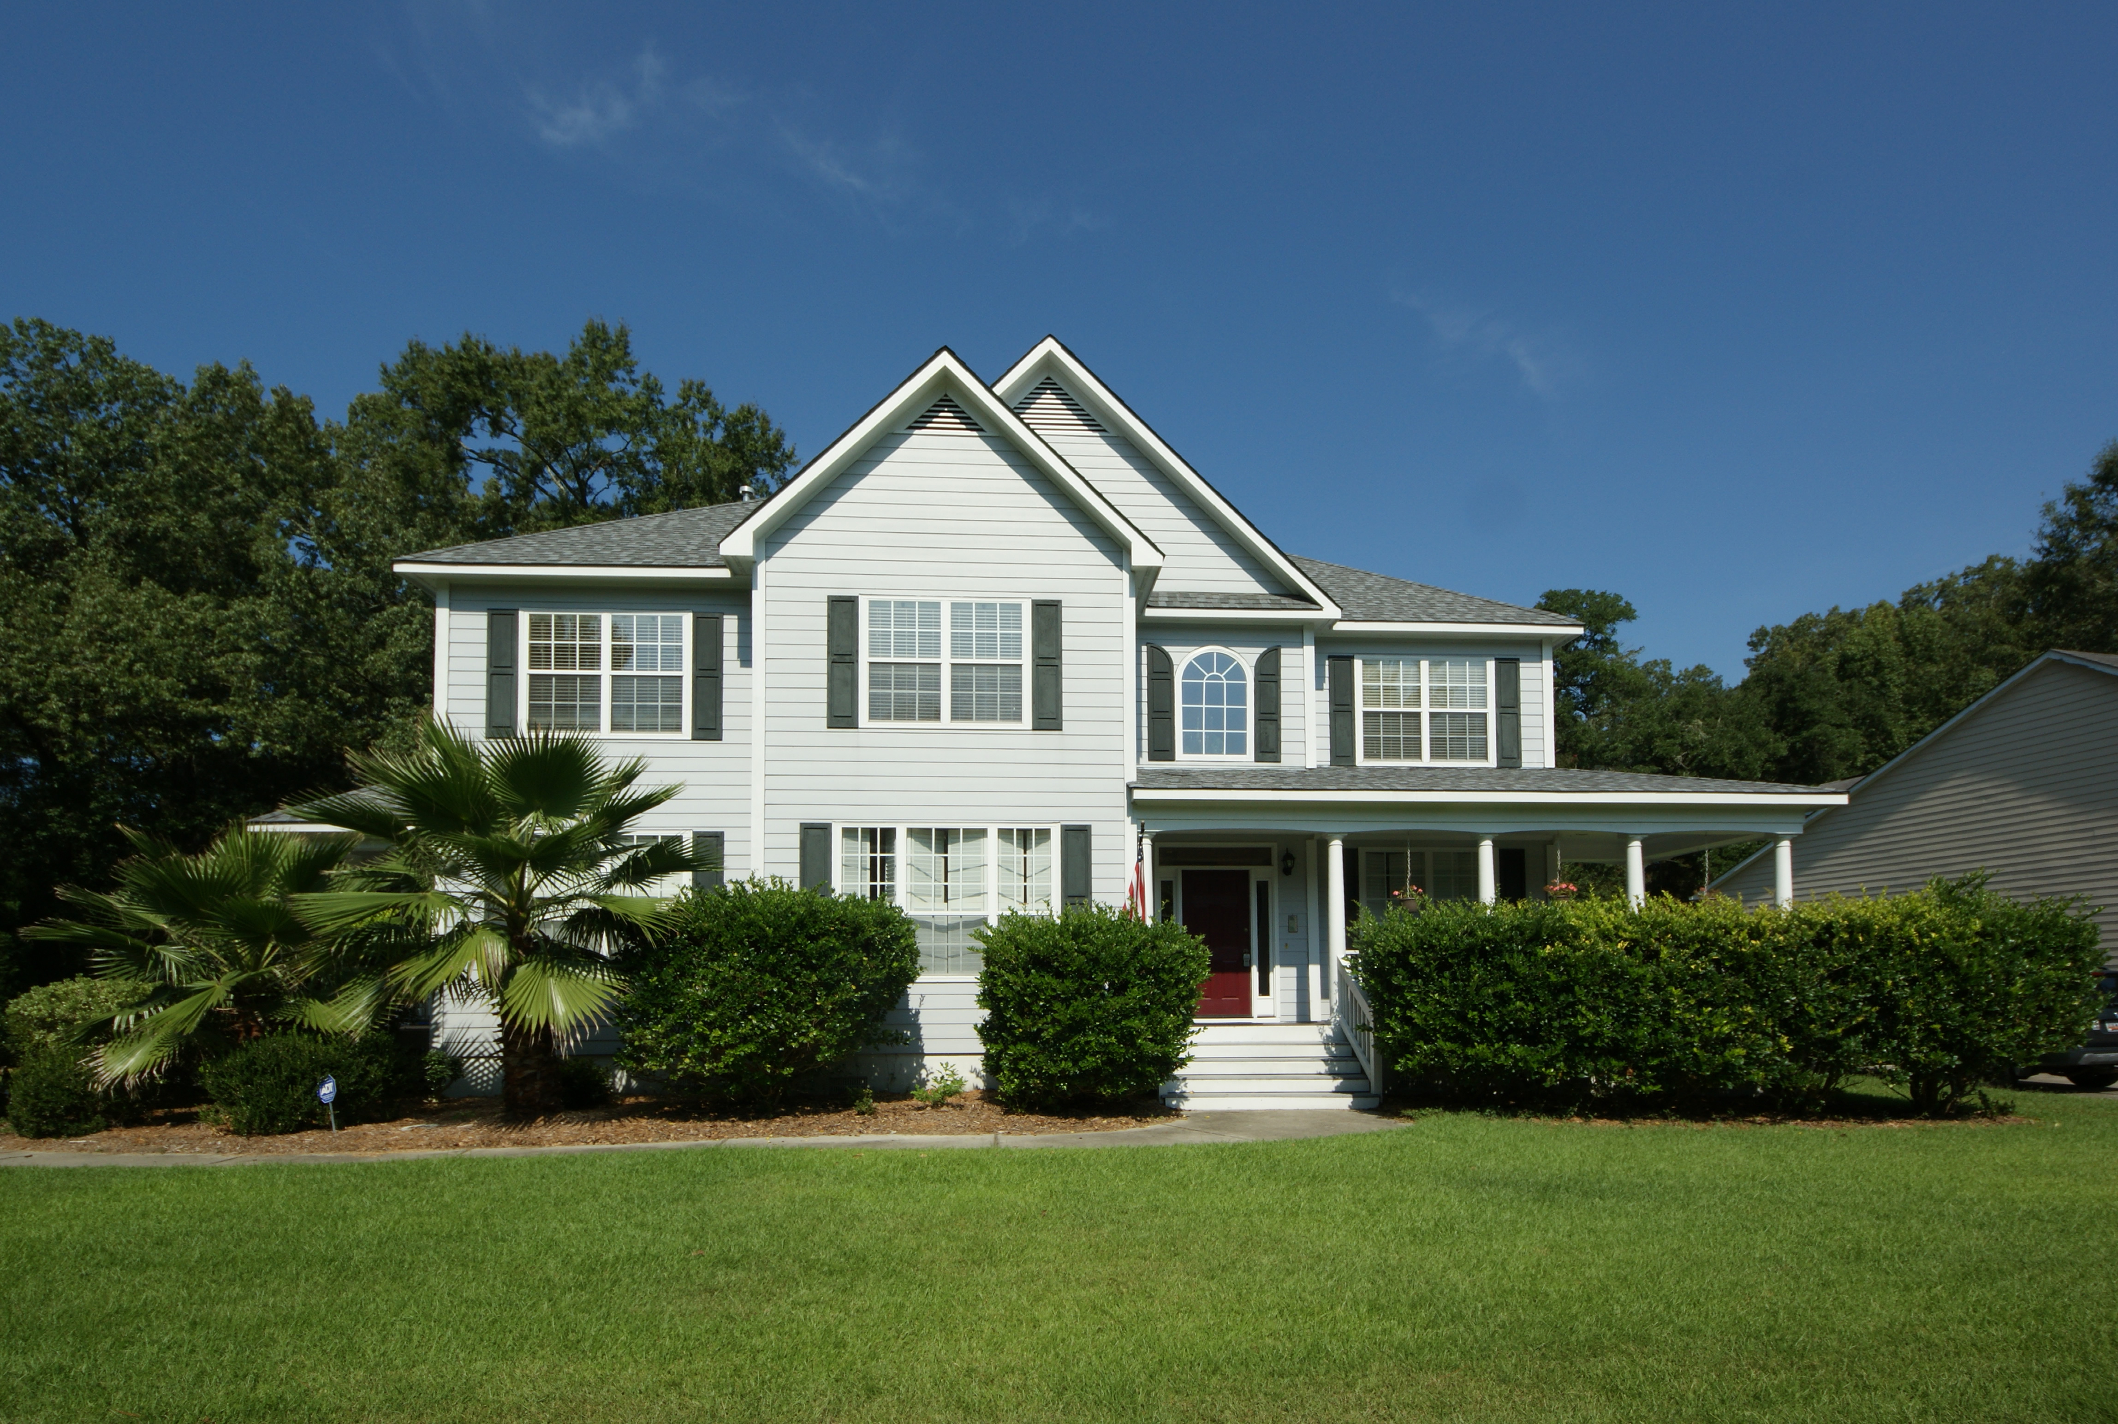
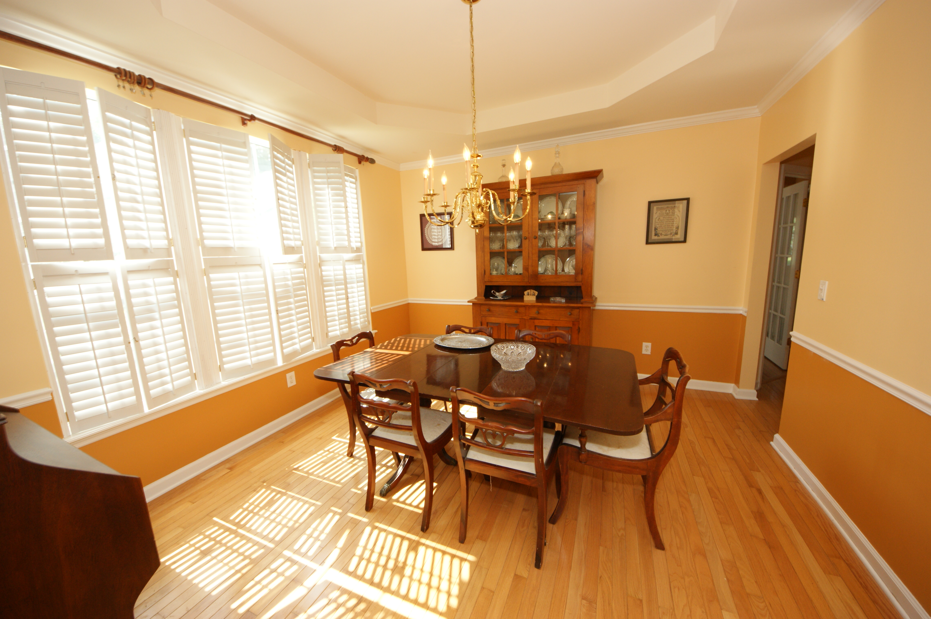
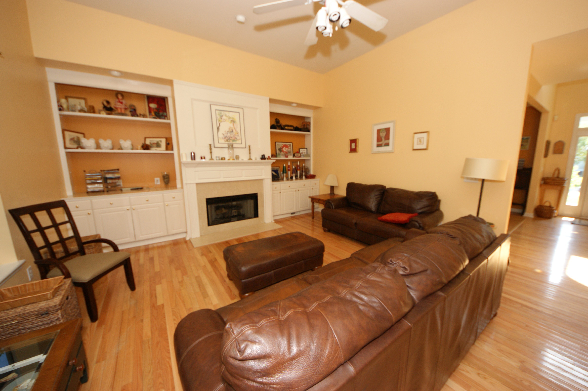
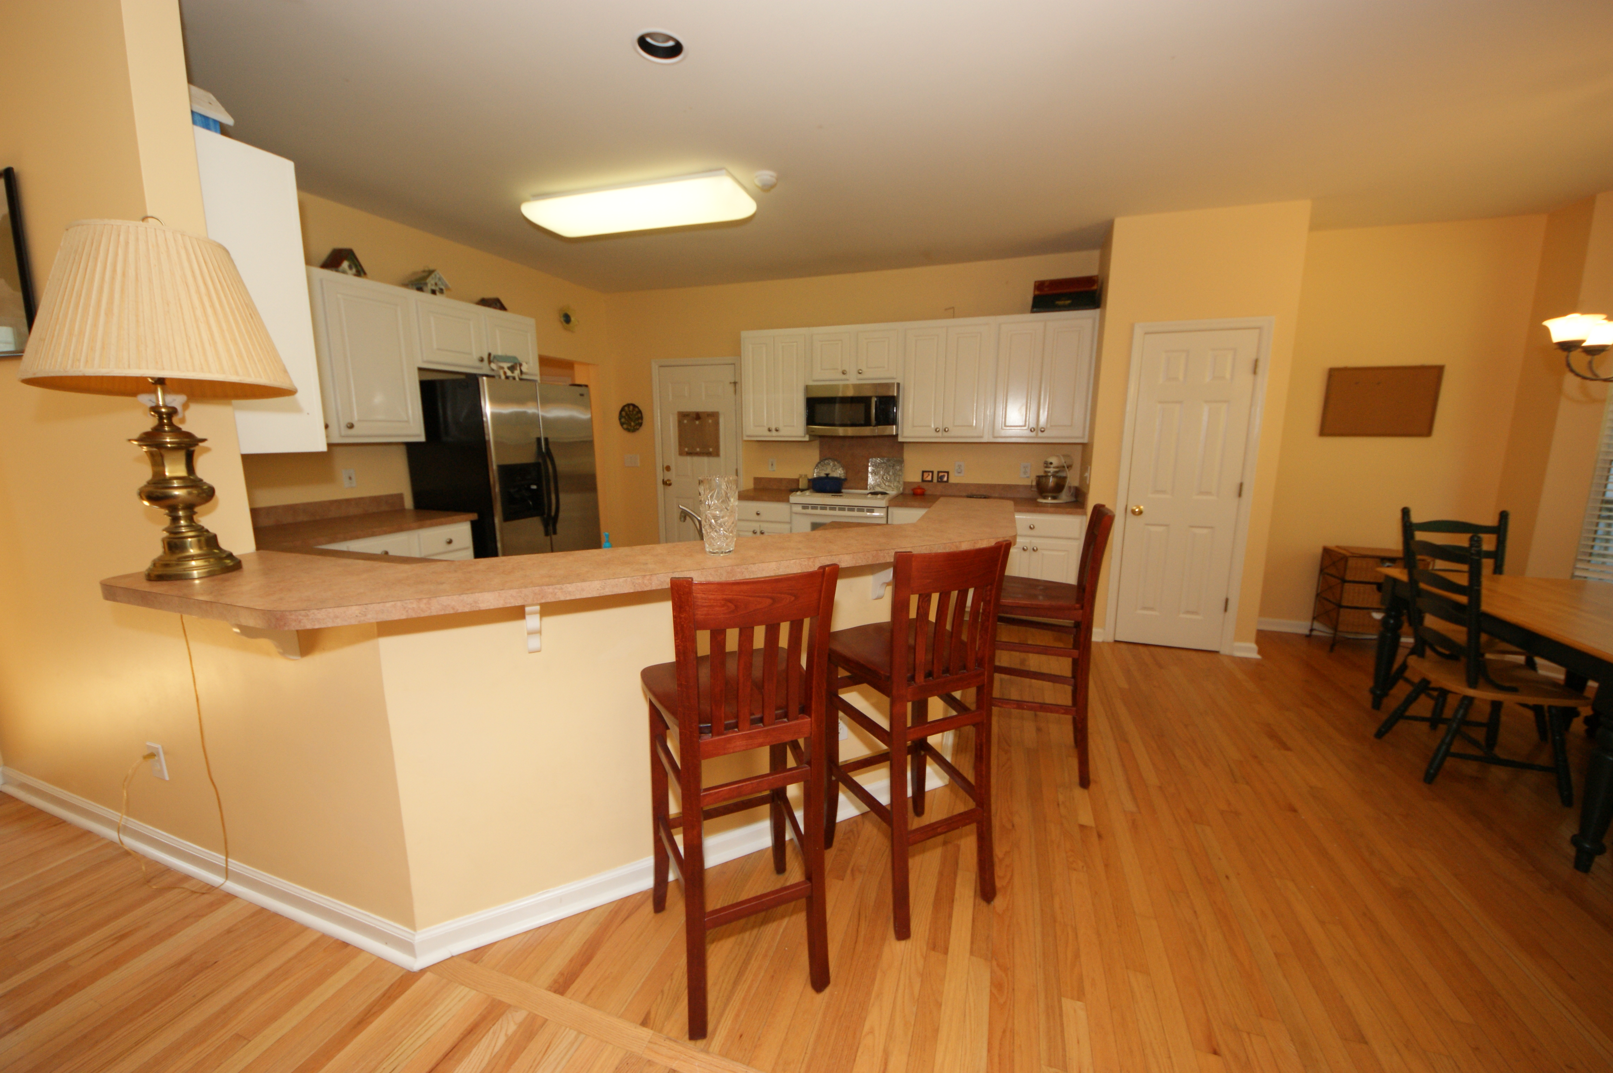
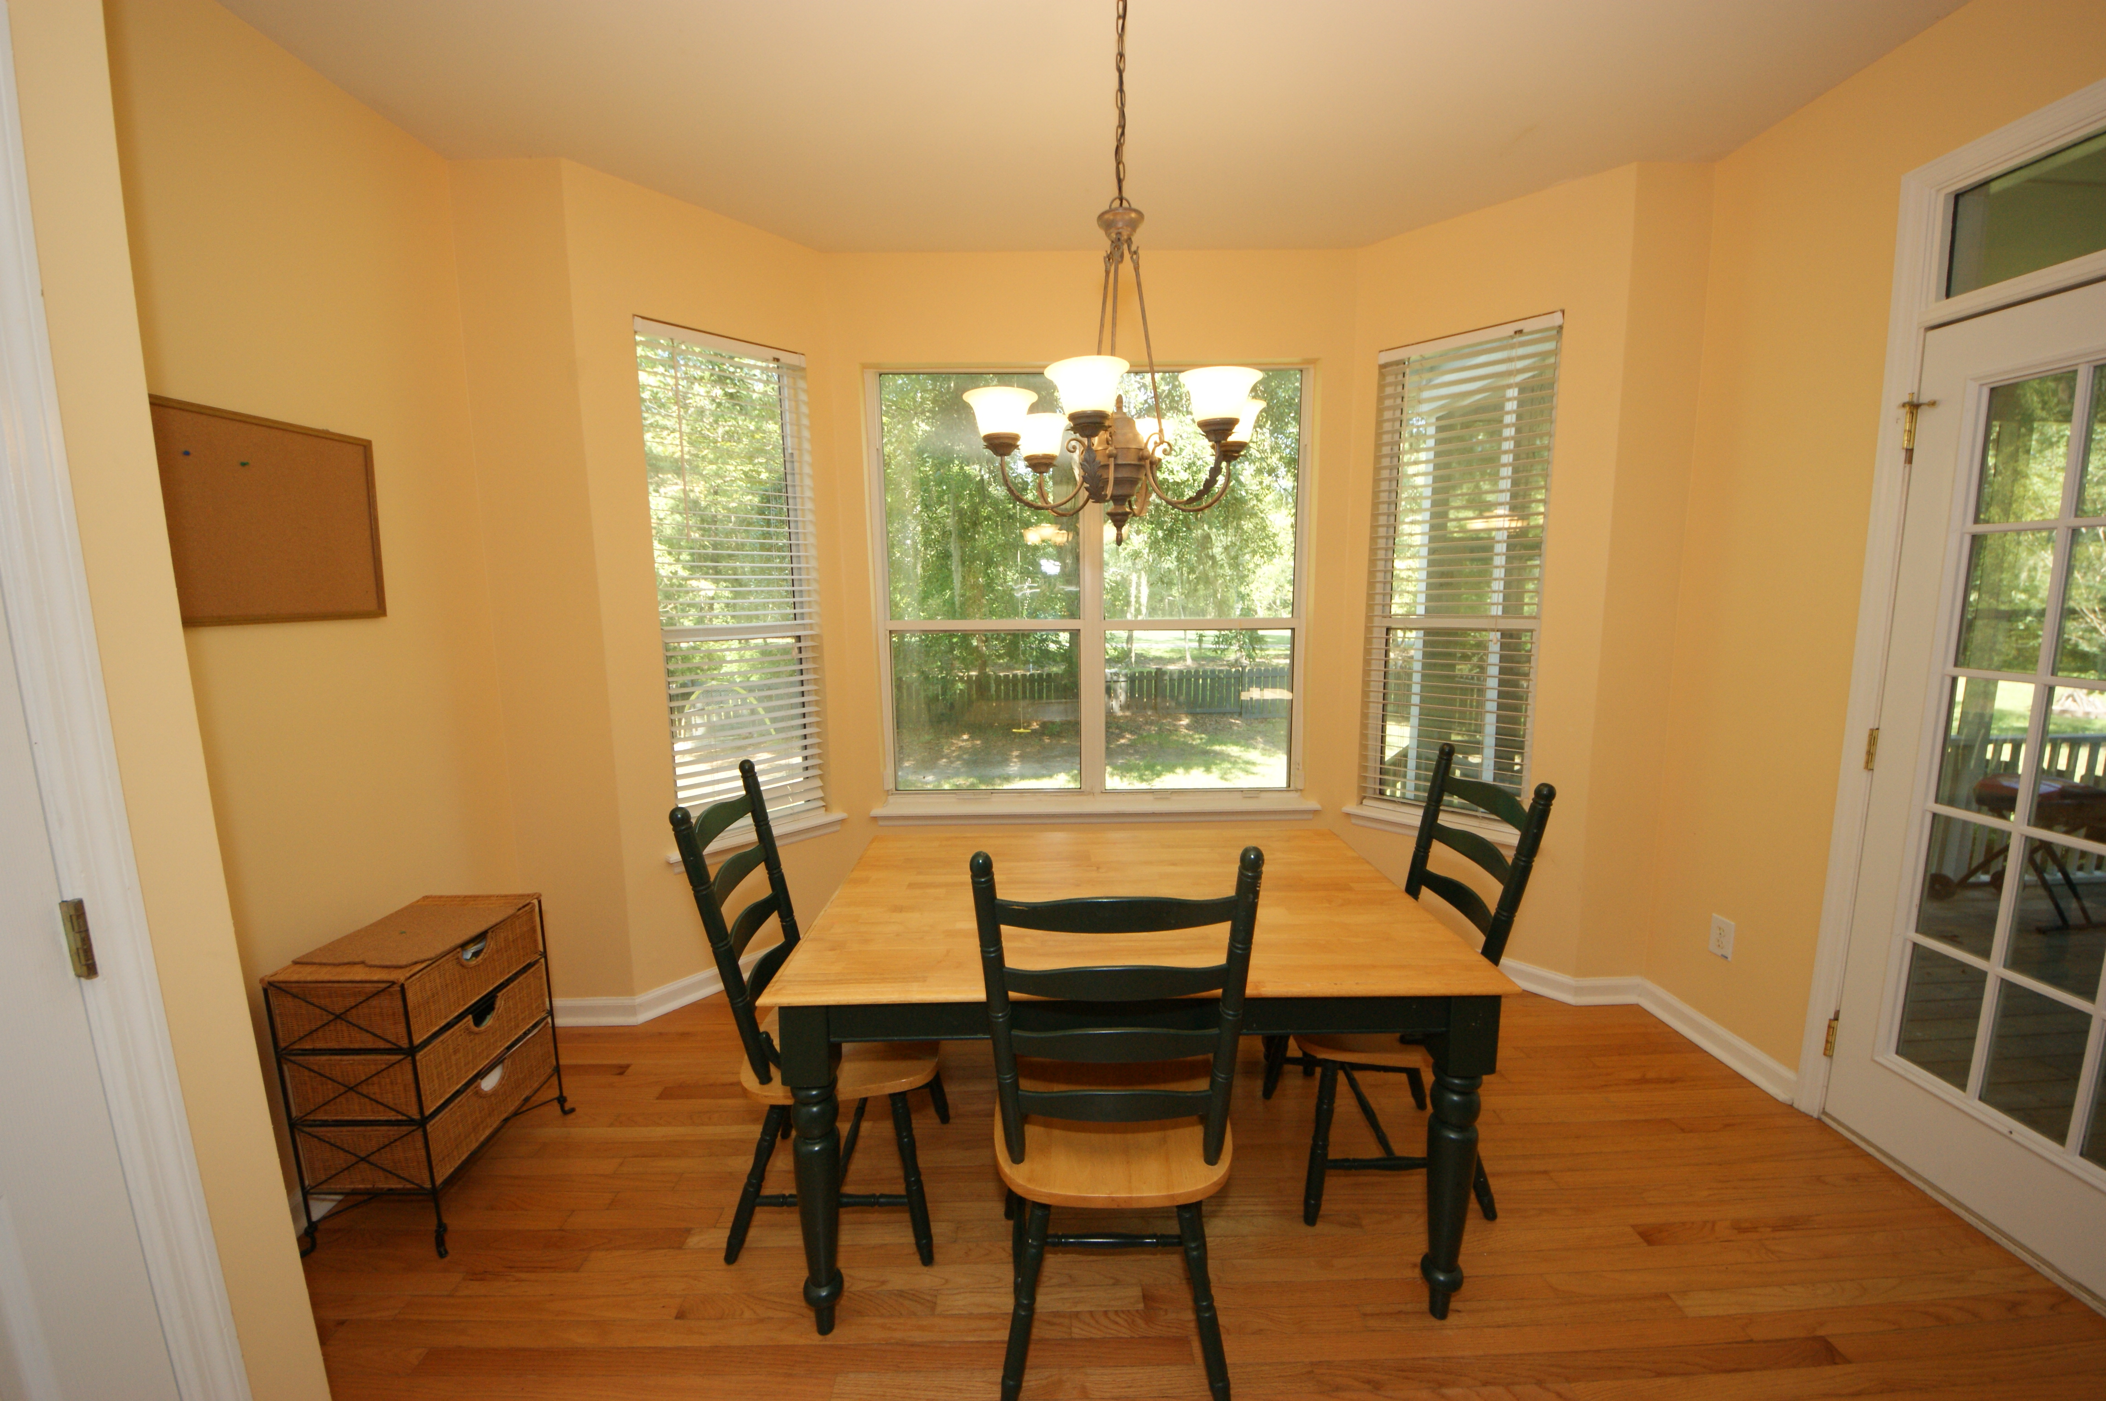
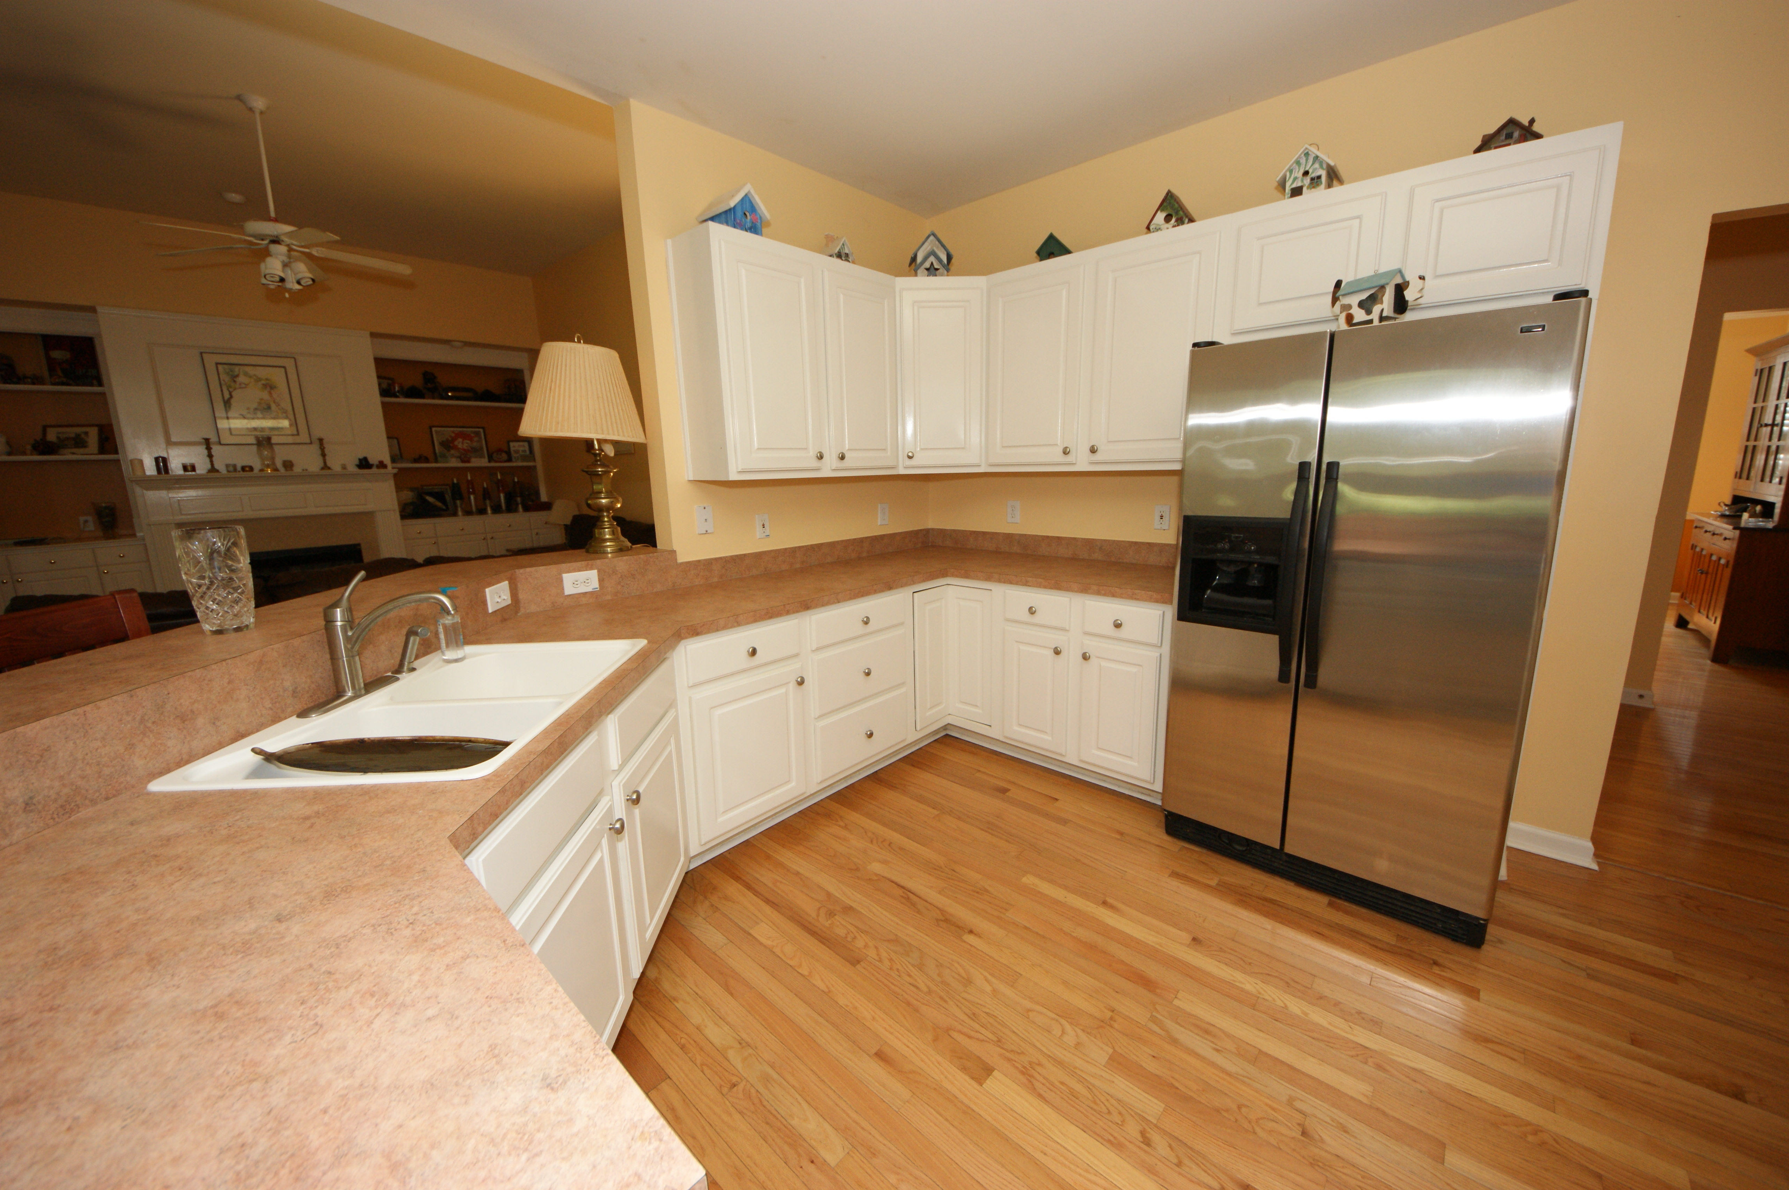
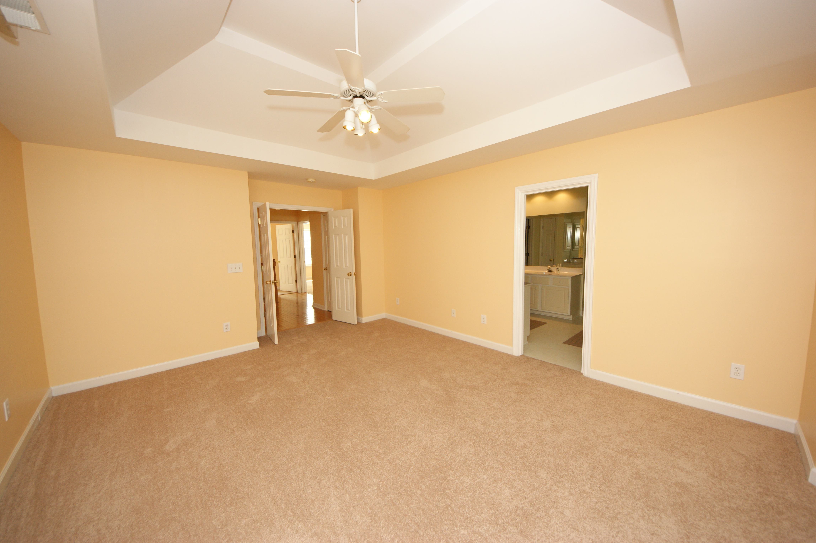
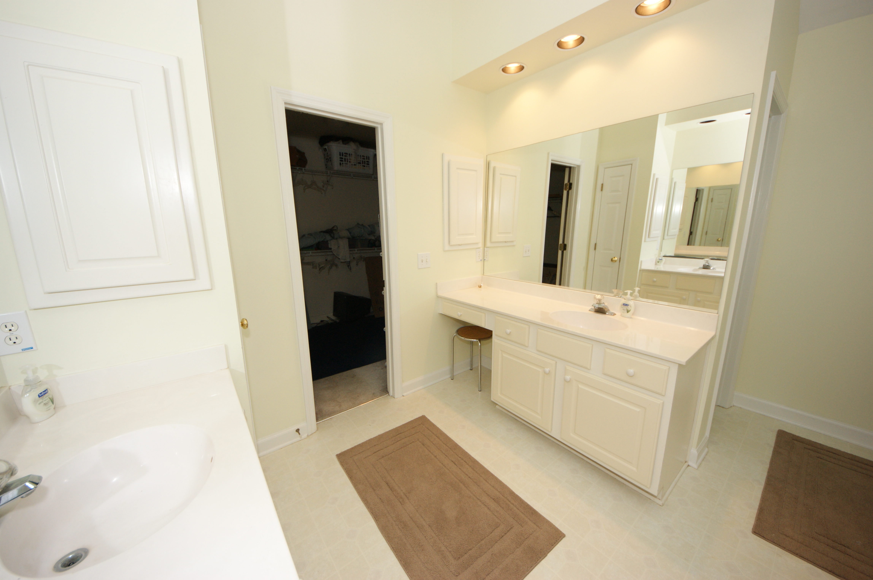
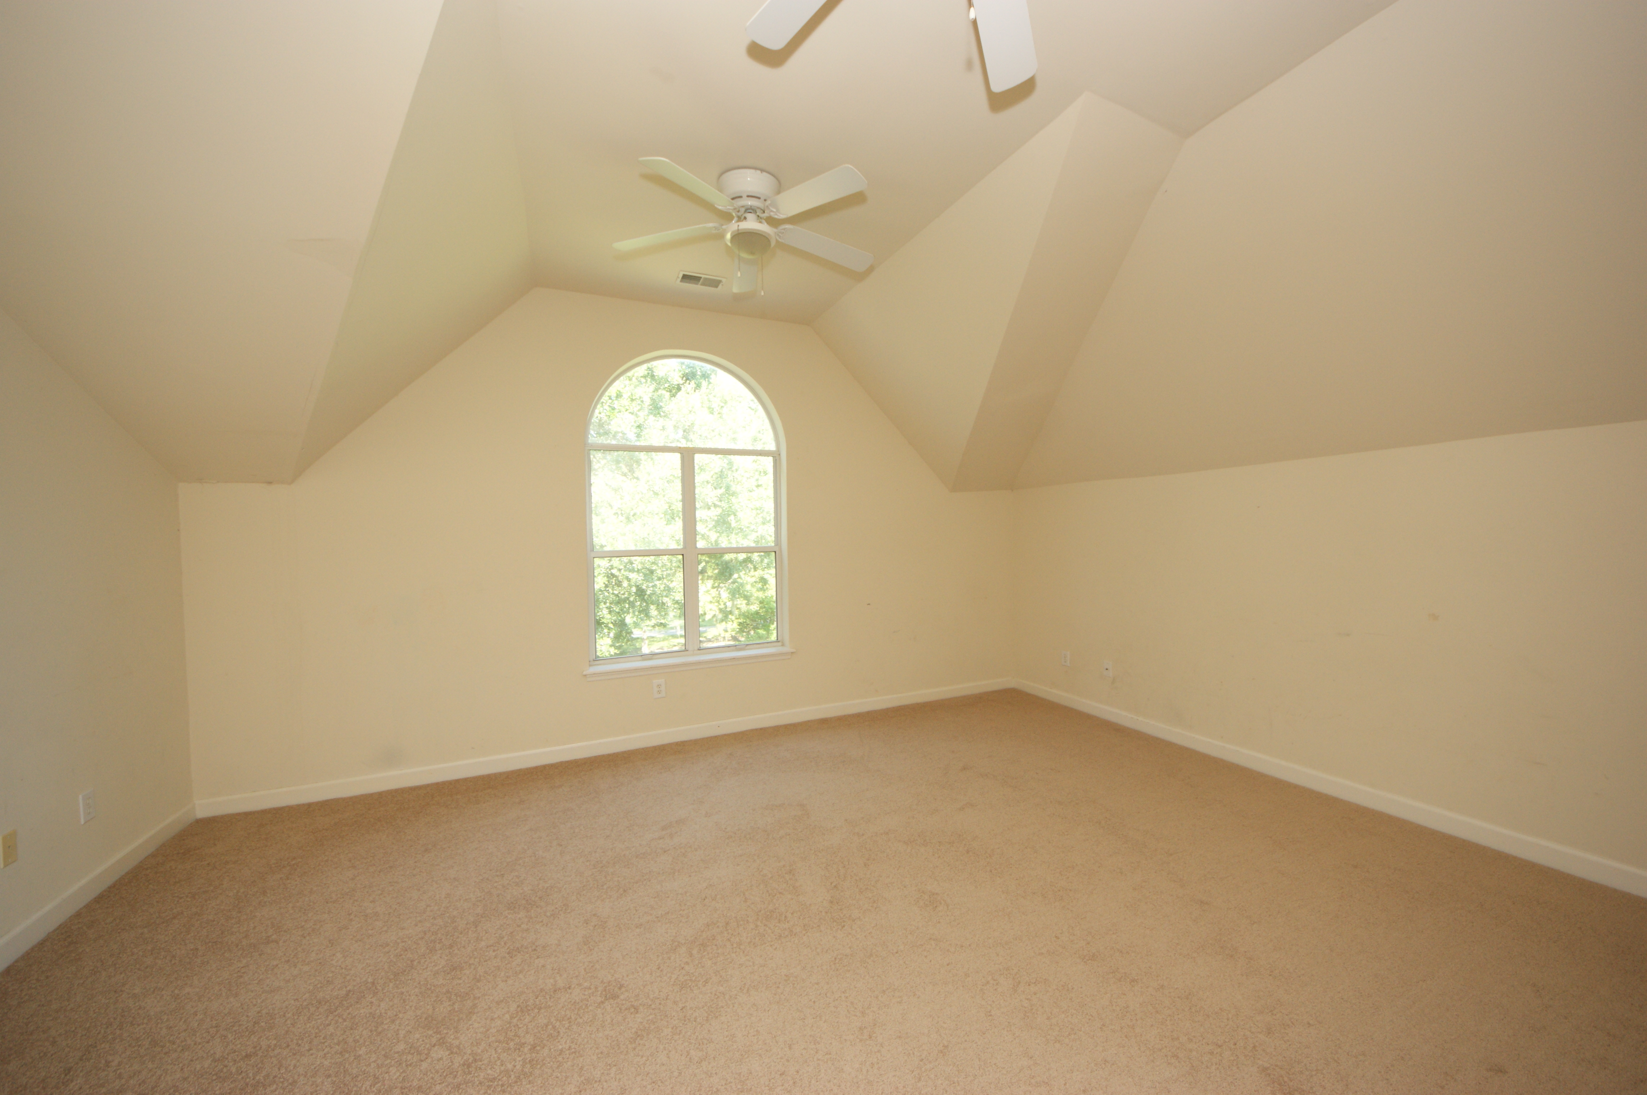
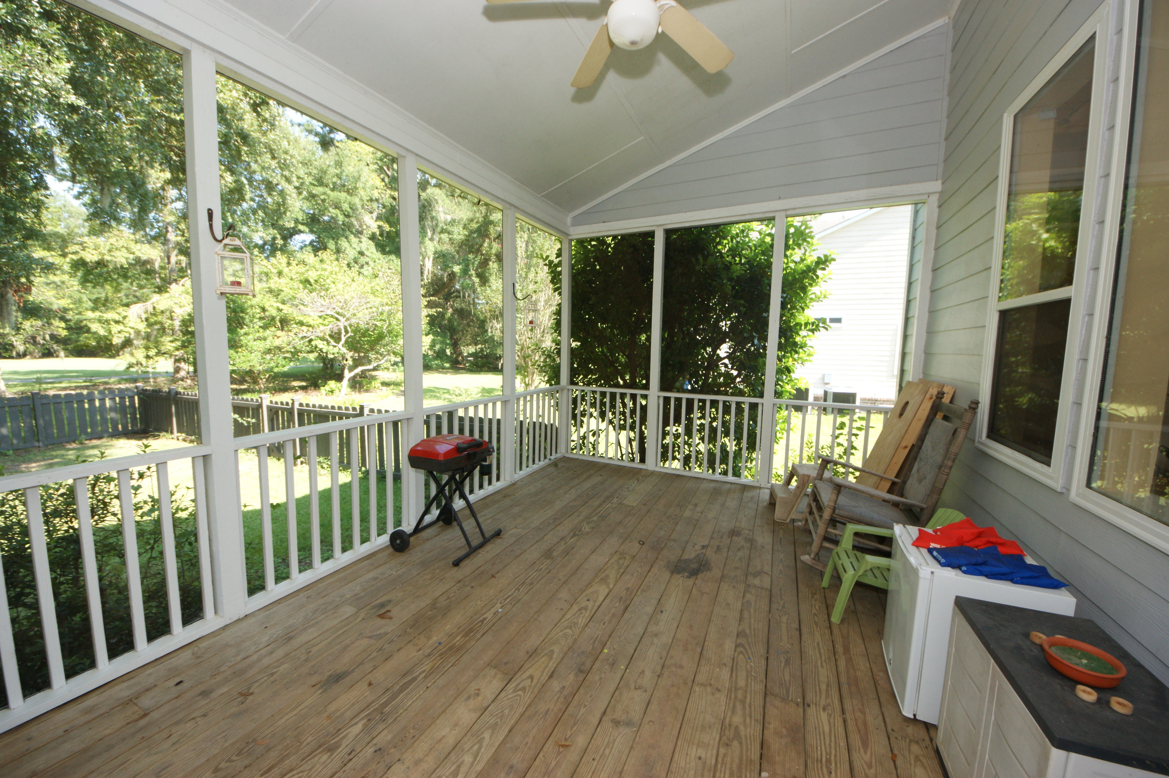
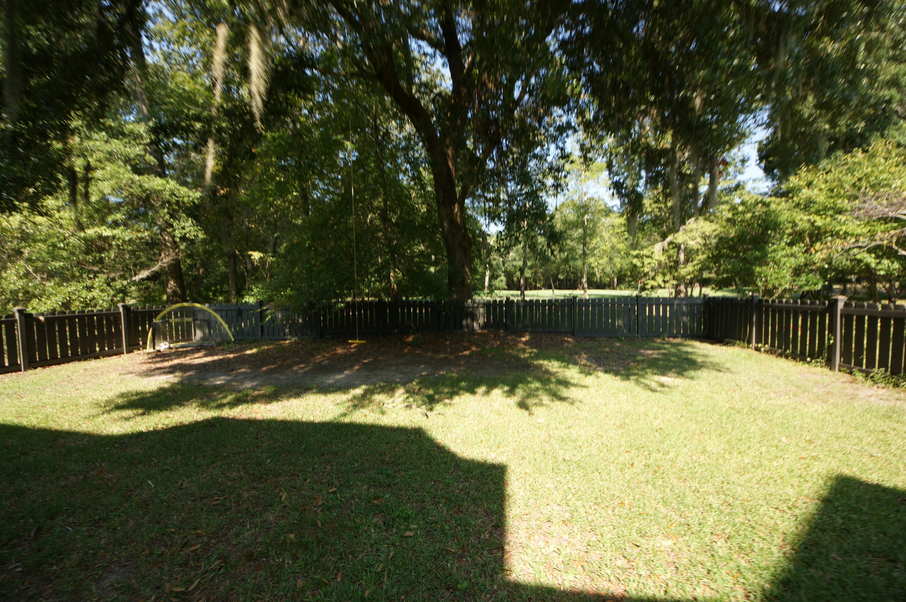

4028 Plantation House Rd Legend Oaks Plantation Summerville, SC 29485 MLS# 15012541 ~ $334,900 5 Bedrooms | 3 Baths | 3,166 sf
Open House Lunch ~ Friday, Oct 3 from 11 - 1
Handyman Special… Bring your hard hats!
Reduced $20,000
~ $5,000 Bonus ~
This is the home for you! This home backs up to the first hole of Legend Oaks Golf green. The property features a fenced in back yard (very rare), and large storage shed in back in addition to the huge garage. New roof with 30 year shingles installed in 2014. Home stayed high and dry during the recent storms. The wrap around porch brings the southern charm. Inside you will find hardwood floors through the majority of the home. There is a bedroom and connecting full bath downstairs with a separate entrance which could be used as a mother-in-law suite. The eat-in kitchen is bright and sunny and boasts white cabinetry. Upstairs bedrooms have all been re-carpeted and painted in the last month. If you have seen this home before, you need to see it again! Seller says sell! Make an offer! One year home warranty being offered by seller.
Hillary Jones
843-709-4666 hillaryjones67@gmail.com www.agentownedrealty.com
AgentOwned Realty Co. Preferred Group, Inc. | 824 Johnnie Dodds Blvd | Mt Pleasant, SC 29464

