Slide 1
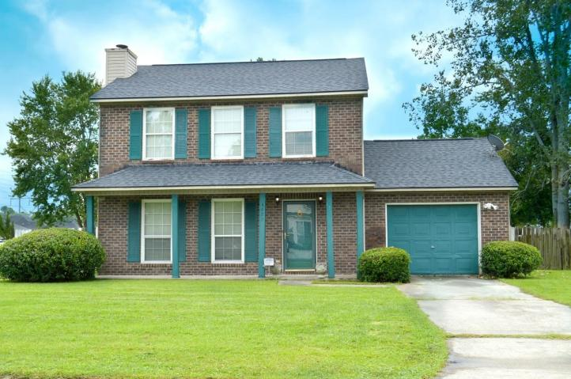
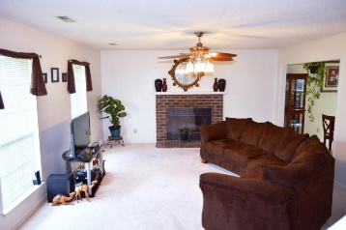
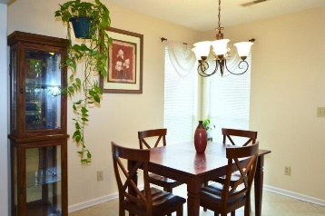
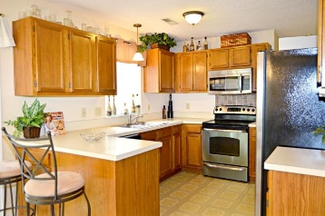
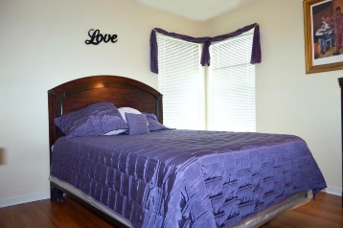
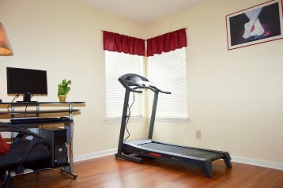
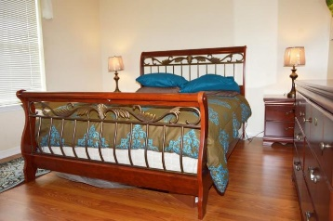
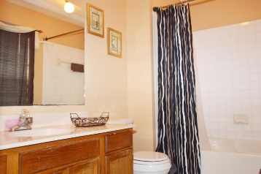
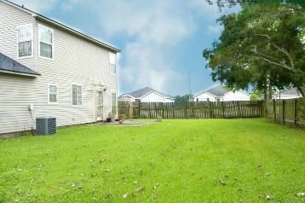


4029 Bonaparte Dr
Northpointe ~ North Charleston
MLS# 17024374 ~ $165,000
Open House Lunch ~ Friday, Oct 3 from 11 - 1
Handyman Special… Bring your hard hats!
Location! Location! Beautiful Starter Home!
Welcome home to 4029 Bonaparte. The home sits on the largest lot in the neighborhood and has a perfect back yard for kids, dogs or just relaxing. Enter into an abundant family room with a focal point fireplace. The floor plan opens into a sunny dining area with tiled floors and features a light and bright kitchen with ample cabinets and plenty of counter space to work with. The stainless steel appliances convey. Half bath located conveniently off of the kitchen. The stairs are newly carpeted and the second floor features brand new low maintenance laminate throughout. The master bedroom can handle a number of furniture arrangements and the tasteful master bath has been lovingly maintained. The secondary bedrooms are good size. Roof has been replaced in 2015. HVAC approx 3 years ago. Newer hot water heater (within last 5 years). Great access to 26 and 526. 1 mile to airport and Boeing. Convenient to Bosch and shopping! Come see it before it's gone!
Diana Johnson
(843) 345-6485
djohnson@carolinaone.com www.ahomeincharleston.com
Hillary Jones
(843) 709-4666
hillaryjones@sc.rr.com | www.hillaryjoneshomes.com
Carolina One Real Estate | 1530 Old Trolley Road | Summerville, SC 29485

