Slide 1
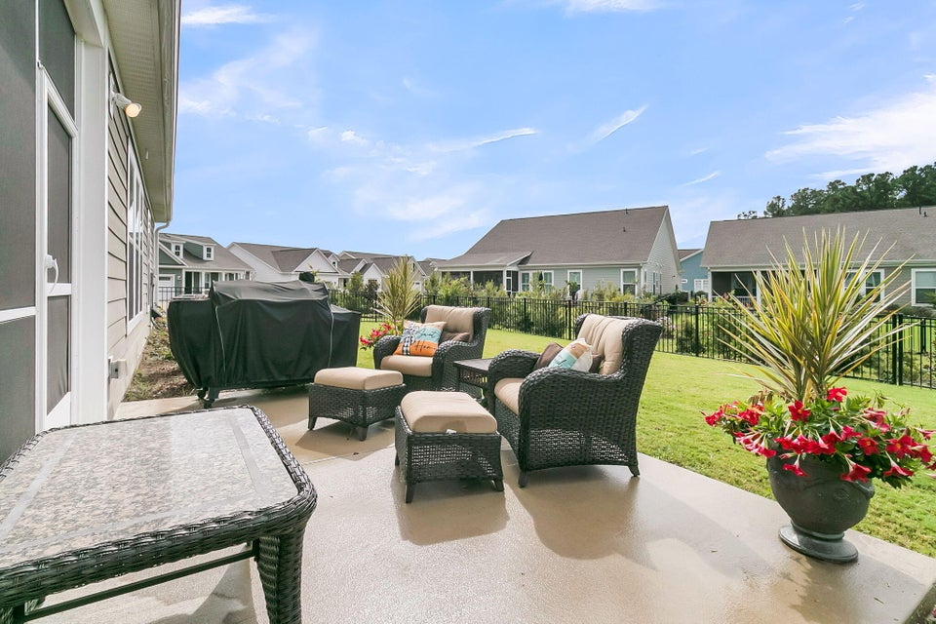
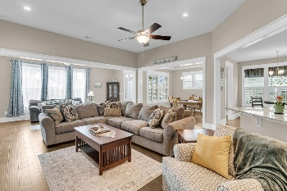
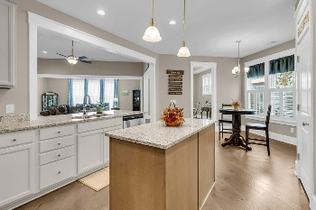
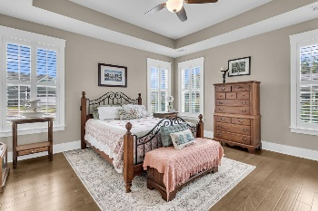
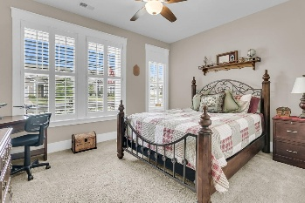
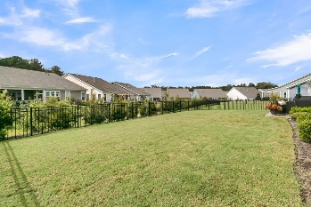

4029 Wood Violet Lane
The Ponds · Summerville, SC 29483 · MLS# 25027222 · $635,000
Cresswind 55+ - The Ponds - 4 Bed/3.5 Baths!
Lock-n-Leave! Stunning! Like-new! Discover this nearly new, immaculate 4-bedroom, 3.5-bath home located just one block from the award-winning Cresswind Community Center in the highly sought-after 55+ neighborhood of The Ponds! This home offers beautiful curb appeal, a fenced backyard, and a floor plan designed for both comfort and entertaining. Step inside to find gorgeous hardwood floors, craftsman trim, soaring ceilings, and 3'' plantation shutters throughout. The chef-inspired kitchen is a showstopper, featuring an island, gas cooktop, granite countertops, white cabinetry, tiled backsplash, stainless steel appliances, and a spacious walk-in pantry. The kitchen opens seamlessly to the oversized family room with a gas fireplace, creating a warm and inviting space for gatherings. A sunroom with a wall of windows fills the home with natural light, while a formal dining or flex room offers versatile options for entertaining or relaxing. The luxurious primary suite boasts a tray ceiling, ample space for a king-sized bed and furniture, and an incredible spa-inspired ensuite complete with an oversized tiled shower, dual vanities, a separate makeup vanity, elegant tile floors, and a massive walk-in closet. Two additional bedrooms share a stylish Jack-and-Jill bath...perfect for guests or for use as an office, exercise room, or craft space. Upstairs, a fourth bedroom with dual walk-in closets and its own private full bath provides even more flexibility as a bedroom or second living area. Step outside to your private fenced backyard oasis, featuring a screened-in porch and patio ideal for grilling, relaxing, or entertaining. Just a short stroll to the Cresswind Community Center, where you'll enjoy a state-of-the-art fitness area, yoga/dance studio, art room, resort-style pool, hot tub, bocce ball, tennis, and pickleball courts. Plus, residents have full access to all The Ponds' amenities, trails, and social activities. This better-than-new home has it all-location, luxury, and lifestyle. Don't wait...schedule your showing today, this one will not last!
Stan Huff
843-670-2835
stan.huff@agentowned.com
Jill Marcacci
843-297-5590
jill@agentowned.com
www.agentownedrealty.com
AgentOwned Realty Co. Preferred Group, Inc. | 824 Johnnie Dodds Blvd | Mt Pleasant, SC 29464

