Slide 1
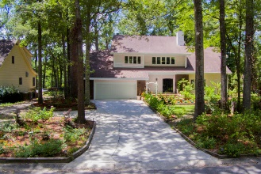
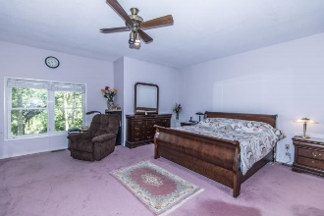
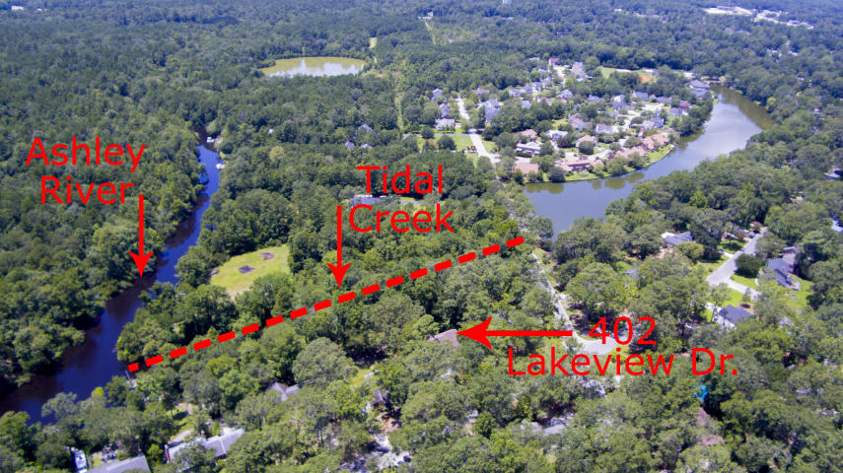
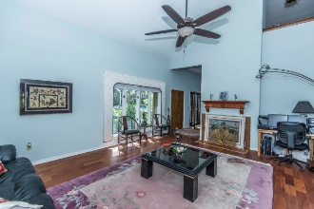
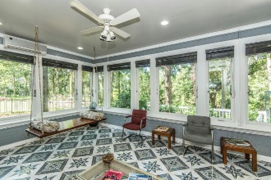
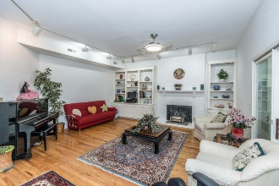
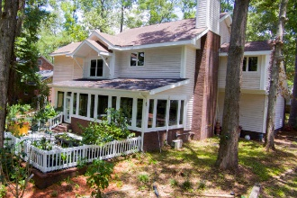
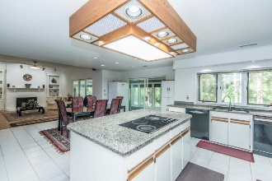
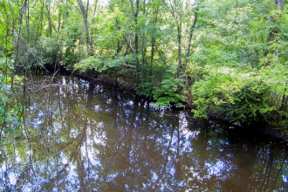

402 Lakeview Drive Ashborough ~ Summerville, SC 29485 MLS# 17020447 ~ $535,000
The Only Deep Water Home On Daniel Island
Amazing .8-Acre Tidal Creek Lot
I am proud to offer 402 Lakeview Drive which is now for sale in the sought after Ashborough Subdivision. This Tidal Creek home is located on a .80/acre lot and is certainly a rare find in Summerville. Space has not been spared in this home. Upon entering, you are greeted to an oversized two story proper foyer entryway. The staircase is immediately to the left of the foyer and the large formal living room is to the right. The Living Room features a vaulted ceiling, a gas log fireplace, Brazilian Teak Wood floors and a wet bar open to the kitchen. The Large Formal Dining Room sits beyond the Living Room and adjacent to the Oversized Kitchen. Need Cabinet and Counterspace? The kitchen has an unbelievable amount of space with a huge kitchen island, granite countertops and tons of cabinetry and pantry space. The eat-in kitchen can fit another six-foot table comfortably and is open the family room. The family room does not lack for space either and features the 2nd gas log fireplace along with custom built-in bookshelves. Along the backside of the home is the all-season sun room with tiled flooring and its own mini-split unit. Upstairs offers 4 bedrooms plus 3 full bathrooms. The Master Suite features an oversized Master Bedroom with a dressing vanity in the room itself. The Master Bathroom has an extended dual Vanity, a separate Water Closet, a five-foot separate shower, a jacuzzi tub and an enormous walk-in closet. The 3 extra bedrooms are all generous in sizes. One of the extra bedrooms has its own private bathroom and the other two bedrooms share a full hall bathroom. A few extras worth noting are that all of the plumbing in the home has just recently been replumbed, the hot water tank was replaced just a year ago and the roof is approximately 6 years old. The current owners are the original owners of this home and have transformed their yard into something quite amazing over the years. There are Tropical Plants, Herb Plants, Fruit Bearing Trees and Flowering Trees and Bushes that will blossom every year. The vast backyard offers peace and tranquility with all tropical foliage, the matures oaks and the tidal creek that sits at the bottom of the property. Take out your boat during high tide or jump on your paddle board to navigate the river. The choice can be yours. If this were not enough, I would be remiss not to highlight the neighborhood itself. The Ashborough Subdivision has a lot to offer with a neighborhood pool, tennis courts and a play park. Ashborough Residents have access to the Ashborough Lake that tends to attract the fishing enthusiast and the bird watchers. 3.9 miles of Nature trails have been established through the approximate 95 acres that is owned by the Ashborough Association along the Ashley River for the Hiker, Mountain Biker and those that enjoy leisurely walks through the woods. This home and community is truly a must see.
Nickole Samios
(843) 330-4136
nickole@carolinaone.com
Carolina One Real Estate
1530 Old Trolley Road
Summerville, SC 29485
www.summervillesouthcarolinahomes.com

