Slide 1
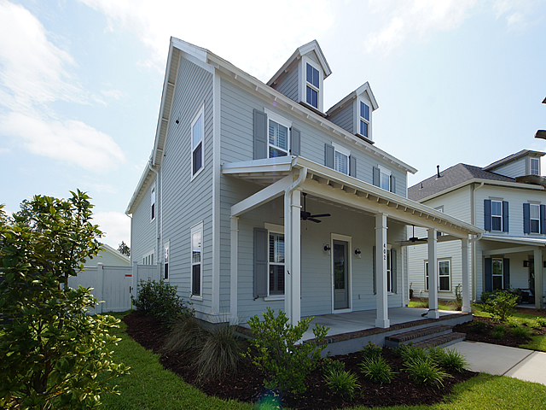
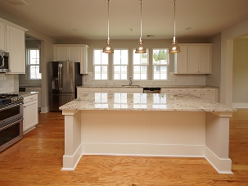
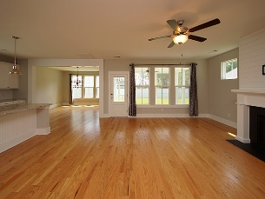
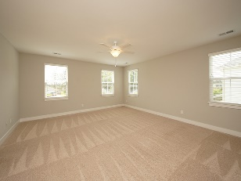
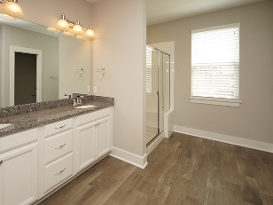
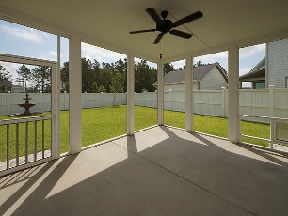

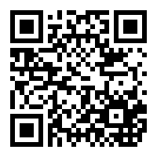
$2,500 Selling Agent Bonus *
$15,000 Agent Bonus
with ratified contract by 4/15/18
402 Park Place Circle
Nexton
Summerville, SC 29486
MLS# 18017047
$433,500
* Seller is offering a $2,500 selling agent bonus – earned and payable at closing - for a ratified contract by August 15, 2018.
4 Bedrooms / 3.5 Baths / Hardwood flooring / Plantation Shutters / GE Café series gas range / Large Kitchen Island / Open Floorplan /
Fenced yard / Decorative fountain / Screened Porch / more …
Home is only 16 months old – Shows Like New – I promise!
Seller is only selling because of a job change – price has been significantly reduced.
Easy to show and sell.
Mason Thurber
(843) 709-5109 – C
(843) 576-2699 – O
mason@theeverettgroup.net
RE/MAX Pro Realty, 9209 University Blvd, Charleston, SC 29406

