Slide 1
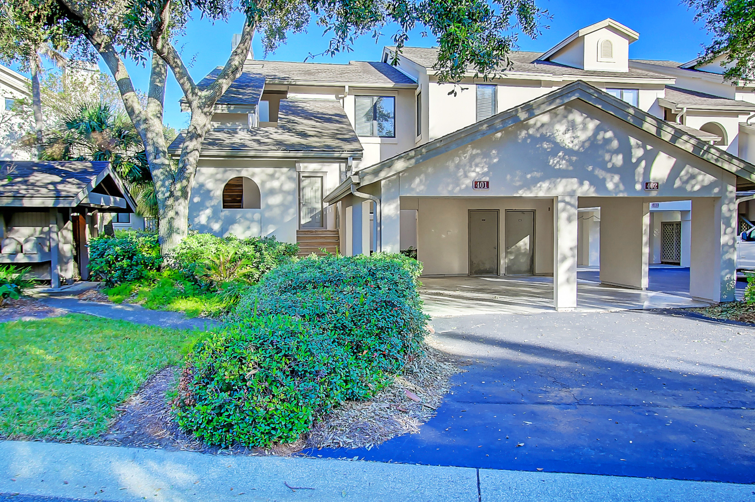
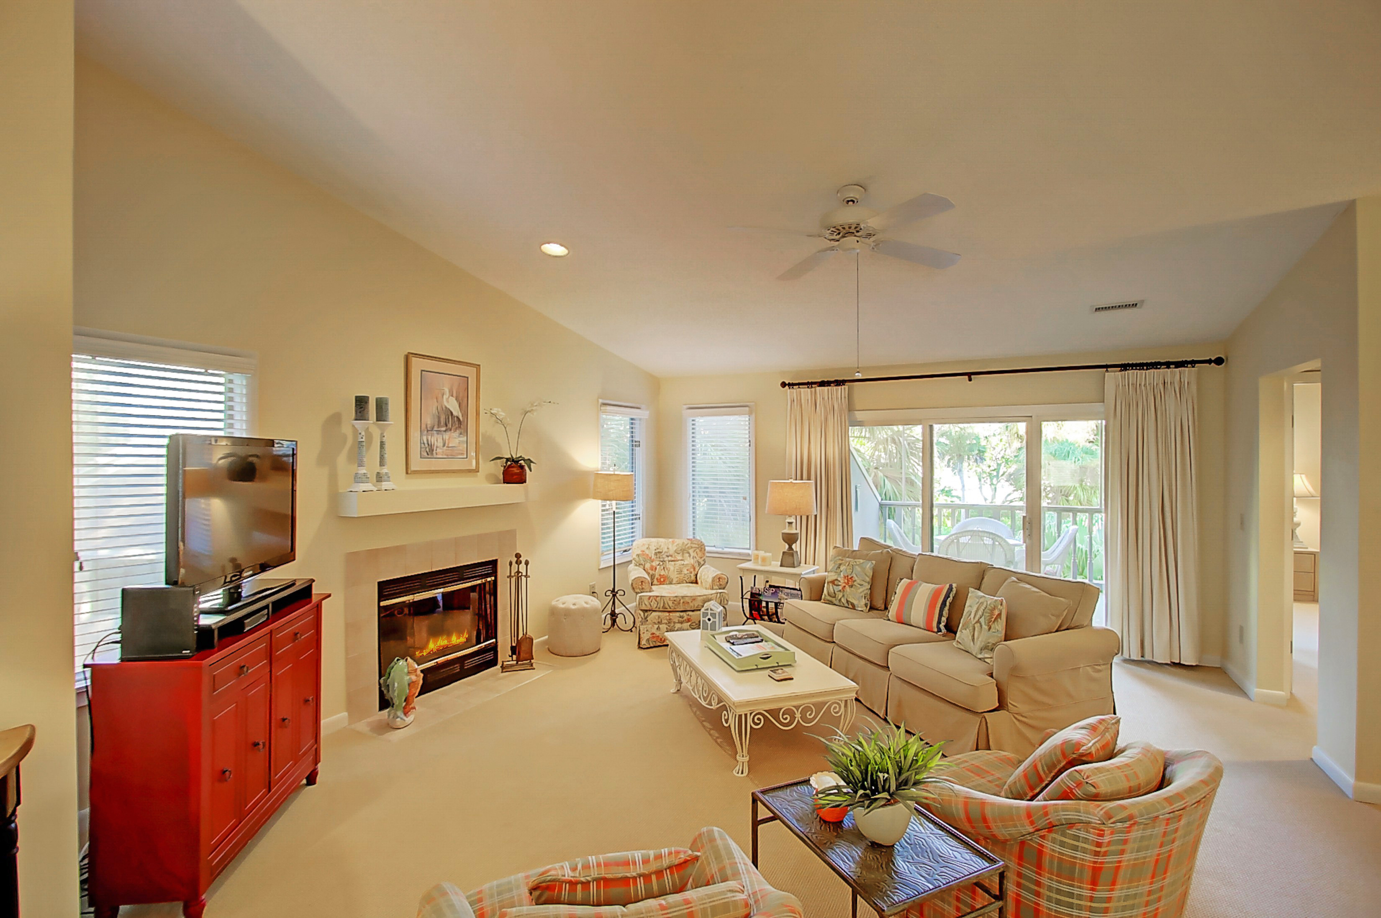
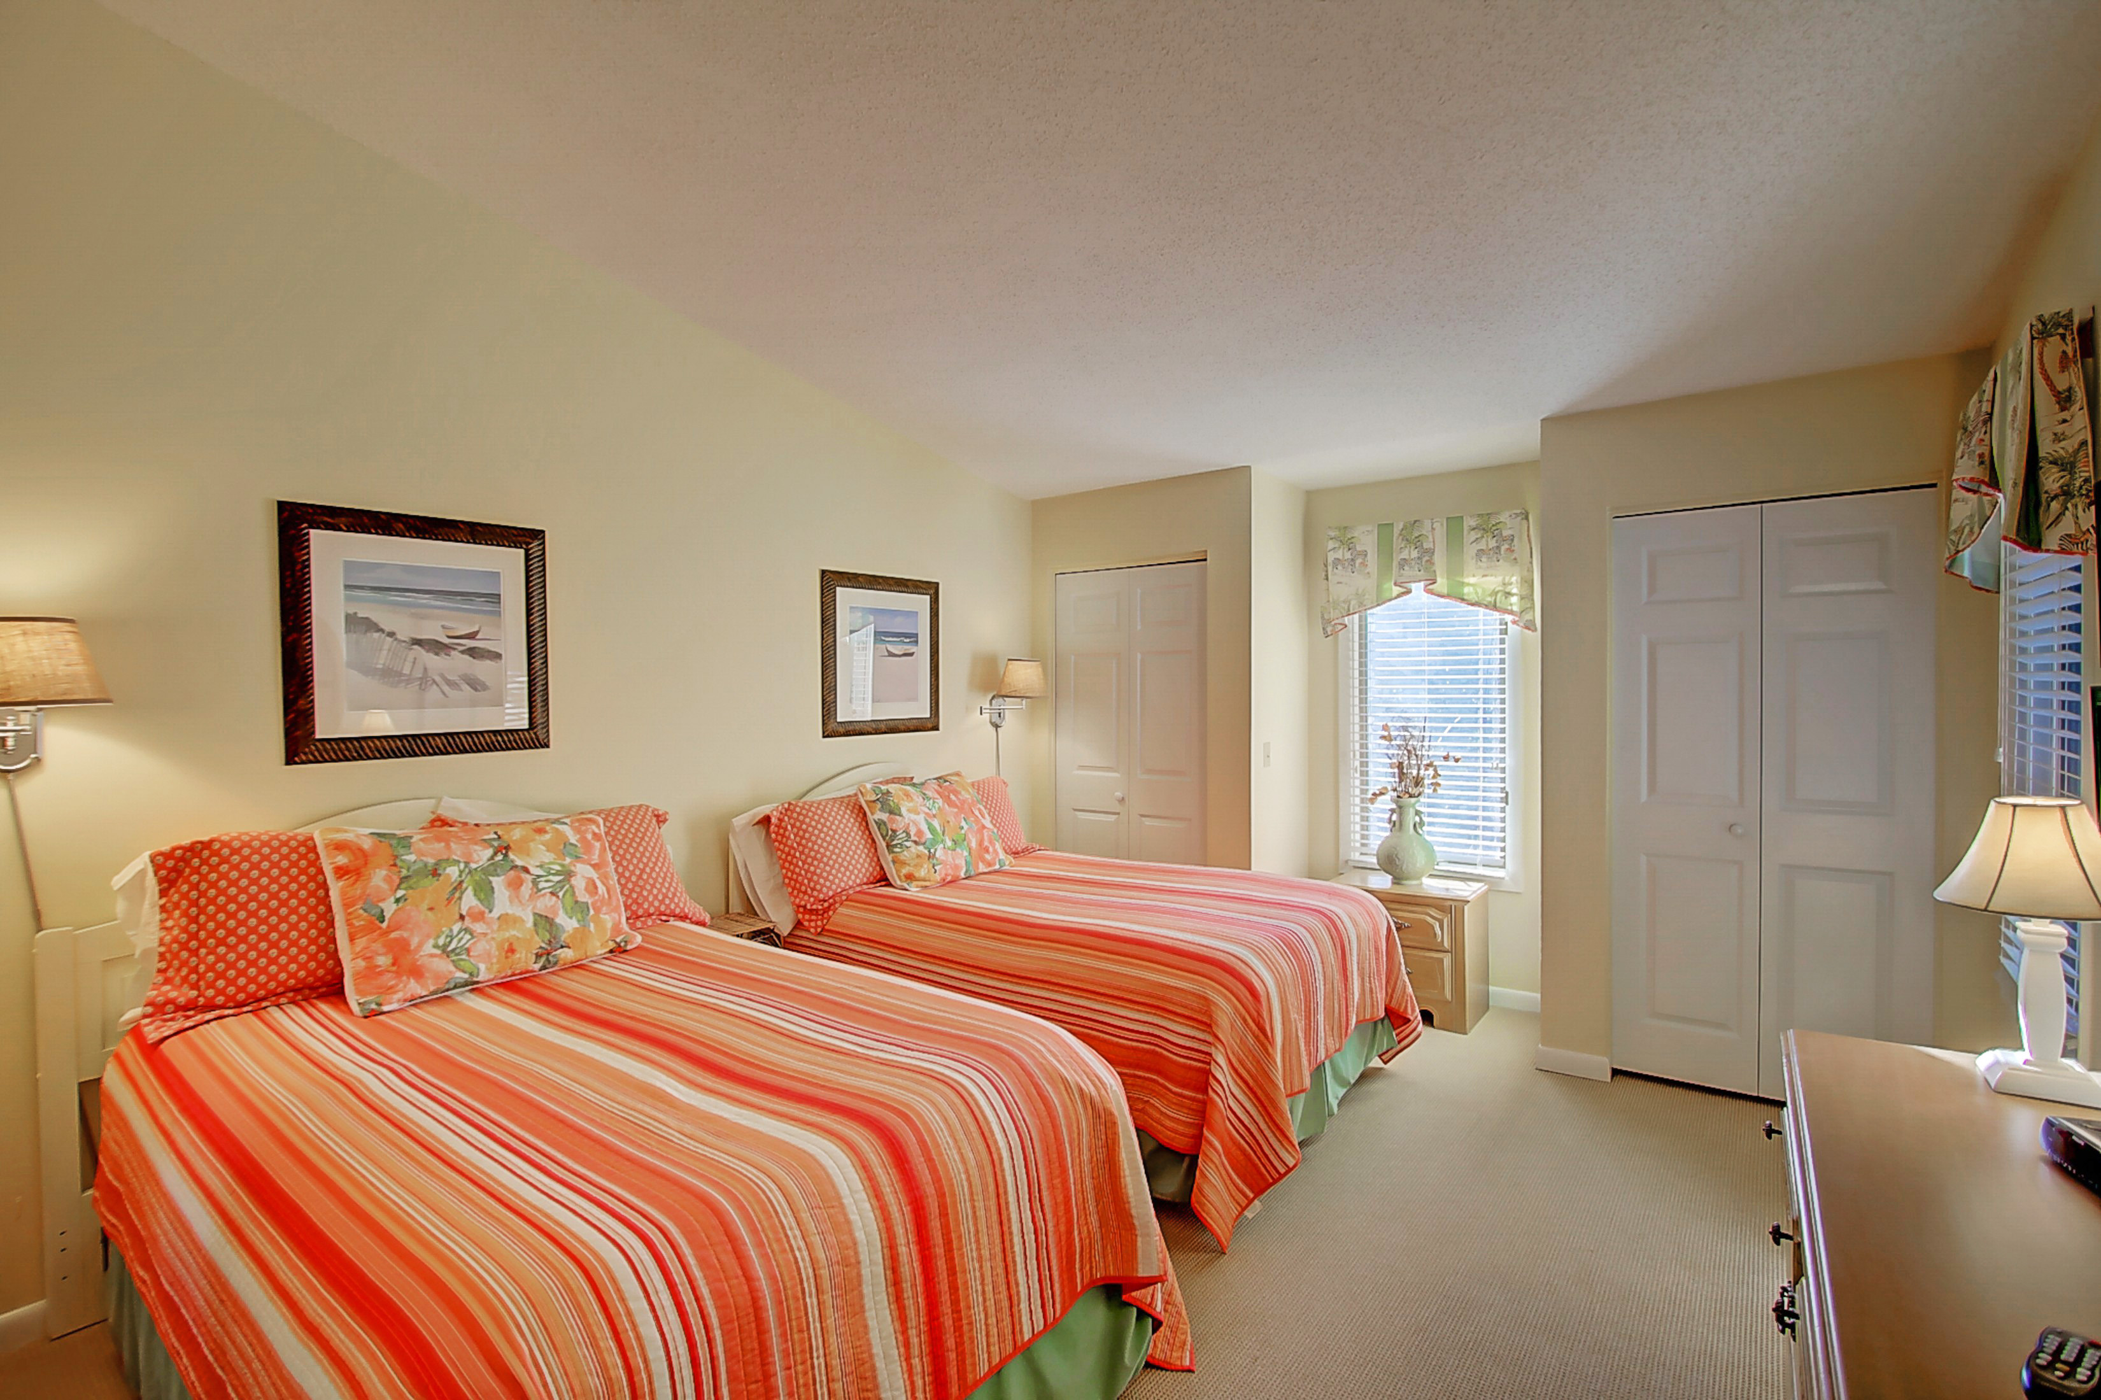
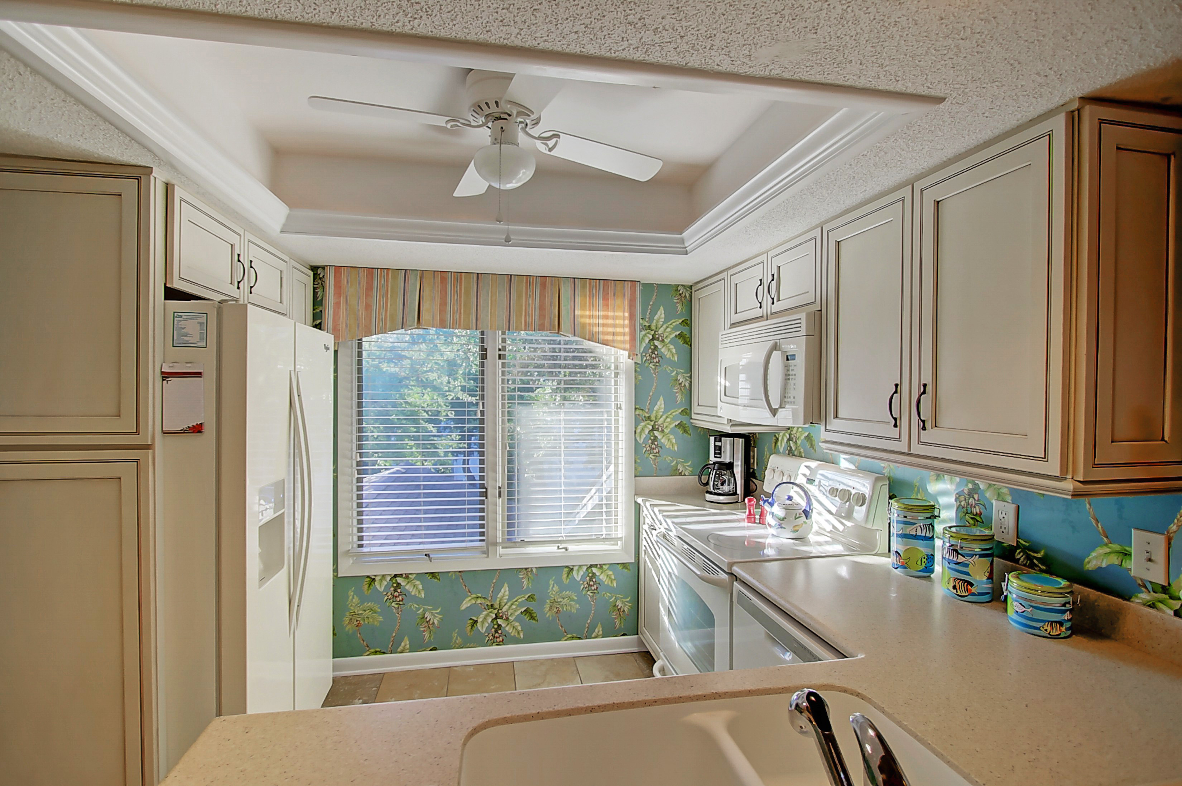
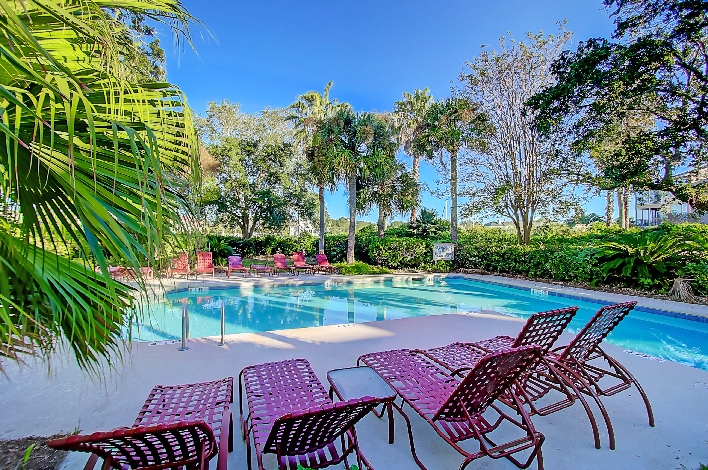
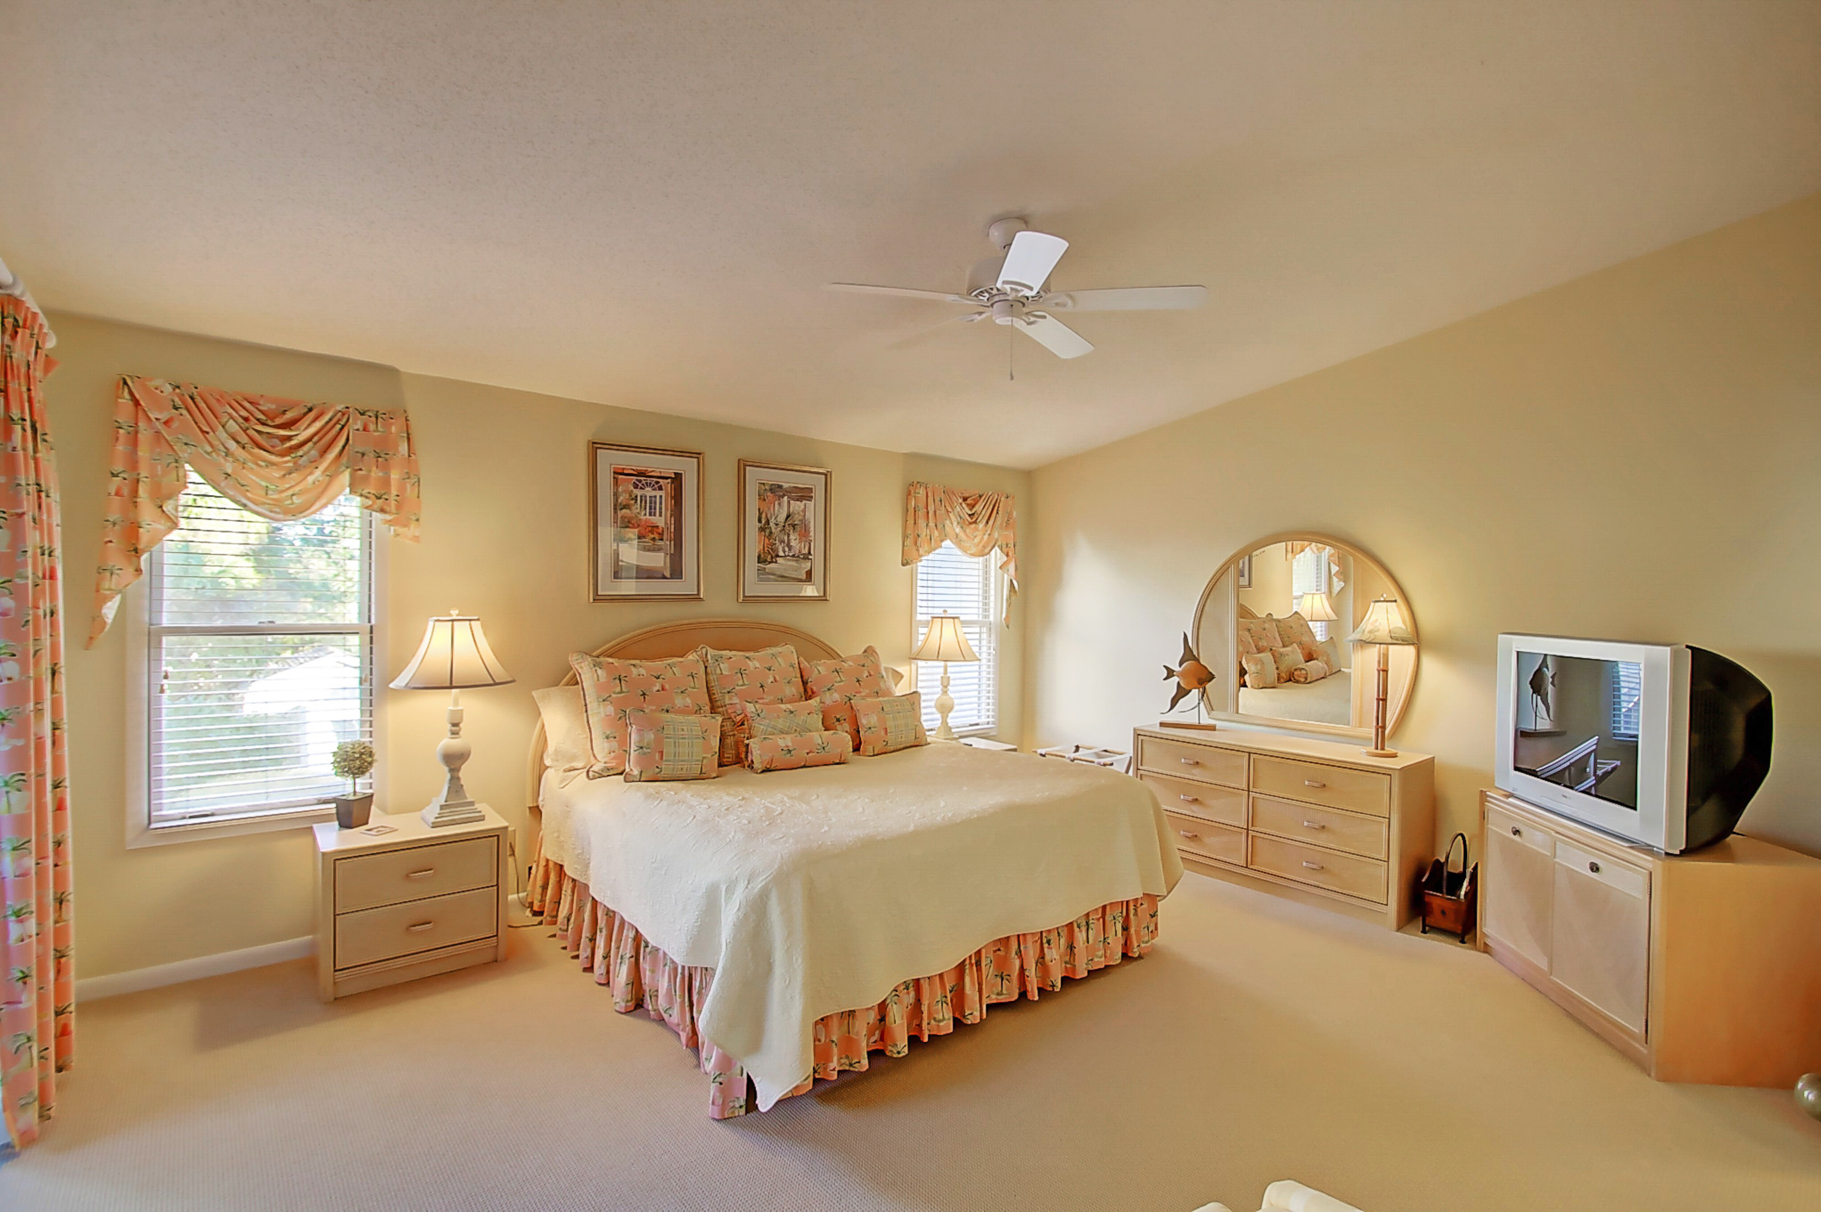
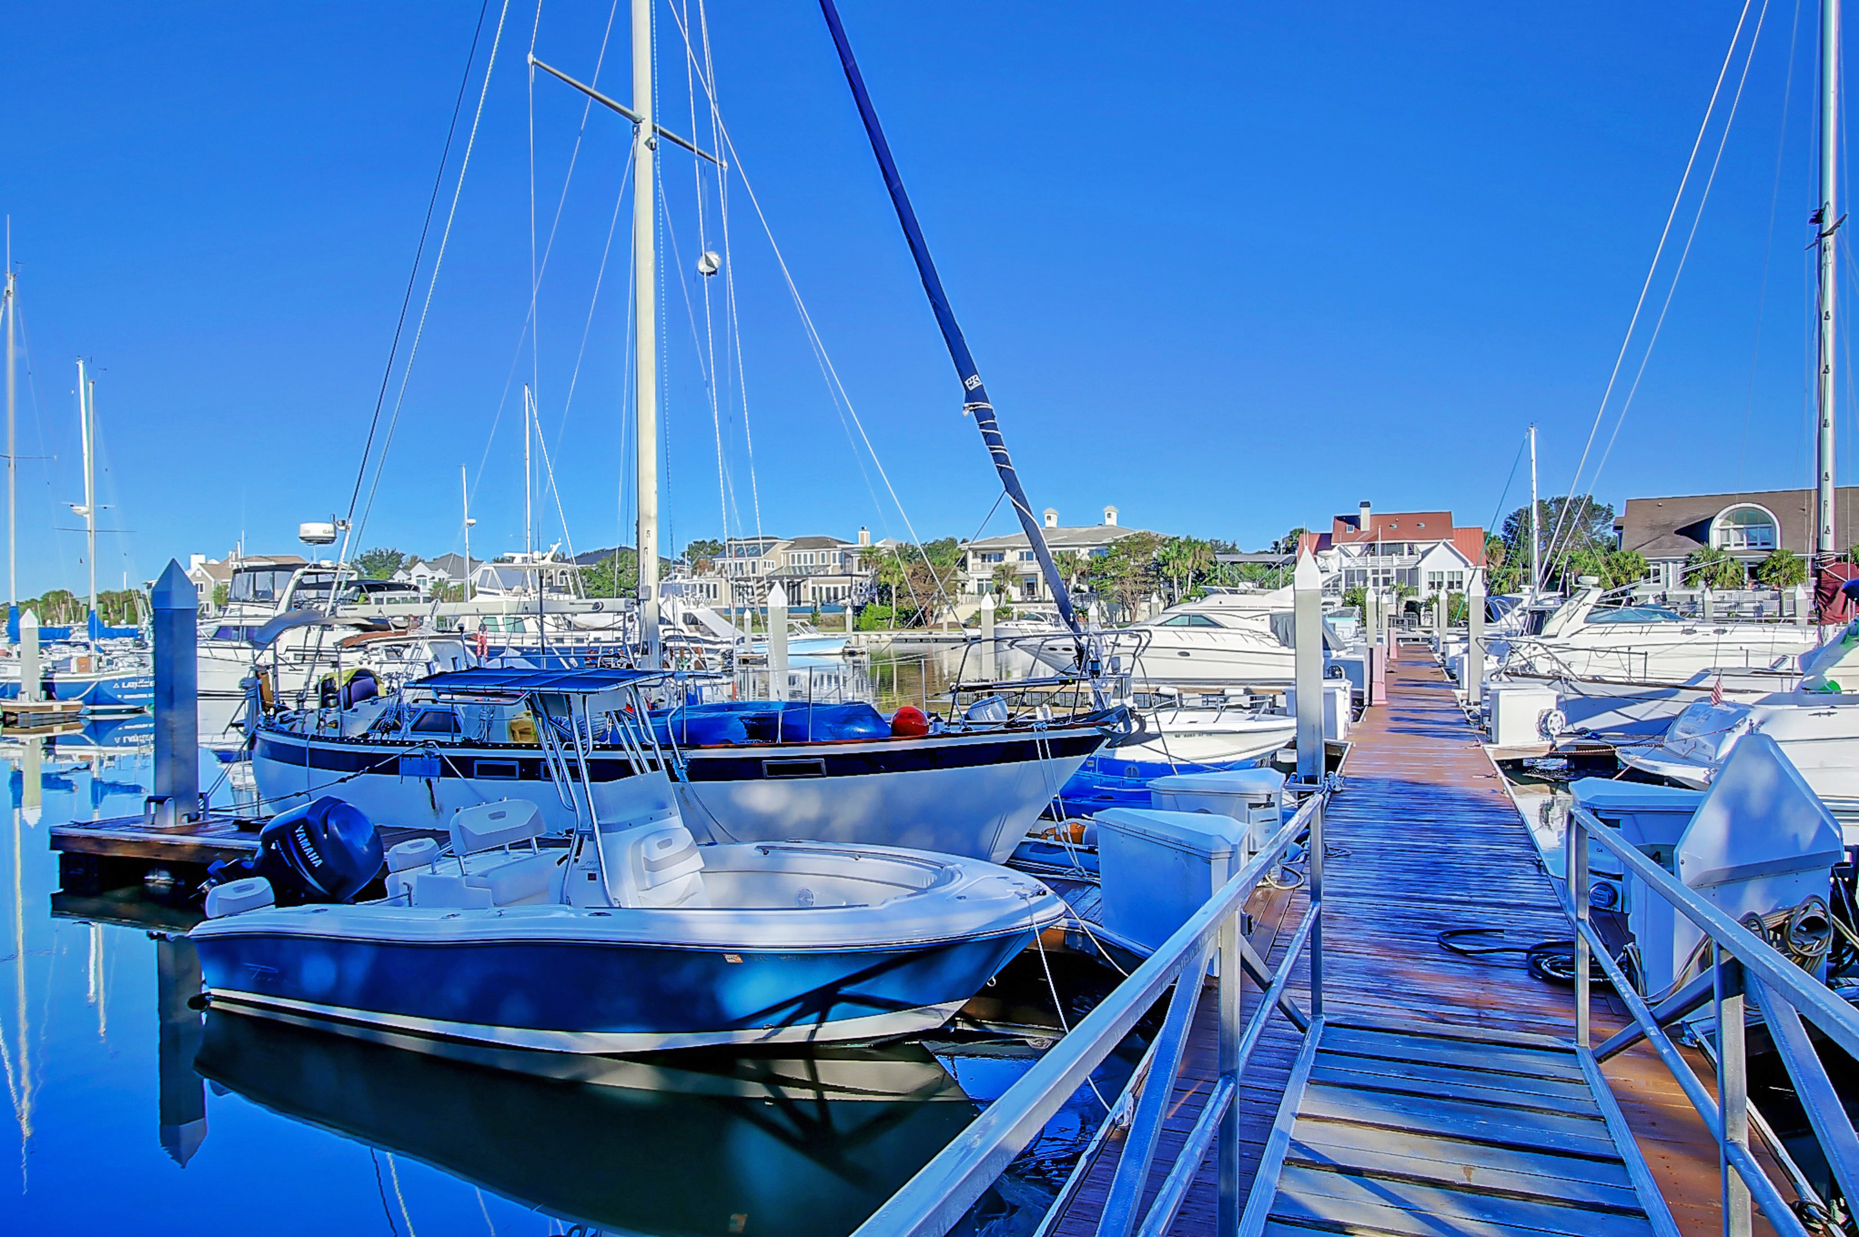


402 Yacht Harbor Court MLS# 16027498 ~ $100,000
Elevator to all levels
Lot Elevation is AE 13
Viwinco Hurricane rated windows
Raised seam metal roof
Water faucets on front, rear, and screened porches!
(No reason for dead flowers!)
Paver Patio
Garage is up fitted with additional electrical for golf cart charge or workshop
Custom heavy duty garage door, Custom Mahogany finished
Exterior door from inside garage to rear living area and paver patio
Hot/Cold Outdoor Shower
Spray foam insulation in attic ceiling
Multi zoned HVAC
10'Ceilings
Custom Rosewood Cabinetry in kitchen with 2 Corner lazy Suzanne's to maximize use of space, soft close drawers, pull outs
GE Profile Kitchen Appliances that include:
-Microwave/Convection Oven
-Wall oven
-Refrigerator
-Trash Compactor
-Dishwasher
Deep Sinks
Garbage Disposal
Custom Built closets throughout all bedrooms, linen and laundry
Granite in kitchen and all baths
Custom tile in all bathrooms and entry and oak wood floors throughout
Master bath elegant oval soaking tub with wand for body rinse
Oversized shower with wide glassed door entrance
Dual vanity with cosmetic seating area
Additional cabinetry
Separate commode area
Main level Bedroom/Office with window seat with storage
and attached bath.
Pocket doors maximize wall space.
Front entry door is custom Mahogany
Boat slips are available for lease and purchase Morgan's Creek Marina
Fractional Ownership ¼ Share ~ 13 weeks/year
What? "Fractional Ownership?" It works like this: 2 weeks at a time with rotation about each 2 months. 1/4 Share equals 13 weeks yearly! Taxes, Insurances, Housekeeping and Maintenance are included in Regime quarterly fee! This is a lovely bright Villa situated in a quiet area of Wild Dunes. The views of the Marina and river are mesmerizing and a short stroll, cart or bike ride takes you to Morgan Creek Marina for FUN and "Good Eats!" Inside, this well appointed 2 Bedroom, 2 Bath, with Fireplace, offers an open floor plan, volume ceilings and tropical flair. Wild Dunes amenities including the Beach House, are all available to you as well as that special feeling of life on an Island...Isle of Palms! Fees are paid quarterly.
$10,000 Bonus!
Listed by
Bill Donovan 843-991-0146 donovans@carolinaone.com
Renee Meyer Mobile - (843) 991-0007
renee@carolinaoneplus.com
www.CharlestonHomesHotline.com
Carolina One Real Estate
1503 Palm Blvd
Isle of Palms, SC 29451

