Slide 1
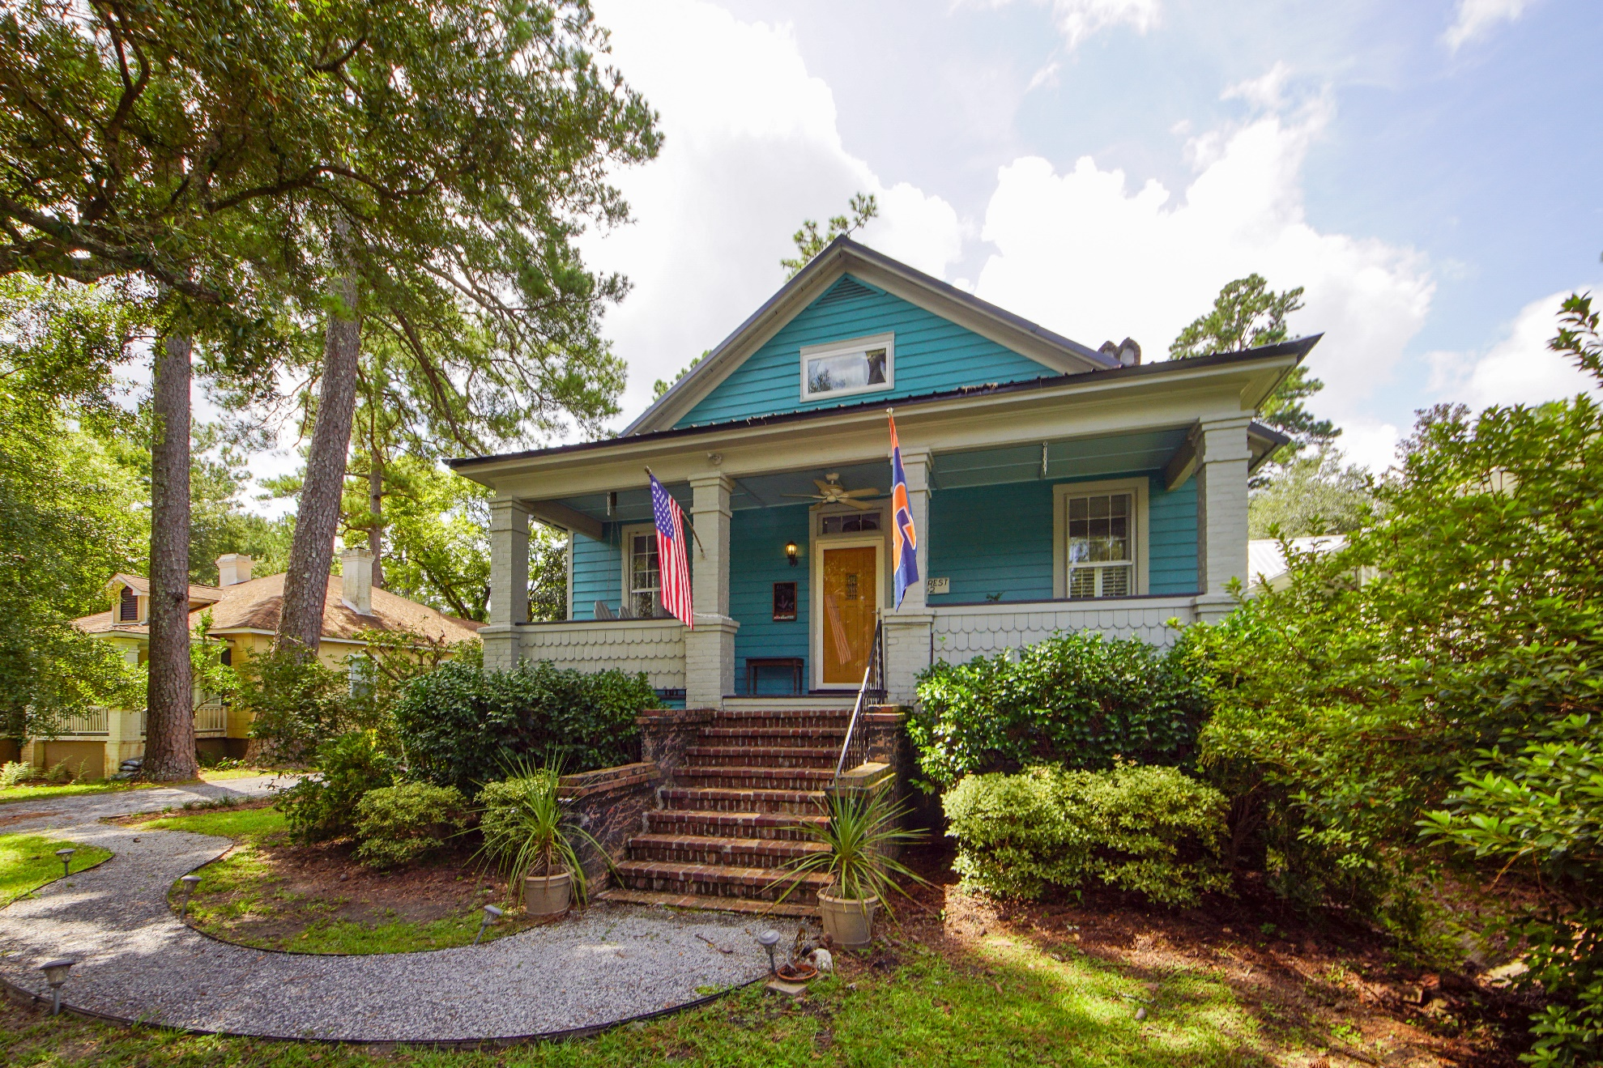
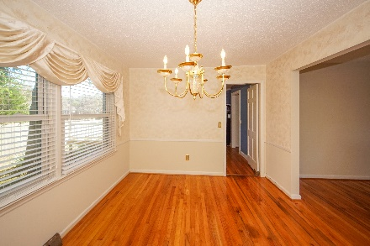
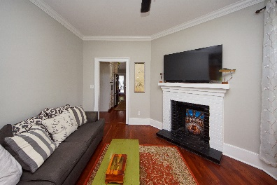
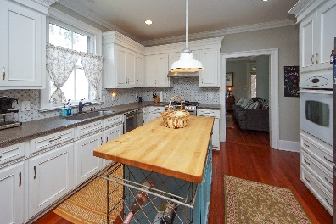
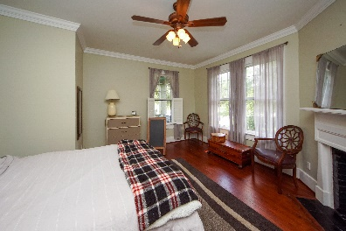
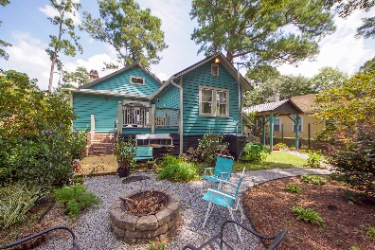
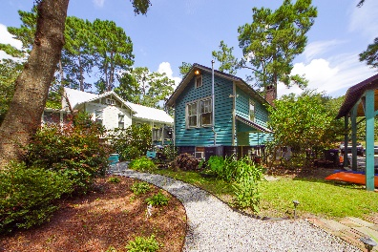


402 W Doty Avenue Historic District :: Summerville MLS# 21023401 :: $460,000
Summerville Cottage
In the Historic District
WOW!
This is a rare find! Pine Rest Cottage is available for purchase. Built in approximately 1910, this southern charmer features original heart pine floors, 9' smooth ceilings on the main floor, crown molding, tall windows and 2 fireplaces. Deep rocking chair front porch, fish scale accents, raised rear deck and extensively landscaped yard set the stage for this lovely home. Brick fireplaces are located in the family room & master bedroom. Kitchen features center island, gas range, solid surface counters & large single bowl sink. Full view French doors off the eat-in area came from an old Charleston home. Hardwood staircase, chair rails trim over bead board accents, haint blue ceiling at front porch. Pure southern charm! Master suite offers walk-in closet plus separate handing closet, updated bath with dual sinks, tiled walk-in shower and built-in linen closet. Bedroom #2 located in the rear of the home. This lovely space offers a window seat overlooking rear yard and built-in cabinets with display shelves flanking both sides. Hall bath located on the first floor features a tub/shower combination & pedestal sink. Laundry area is located on the main floor for convenience. Hardwood staircase leads to finished space currently used as a 3rd bedroom with a half bath. Raised rear deck, 2 detached storage sheds (one used for gardening shed), small basement area with workbench and portable air conditioning unit, detached 1 car carport. Exterior of home is highlighted with raised brick foundation, fish scale accents, metal roof and 2 chimneys. Love to garden? This yard is filled with mature trees, flowering shrubs, gravel pathways - perfect for outdoor entertaining! Walk to restaurants, shopping, parades, plays at the Flowertown Historic Theater and more. This location is truly in the heart of Summerville.
Come take a virtual tour: https://charlestonvirtualhomes.com/ 2210355
Connie White, Broker
843-532-3356
connie@chrepros.com · conniewhiterealestate.com
Charleston Homes · 597 Old Mt. Holly Road · Suite 301 · Goose Creek, SC 29445

