Slide 1
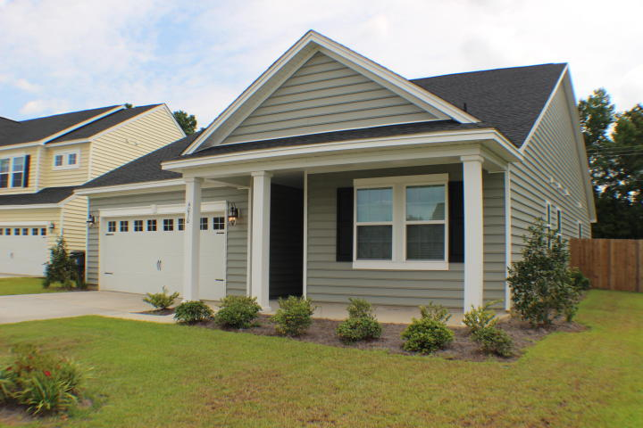
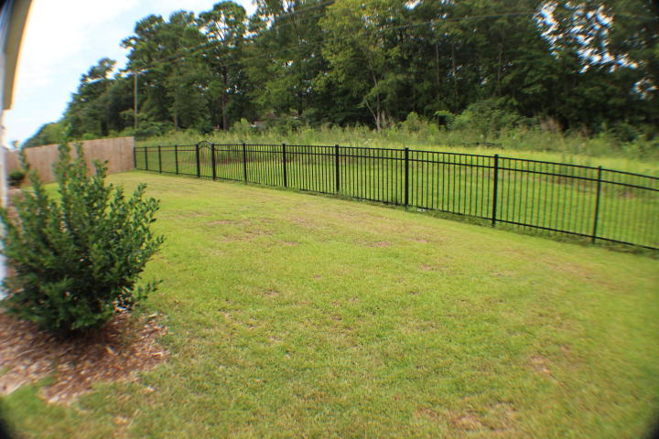
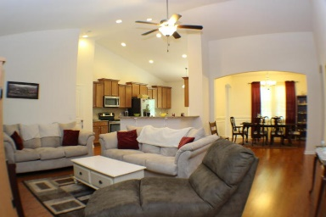
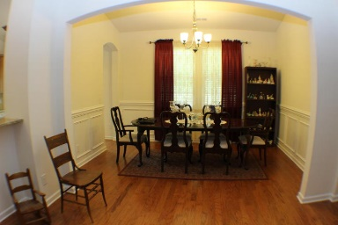
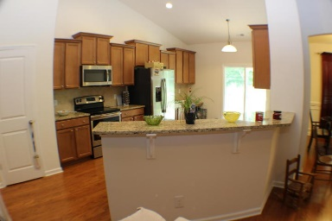
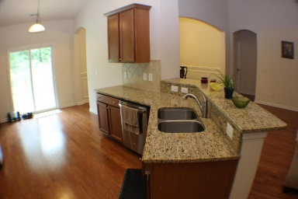
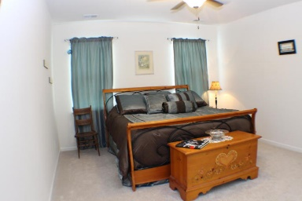
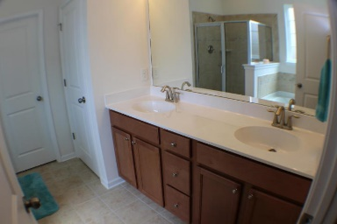
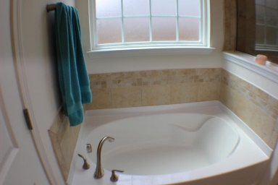
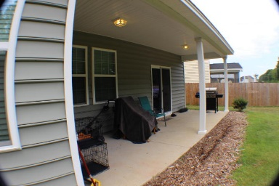


4030 Exploration Road Hunters Bend ~ Ladson, SC 29456 ~ MLS# 16020719 ~ $219,000
Motivated Seller
~ Very Popular Floorplan, Only 1 Year Old ~
The top selling Jarvis plan by Lennar. This wonderful, open floor plan is only one year old! Save time and money!
Great room with vaulted ceiling is warm and inviting. Hardwoods, tiled baths and laundry. Spacious Master is in rear separated from the other 2 bedrooms by a full tiled bath! Large walk in closet, dual sinks, garden tub, water closet, and a tiled walk in shower!
Upgraded S/S GE Profile appliance package. Out back is a large covered patio and nice fenced yard.
Christopher McCormick
Office - 843-974-6200
Cell - 843-224-3204
cjmccormick@carolinaone.com
Carolina One Real Estate
900 N Main St
Summerville, SC 29483

