Slide 1
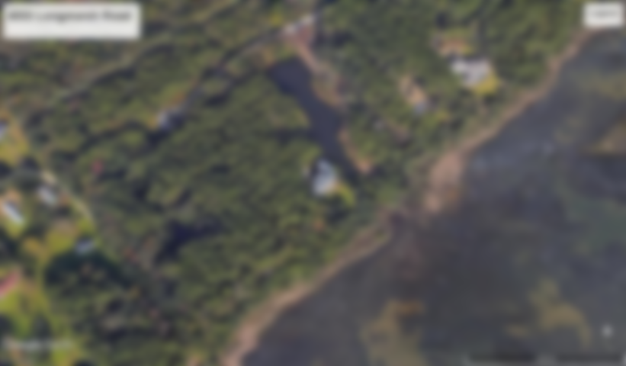
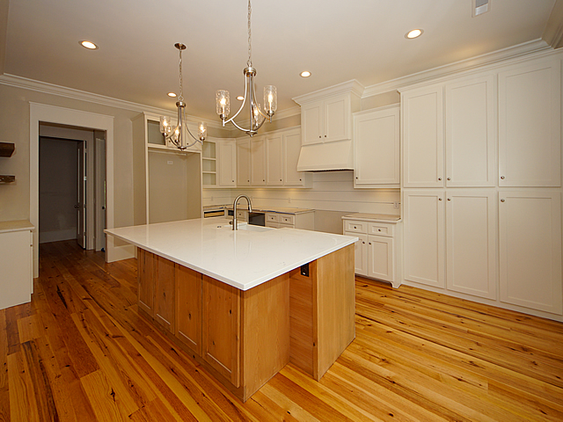
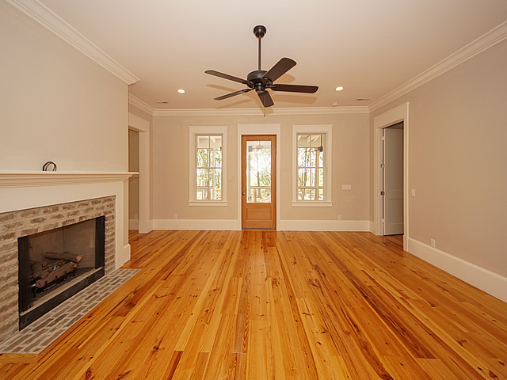
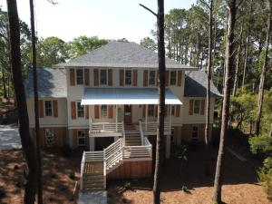
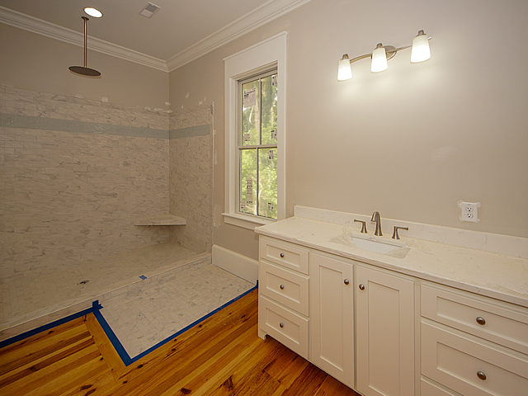
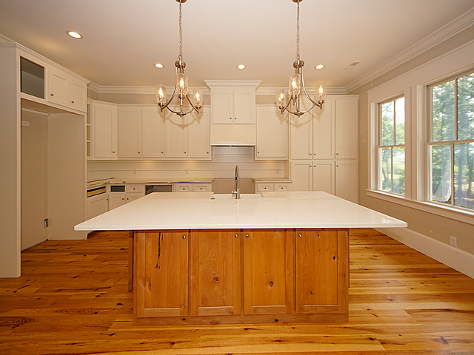
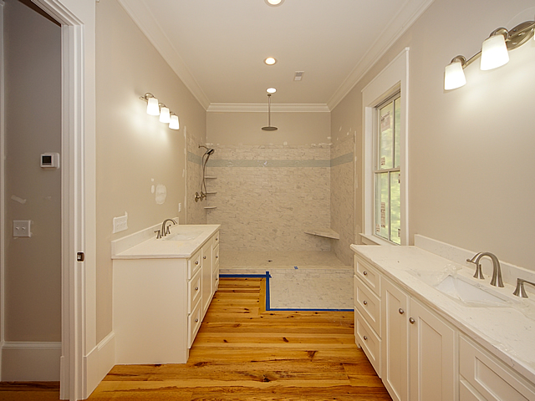
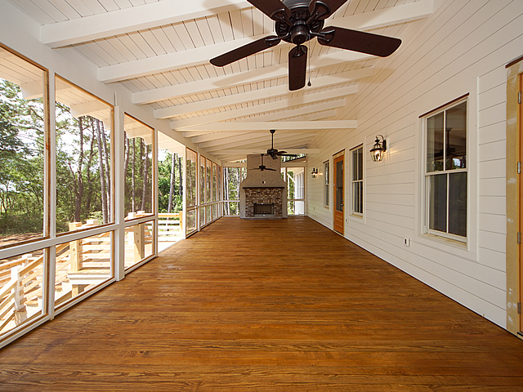
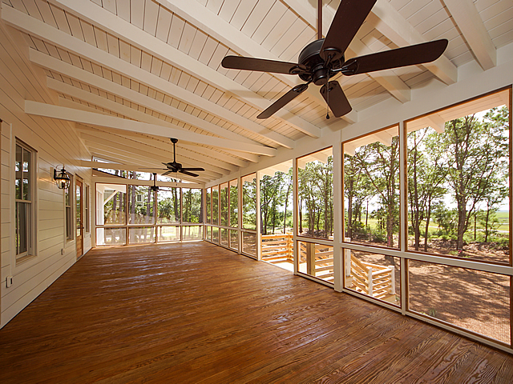

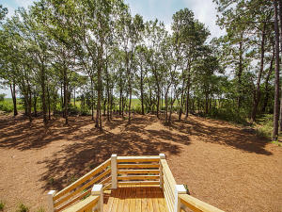
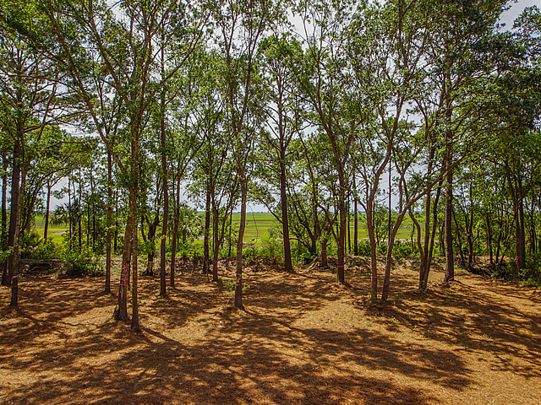
New Construction
4033 Longmarsh Road
Sewee Preserve | Awendaw, SC 29429 | MLS# 19030877 | $1,595,000
Discovered – this hidden jewel of a gated community offers a 30 lot community of large (3+/- acres) waterfront homesites that offer spectacular views of the ICW and Capers Island – the home being constructed on this particular site will be a 4 bedroom, 3.5 bath, 3629 sqft elevated home that will offer all of the bells and whistles of custom construction.
1st floor will offer custom kitchen with upgraded appliance package, large island and granite counter tops, there is a keeping room with gas log fireplace, separate dining room, living room, and master suite – there will be 10 ft ceilings downstairs and 9 ft on the second level -floor coverings will be wide planked wood and tile - the first floor will open onto a huge screened porch with a wood burning fireplace - lots of big windows for lots of light.
2nd floor will have 3 large, secondary bedrooms with generous closet space and a common area. Exterior will be hardi-plank and the elevated construction will allow for lots of parking and storage under the home. Finished product will be a casually elegant home with knock-out views in a great community.
You also will have a 1/30th ownership interest in 400 acres of conservation area, hunting, fishing, horses and a shared community dock which will allow for your boating activities.
Fudgy Brabham
(843) 568-1241
fudgy@hbrtwn.com
www.hbrtwn.com
Harbourtowne Real Estate
672 Marina Drive, Ste 110
Daniel Island, SC 29492
Harbourtowne Real Estate | 672 Marina Drive, Ste 110 | Daniel Island, SC 29492

