Slide 1

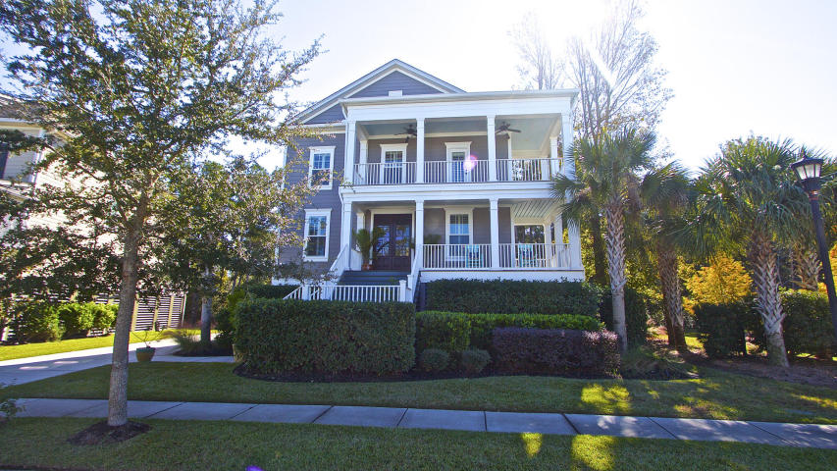
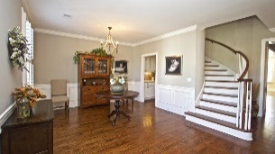
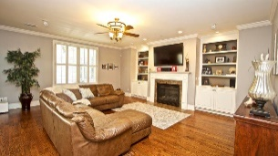
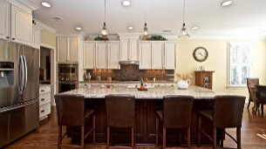
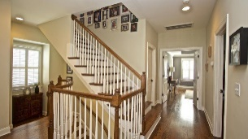
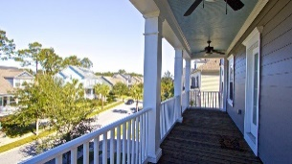

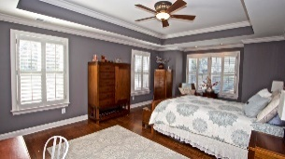
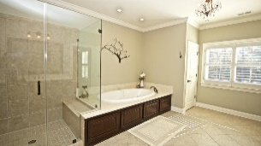

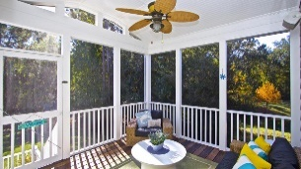
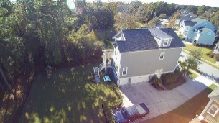



Waverly STUNNER in Hamlin Plantation!
1138 Waterfront Dr
Hidden Lakes ~ Mt Pleasant ~ MLS# 16000069 ~ $765,000
4034 Blackmoor Street
Hamlin Plantation ~ Mount Pleasant, SC 29466
MLS# 17030518 ~ $789,000
WAVERLY STUNNER! This gorgeous, 3 story home in the Waverly section of Hamlin Plantation will capture your heart at first glance. It's situated on a comfortable and private lot next to a large pond and backs up to woods. The elevated construction allows for a 3 car garage and an incredible workshop space on the ground floor. As you enter the foyer on the main floor, you're greeted by a beautiful, curved staircase and hardwood flooring throughout. The main floor has a very functional and open floor plan with huge island in the kitchen and upgrades everywhere. Up one flight of stairs you'll find 3 fantastic guest rooms and a huge Master Suite on the back of the house. Up one more flight of stairs you'll find an incredible bonus room/guest suite, complete with it's own full bathroom!
Mark Macpherson
mark@beachbreak-properties.com
843.367.5640 Mobile

