Slide 1
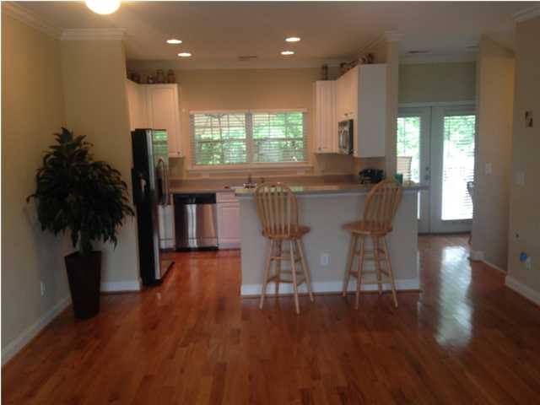
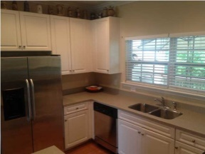
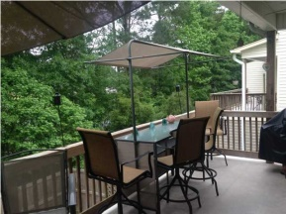
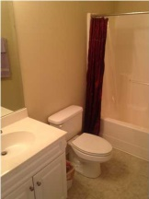
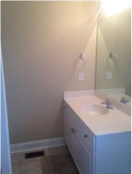
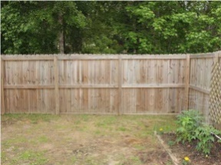
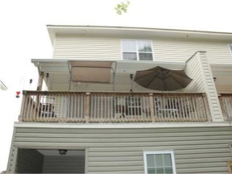

Low Maintenance Lifestyle Awaits
4035 Hartland St | Ashley Park | Charleston | MLS# 1412040
Only $165,000
Lowest HOA fees around!
Welcome home to this better-than-new, low maintenance townhouse. As an END UNIT with the largest lot around, this townhouse is ideally located against a wooded buffer, pond and West Ashley High School. The open, well-designed floor plan features a partially covered DECK overlooking the fenced-in back yard and wooded buffer. The ground floor contains the oversized, 2+ car garage. In the garage, the seller has installed a temporary wall that divides the garage and provides a Bonus room with window unit AC, cable hook-up, and outside access (Man-Room Ready). This can be removed if the Buyer desires. The garage also has a spot with plumbing access for a bathroom to easily be built-out. The home has a gas tankless water heater, electric heat and air, and ceiling fans in the bedrooms and on the deck. The second floor/ main living floor features gleaming wood floors, smooth ceilings, crown molding, open kitchen with solid surface counter tops, recessed lighting, stainless steel appliances, large windows for natural lighting, and raised bar for barstool seating. There is a breakfast table nook, a half bath/ powder room, and access to the entertaining back deck as well. The rear, partially covered deck, with ceiling fans, provides privacy with room for grilling and entertaining. The third floor features dual large master bedrooms, laundry room, and access to the large attic with plentiful floored storage space. Each bedroom has a cable hookup and a private bathroom. The floor plan allows for a great roommate situation. The low quarterly HOA fee covers exterior pressure washing, termite bond, front lawn maintenance, and more. The home also has irrigation sprinkler system on the front and side yard. This low maintenance, meticulously maintained, beautiful townhouse can be yours today.
Scott Baskin
843-324-4139 M | 843-972-2400 O scott@davidwertan.com | www.scottbaskin.com
RE/MAX Advanced Realty
311 Johnnie Dodds Blvd
Mt Pleasant, SC 29464

