Slide 1
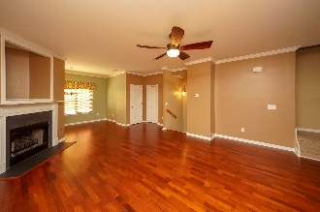
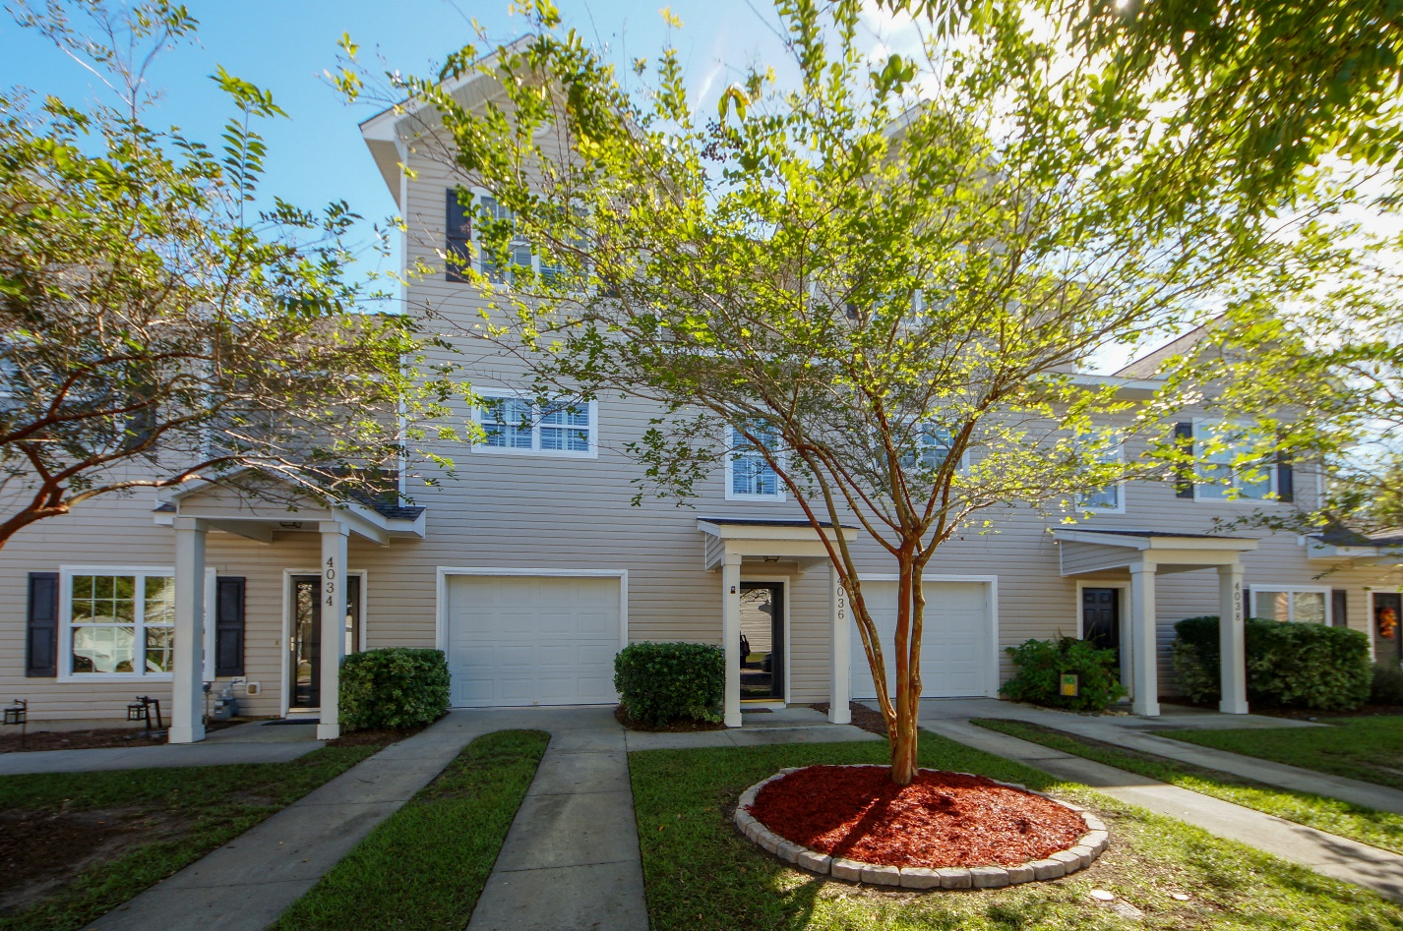
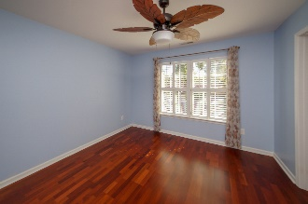
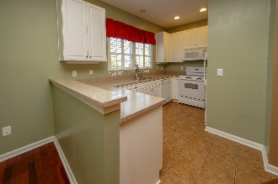
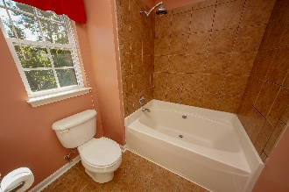
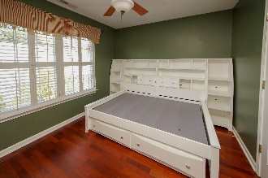
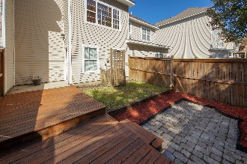
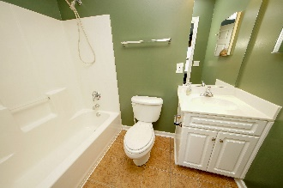
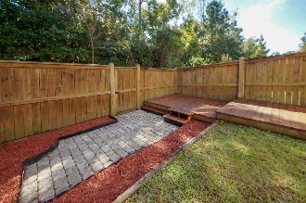
$200,000 ~ Walking Distance To Schools, Dog Park, Restaurants & More!
4036 Babbitt Street
Ashley Park | Charleston, SC 29414 | MLS# 18030130 | $200,000
Trundle bed/dresser set conveys! Tons of upgrades. Public park/dog walking area/trails! PRIVATE LOT! Hospitals, shopping, Walmart, etc. , 1-2 minutes minute away! Hardwoods upstairs and down! Real Plantation blinds throughout. Tiled shower & rainfall shower head, Zen garden deck installed to enjoy the fenced in back yard. Gas fireplace in great room. All the window treatments convey. No expense spared, take advantage of these expensive upgrades! Huge 2 car garage with storage closet. Dual master bedrooms with large closets. HOA is extremely reasonable at $175 quarter. HOA fee includes front yard maintenance, common area maintenance, building insurance, termite bond and HOA scheduled pressure washing. Property was high and dry in all hurricanes, tropical storms,1000 yr flood.
Johnny Crosby
jcrosby@propertyadvisorsinc.com | 843-270-9407 | www.charlestonhomeproviders.com
Brand Name Real Estate | 4 Carriage Lane, Suite 106 | Charleston, SC 29407

