Slide 1
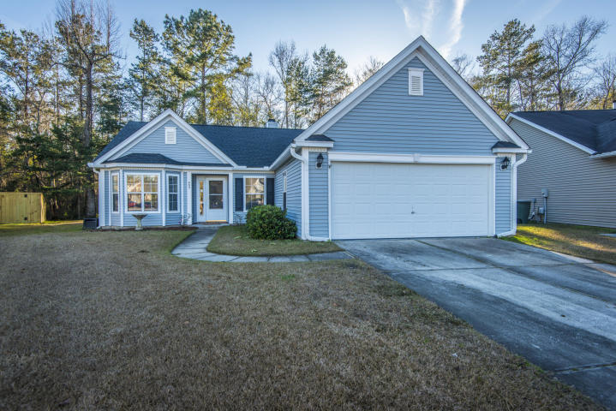
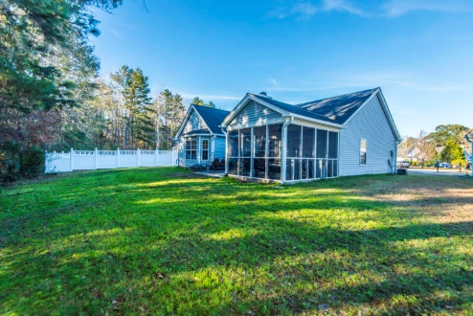
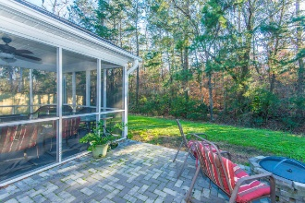
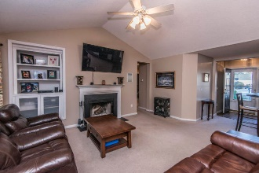
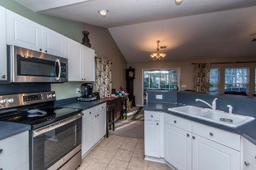
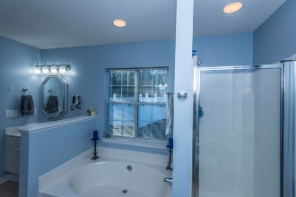
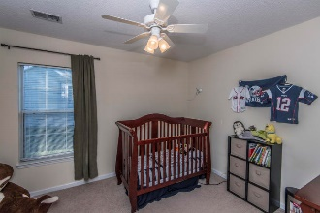
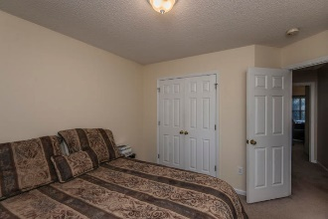
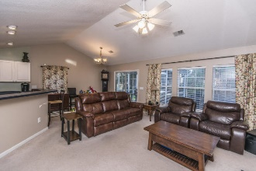
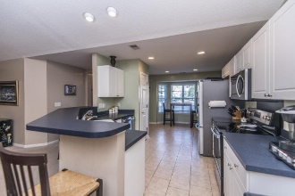
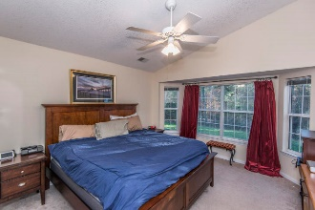
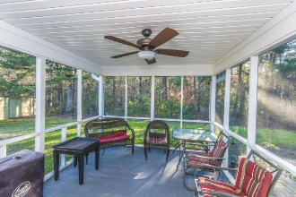

403 Manorwood Lane
Grand Oaks Plantation ~ Charleston
MLS# 19000975 ~ $273,500
Open House Saturday, Feb. 2 12-3 pm
NO FLOOD INSURANCE! Privacy with rear wooded easement (plat map in photos)at the end of cul du sac Lot extends past wood line to berm. Pretty bay windows in kitchen and master. Master en suite with soaker tub and shower. Seller offering carpet/flooring allowance with acceptable offer. Improvements include new roof 2015, tile floor in bathrooms and kitchen 2017, Ac / furnace compressor (outside and attic unit) 2017, Custom media cabinet in living room 2018 so tv wiring runs behind wall, glass top oven, microwave, dishwasher 2017, paver patio 2014, custom closet in secondary bedroom 2017, custom pantry in kitchen 2017.
Mary Warren
ABR, RSPS, REALTOR
Mobile - (843) 224-6272
mwarren@carolinaoneplus.com
Carolina One Real Estate | 1265 Folly Rd | Charleston, SC 29412

