Slide 1
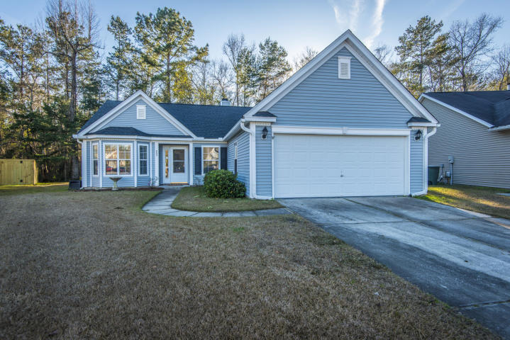
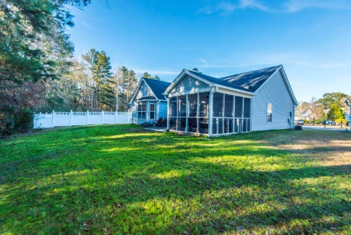
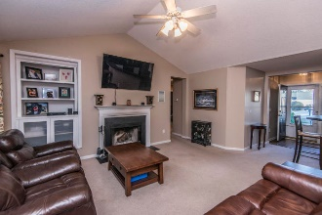
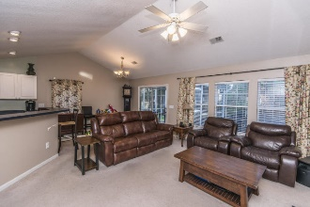
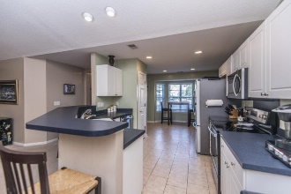
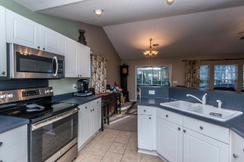
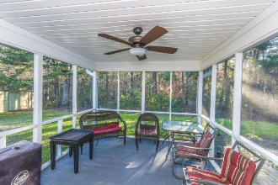
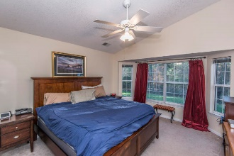
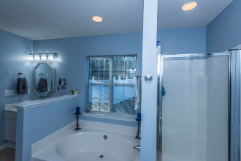
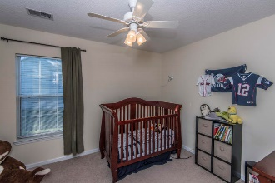
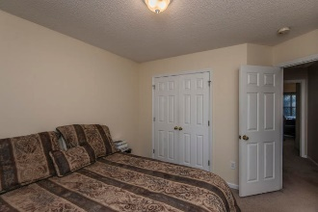
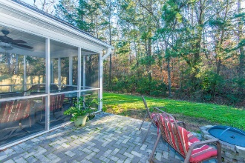

403 Manorwood Lane
Grand Oaks Plantation ~ Charleston
MLS# 19000975 ~ $278,000
Bring Your Offer...
Ocean Views looking down 49th Ave
Great Rental Potential!
Ideal location at the end of cul du sac with rear wooded easement (plat map in photos). Bay windows in kitchen and master. Improvements include new roof 2015, tile bathrooms and kitchen 2017, Ac / furnace compressor (outside and attic unit) 2017, Custom media cabinet in living room 2018 so tv wiring runs behind wall, glass top oven, microwave, dishwasher 2017, paver patio 2014, custom closet in secondary bedroom 2017, custom pantry in kitchen 2017.
Mary Warren
ABR, RSPS, REALTOR
Mobile - (843) 224-6272
mwarren@carolinaoneplus.com
Carolina One Real Estate | 1265 Folly Rd | Charleston, SC 29412

