Slide 1
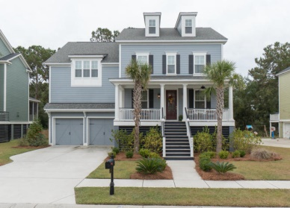
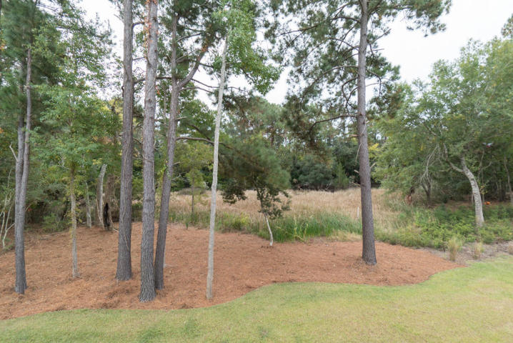
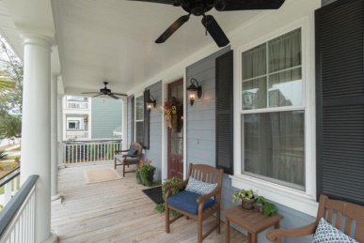
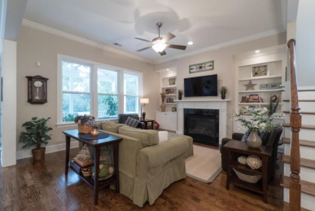
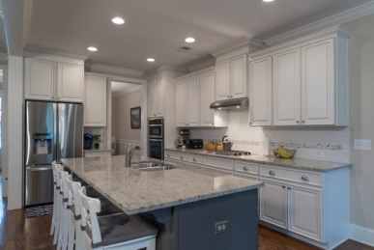
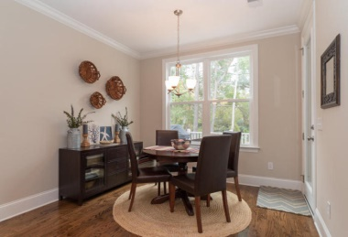
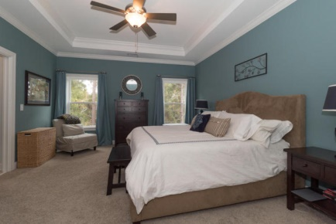
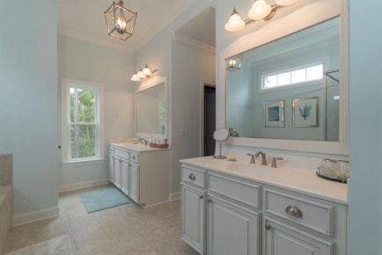
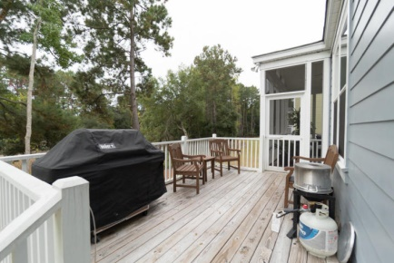





Better than new…
Nice Marsh Lot in Hamlin Plantation
4046 Blackmoor St
MLS# 14029041
This new construction customized home was bought by the owner in 2013. It looks LIKE NEW and is absolutely move-in ready. The full front porch has copper lights and a nice view of the neighborhood. Just inside, a study and formal dining room are off the foyer. The gorgeous custom kitchen is open to the living room and adjoining breakfast area. All face the backyard for privacy and great views. The living room features a fireplace and built in shelves. There is a bedroom with full bath on the first floor. The second floor features four bedrooms, including the master suite, along with three full bathrooms.
The master suite is complete with trey ceiling, his and hers closets, dual vanities and separate shower and garden tub. Also on the second floor is a large media/entertainment room looking over the back of the property. Finally, the third floor has a full bath and office or sixth bedroom.
The back of the house has a custom deck and screened porch off of the main living area.
www.myhamlinplantation.com for amenities and HOA documents.
''Special financing incentives available on this property from SIRVA's preferred lender.''--see flyer.
$645,000
6 Bedrooms
5 Full Baths
Waverly Section
Elevated Home
3 Story
Cement Plank Exterior
Built in 2013
3,523 SqFt
2 Car Garage
Debora Schuyler
Broker Associate, Broker, ABR,CIAS,GRI
Office Phone: (843) 323-7043
Cell Phone: (843) 323-7043
Fax: (843) 266-8066
debbieschuyler@gmail.com
www.desirablecharlestonhomes.com
Coldwell Banker United, REALTORS

