Slide 1
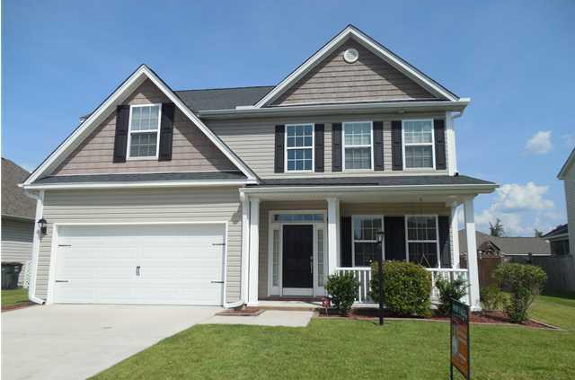
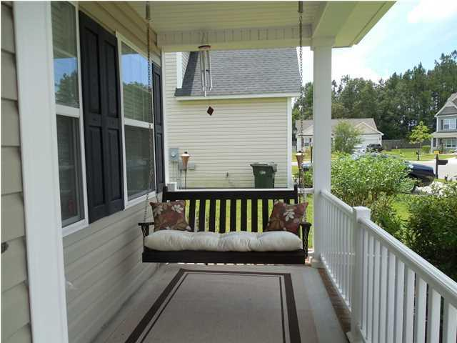
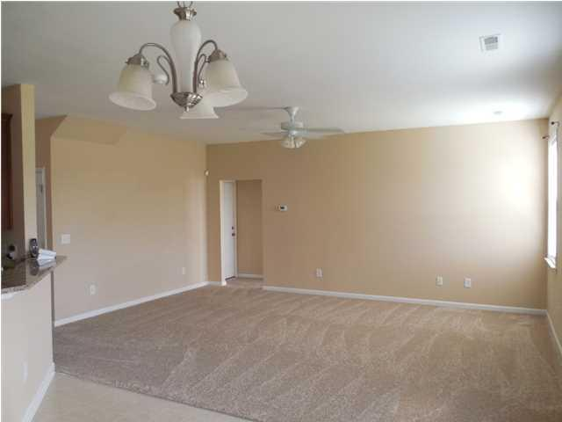
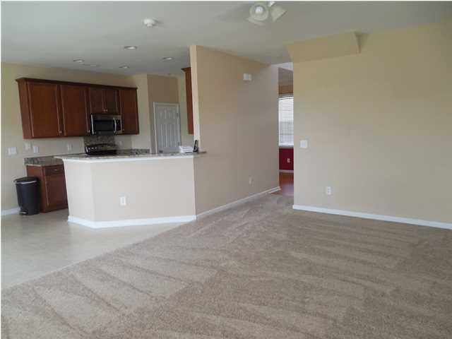
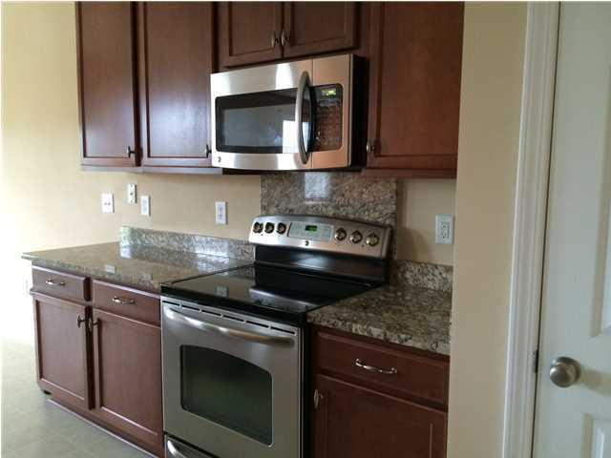
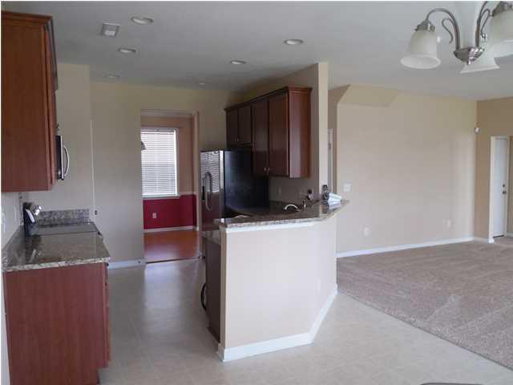
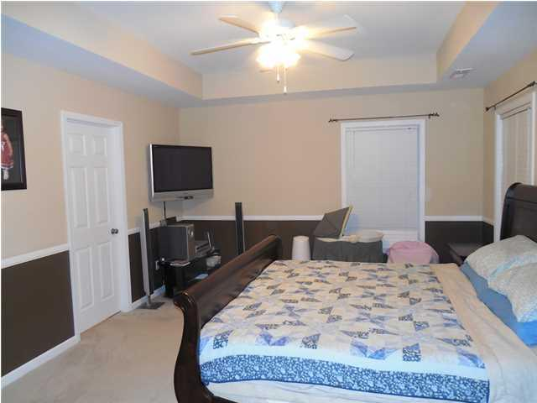
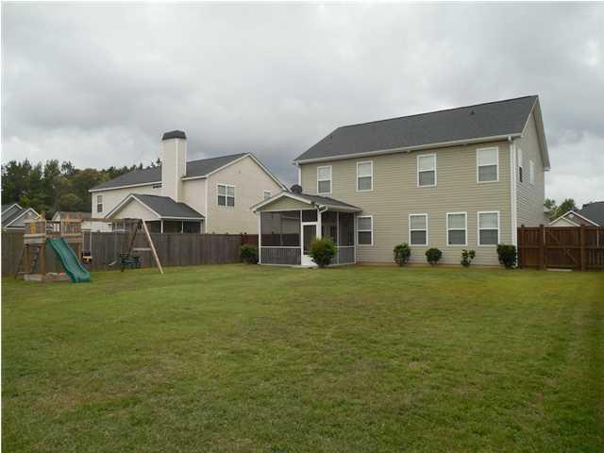
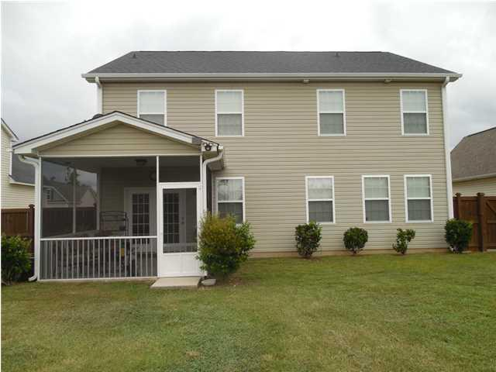

404 Brawley Dr
Cokers Crossing
Goose Creek, SC
MLS# 1420875
$209,999
4 Bedrooms | 3 Baths | 2,305 sf
Open House Lunch ~ Friday, Oct 3 from 11 - 1
Handyman Special… Bring your hard hats!
Best Home in Goose Creek!
New Price Improvement! Best deal in town! Why wait to build when you can move in immediately? Perfect family home with PLENTY of room! Spacious open floor plan that is nice and bright inside. The large family room is a comfortable gathering spot for the family. The huge Master bedroom plus two extra bedrooms are on the second floor. The 4th bedroom/flex space is downstairs. Three full baths!! The beautiful kitchen features granite countertops and stainless appliances, lots of counter space, and a pantry. The upgraded range has a warming drawer. The refrigerator conveys with the home. There is a separate dining room and a breakfast area off the kitchen which leads to a screened-in porch. The backyard is HUGE, fenced in, and overlooks the pond. A great playset for the kids conveys. It's obvious the home has been lovingly cared for and maintained. Sellers hate to leave! Two car garage, great neighbors, pretty neighborhood, a ''forever'' type home. Don't miss it! Seller can close immediately or at your convenience before the end of the year. Perfect location for Boeing, Naval Weapons Station, and Google employees.
Ann McAnallen
843-906-6701
ann@choicecharlestonhomes.com
www.presentingcharlestonhomes.com
Keller Williams Realty Charleston | 496 Bramson Ct, Ste 200 | Mt. Pleasant, SC 29464

