Slide 1
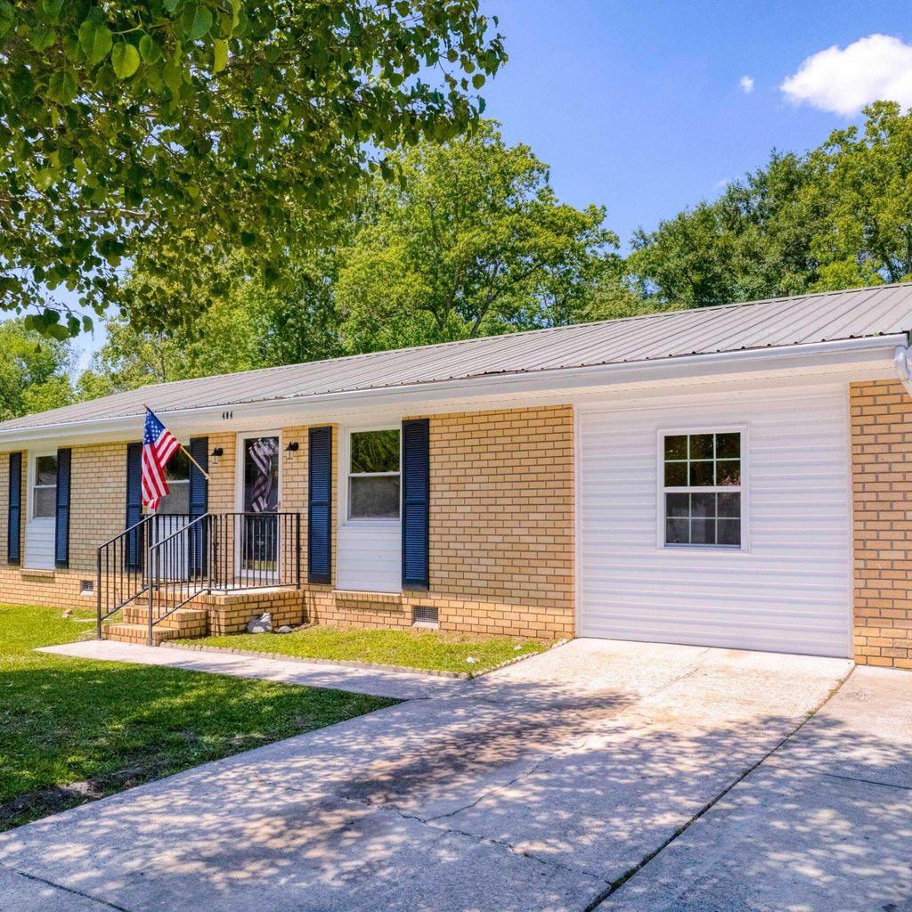
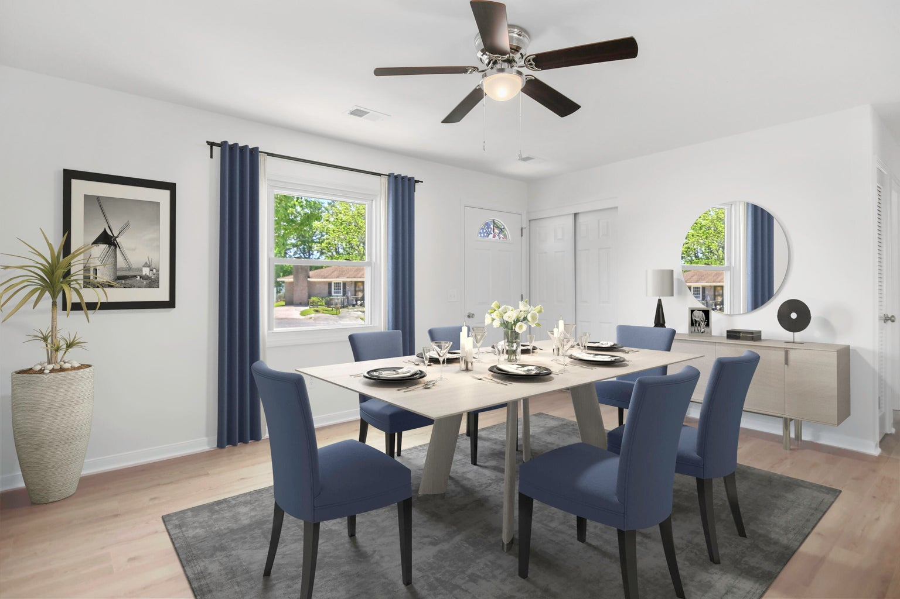
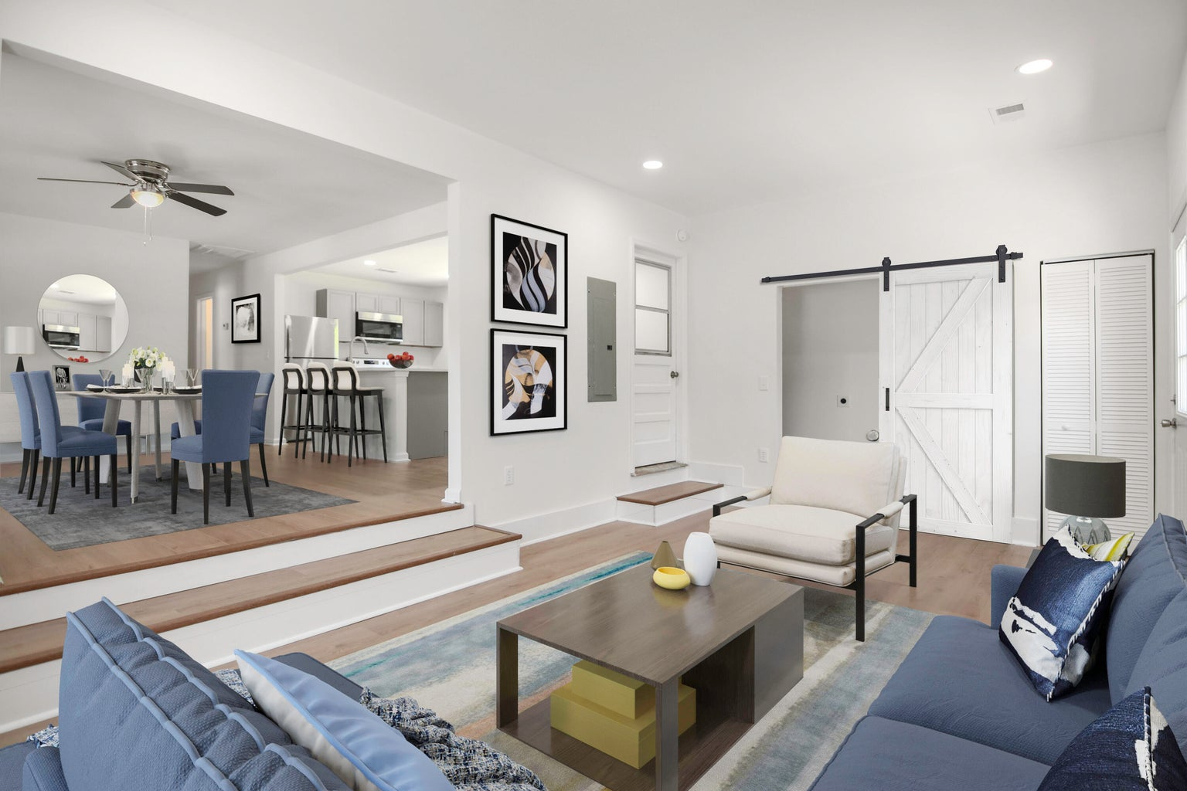
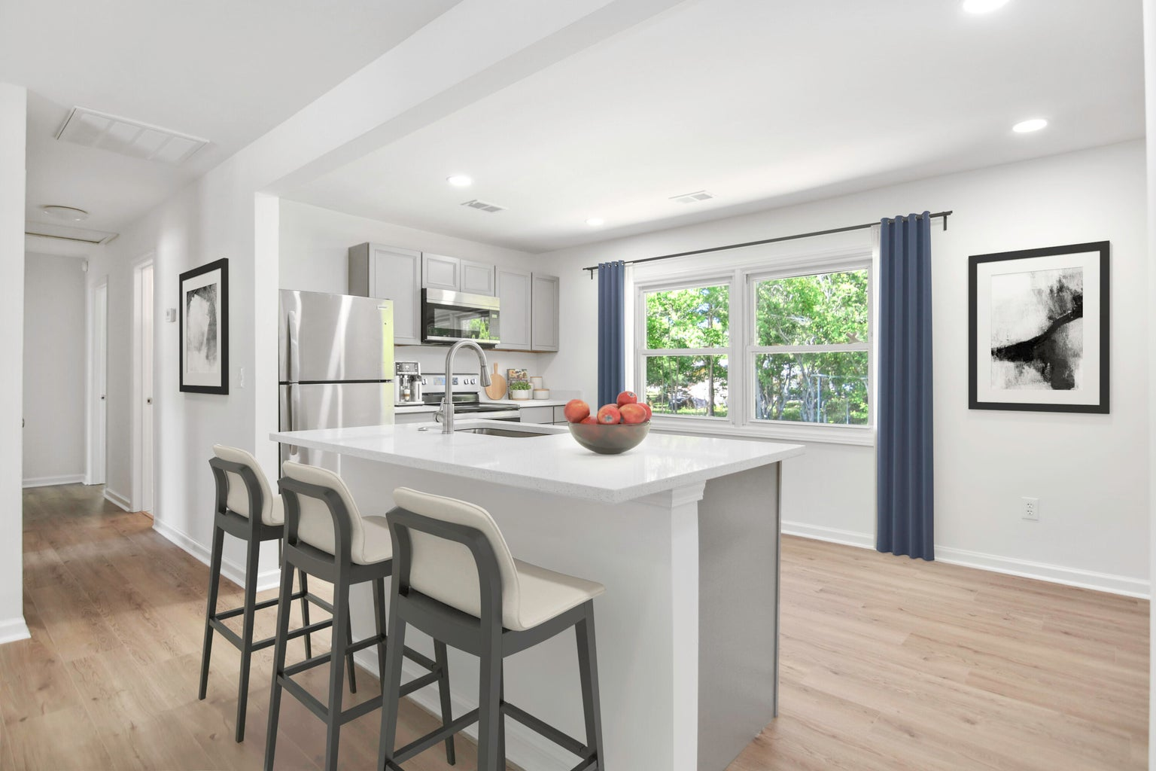




BEAUTIFULLY RENOVATED RANCH ON CUL-DE-SAC
404 Farm Road
Pineview Hills | Goose Creek
MLS# 24010486 | $320,000
This beautifully renovated 1-story ranch with a unique open floor plan offers 3 bedrooms and 2 full baths on a quiet cul-de-sac. The home features an inviting re-designed kitchen with quartz frost white countertops, brand new kitchen appliances and center island seating. Both full bathrooms are also completely re-designed. You will love the large, open step-down area off living/dinirg room with new SLIDING BARN door. FRESHLY painted interior and wood laminate flooring throughout. NEW WATER HEATER & NEW HVAC SYSTEM. The large shed in the backyard is a definite plus for storage! You will notice that living on a cul-de-sac can offer a sense of privacy and safety. Convenient long walking path and park nearby & much more! So kick your feet up and enjoy the peace and serenity of your new home.
Susan Stanley
843-323-5573
susancstanley@gmail.com
1,325 SF
3 BEDS
2 BATH

