Slide 1
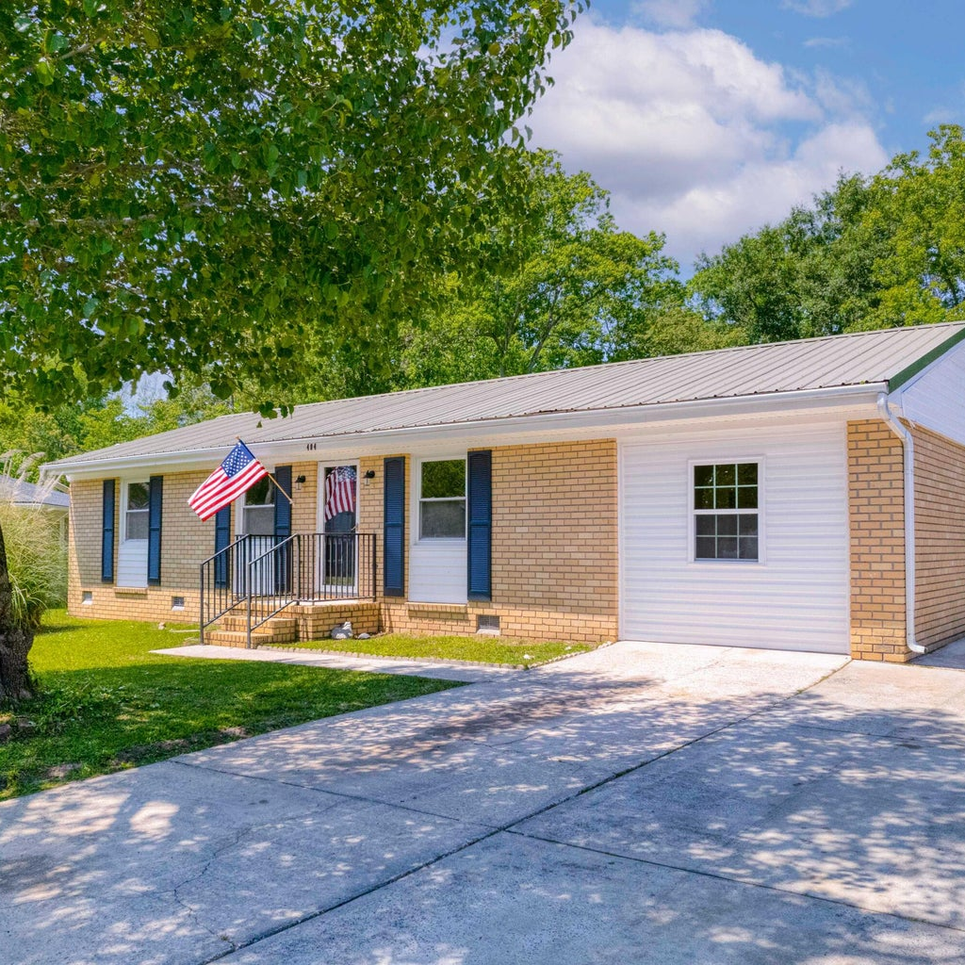
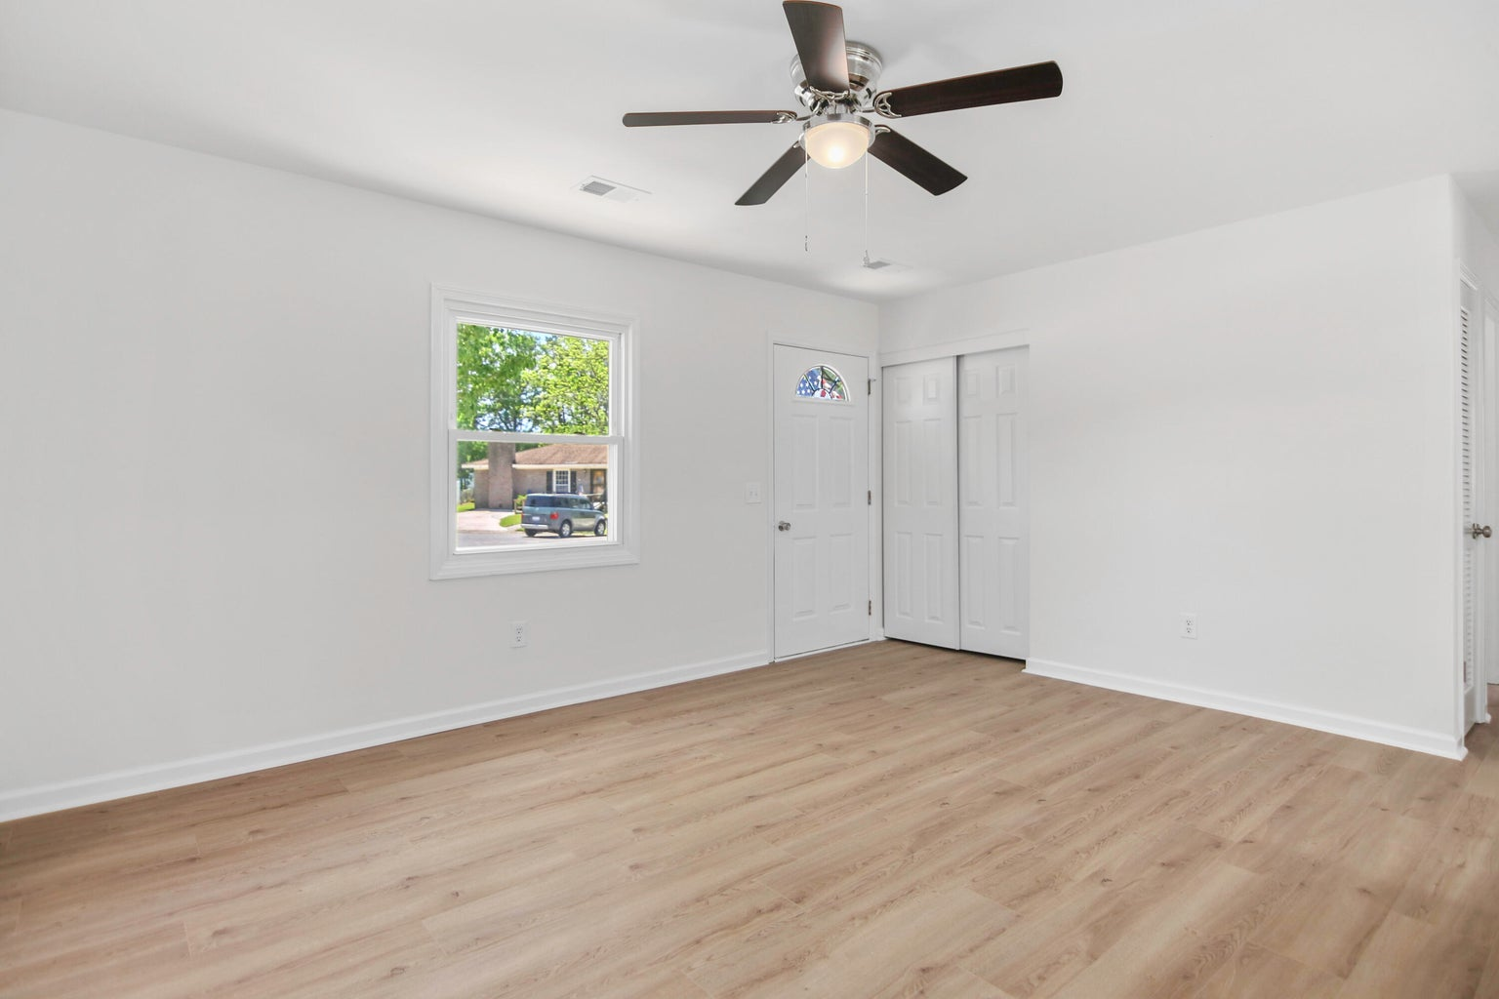
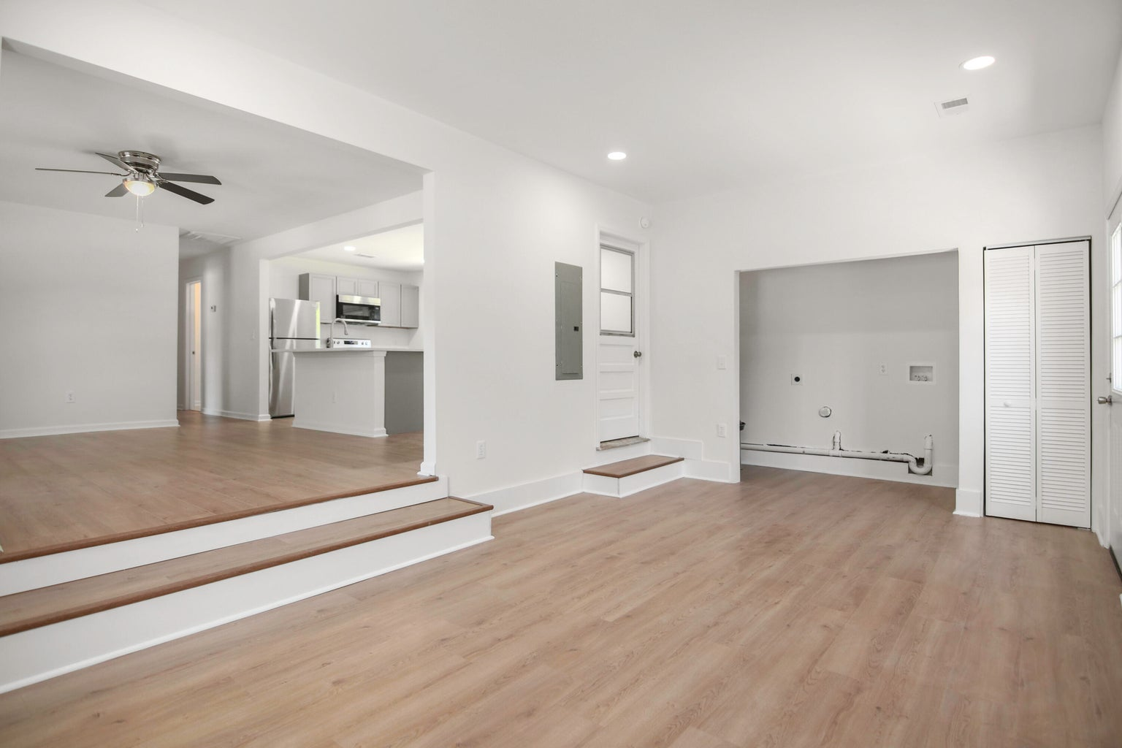
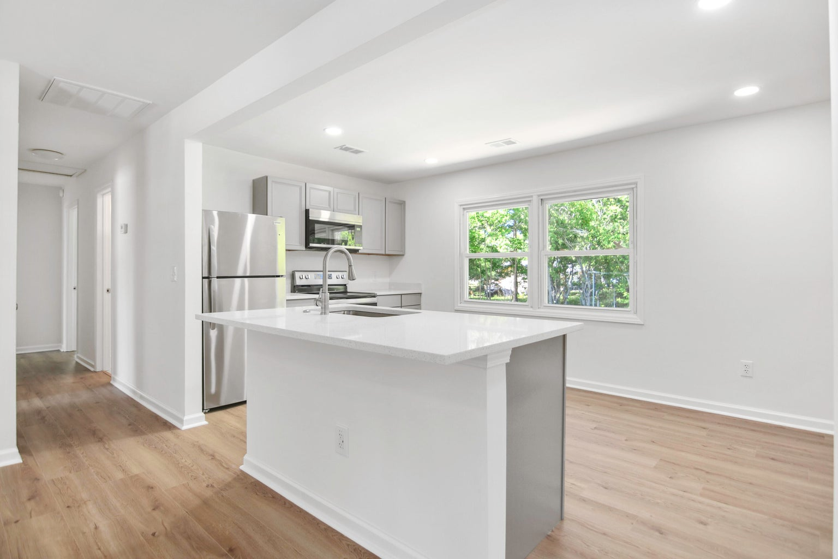
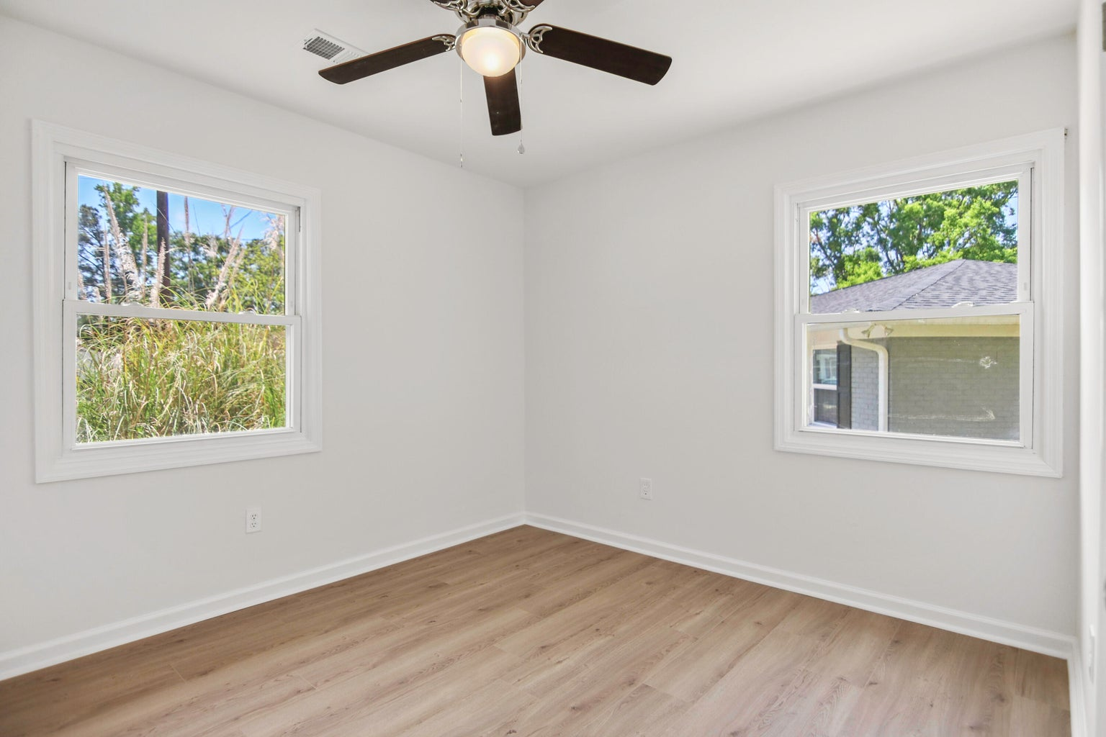




IDEAL STARTER HOME CLOSE TO SOME OF THE BEST PARKS AND PLAYGROUNDS IN BERKELEY COUNTY
404 Farm Road
Pineview Hills | Goose Creek
MLS# 24010486 | $310,000
THE PRICE IS RIGHT ON! Literally steps away from neighborhood walking trails leading to Wannamaker Park! This beautifully renovated 1-story ranch with a unique open floor plan offers 3 bedrooms and 2 full baths on a quiet cul-de-sac. The home features an inviting re-designed kitchen with quartz frost white countertops, brand new kitchen appliances and center island seating. Both full bathrooms are also completely re-designed. You'll love the large, open step-down area off living/dinirg room with new SLIDING BARN door. FRESHLY painted interior & wood laminate flooring throughout. NEW WATER HEATER & NEW HVAC SYSTEM. NO HOA! The large shed in the backyard is a plus. Living on a cul-de-sac can offer a sense of privacy & safety.
Read more about Wannamaker County Park! | Read more about Goose Creek’s Central Park
Susan Stanley
843-323-5573
susancstanley@gmail.com
1,325 SF
3 BEDS
2 BATH

