Slide 1
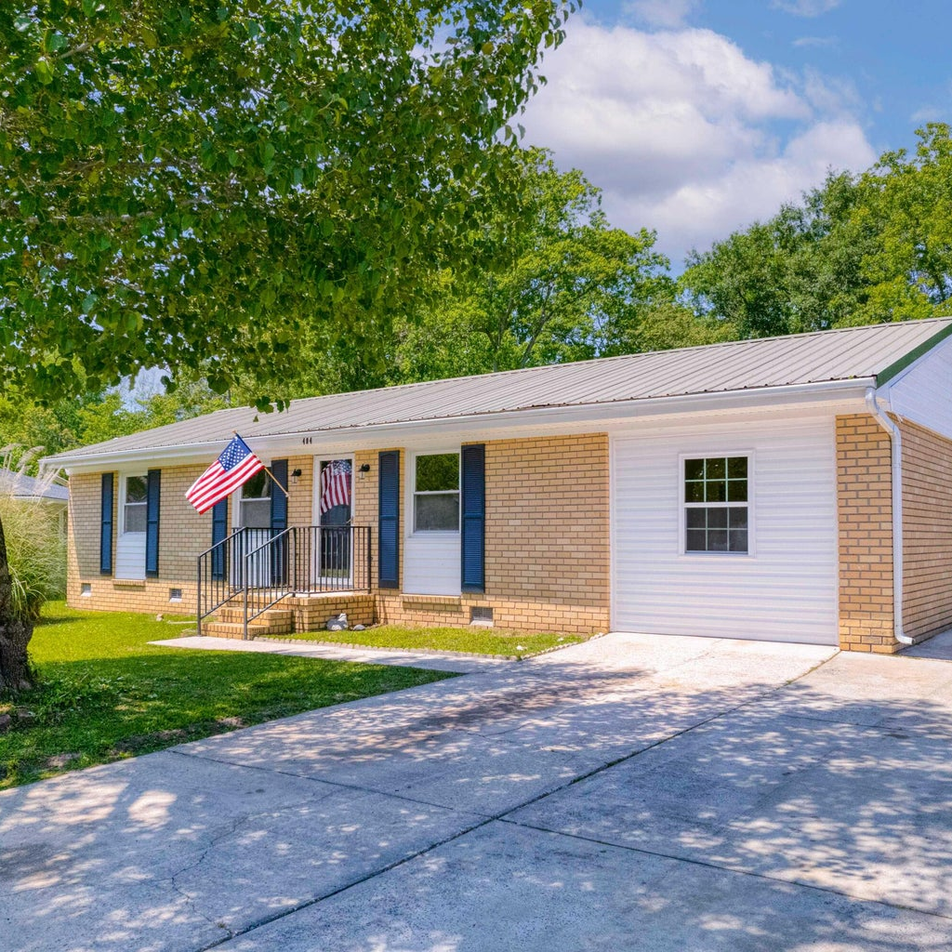
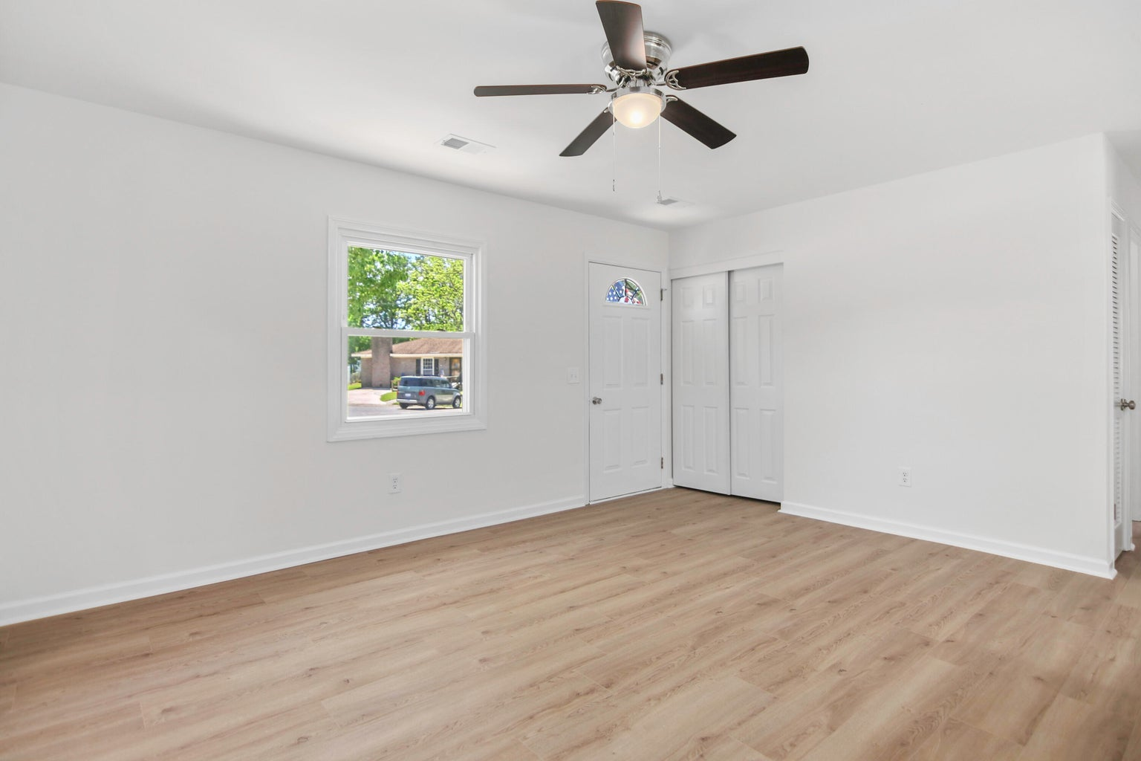
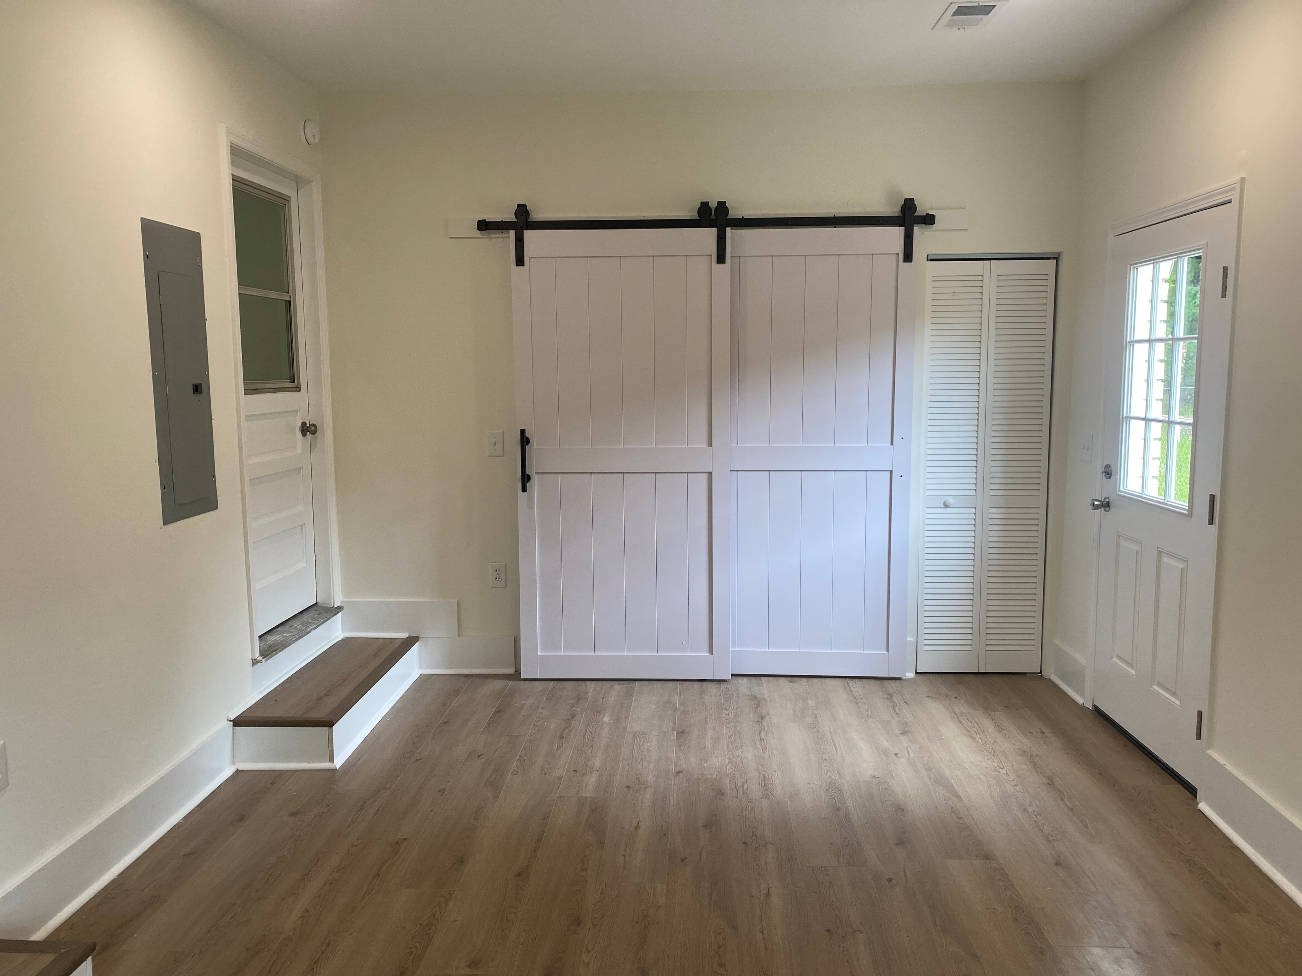
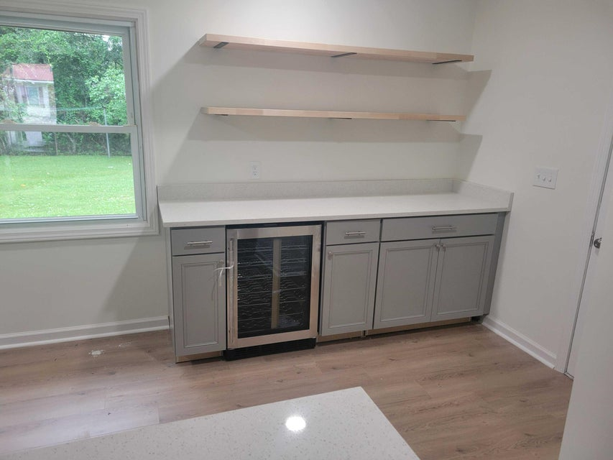
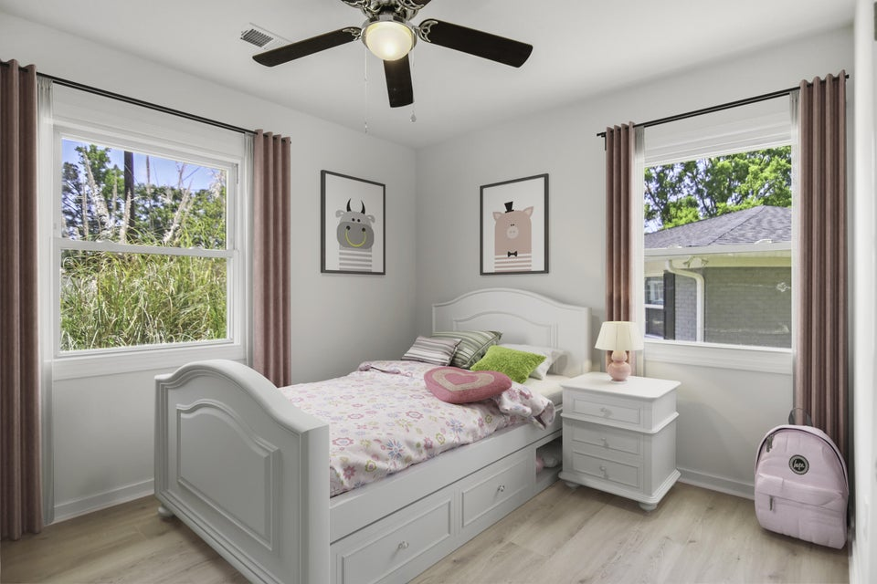




WE INVITE YOU IN TO SEE OUR FRESH NEW LOOK!
404 Farm Road
Pineview Hills | Goose Creek
MLS# 24010486 | $310,000
WE LISTENED TO YOUR SUGGESTIONS & WE ACTED ! New custom enhancements: Additional Kitchen Cabinetry, Wine Refrigerator, Wood Privacy Fencing & much more! This beautifully renovated 1-story ranch with a unique open floor plan offers 3 bedrooms & 2 full baths on a quiet cul-de-sac. The home features an inviting re-designed kitchen with quartz frost white countertops, brand new kitchen appliances & center island seating. Both full bathrooms are also completely re-designed. You'll love the large, open step-down area off living/dining room with new SLIDING BARN door. Freshly painted interior & wood laminate flooring throughout. NEW HVAC, NEW WATER HEATER & NO HOA! Steps from neighborhood walking trails leading to great parks. WE INVITE YOU IN TO SEE OUR FRESH NEW LOOK!
Read more about Wannamaker County Park! | Read more about Goose Creek’s Central Park
Susan Stanley
843-323-5573
susancstanley@gmail.com
1,325 SF
3 BEDS
2 BATH

