Slide 1
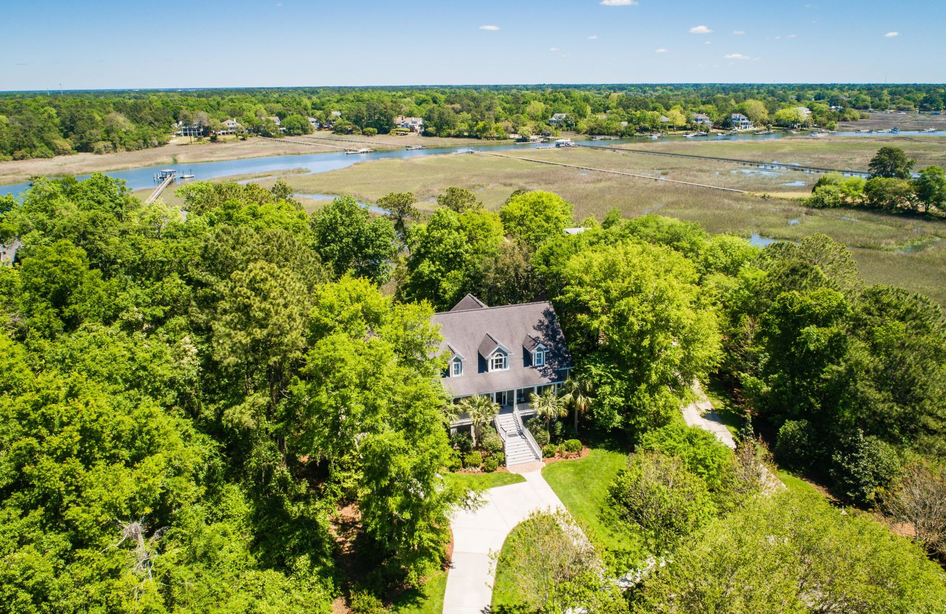
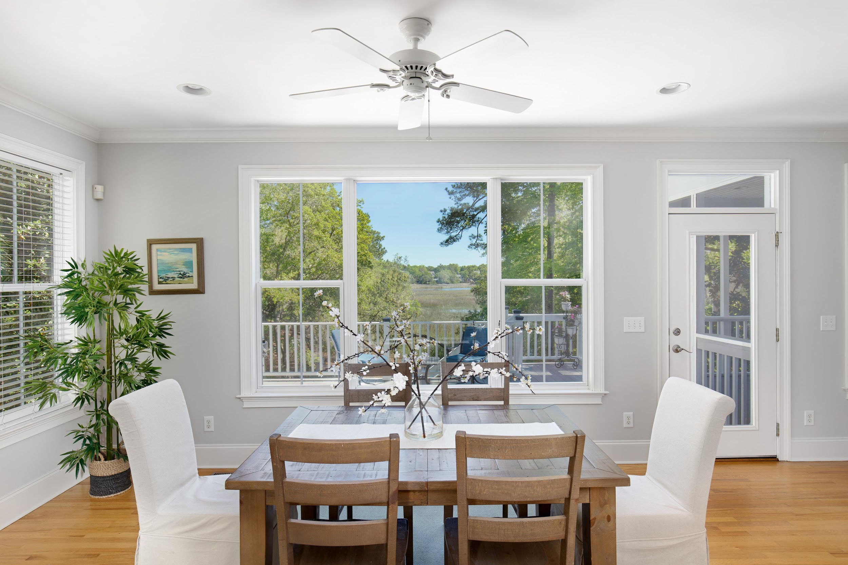
Kay Kennerty, MBA
Zeal, Integrity, Experience
Agent Open House Tues. April 30 , 11:30 to 1
Public Open House, Sun. April 28 & May 5, Noon to 3
KKennerty@aol.com
www.agentowned.com
843-345-5011
405 Creek Bend Wharf
Olde Park
The Reserve
$1,400,000

Slide 2
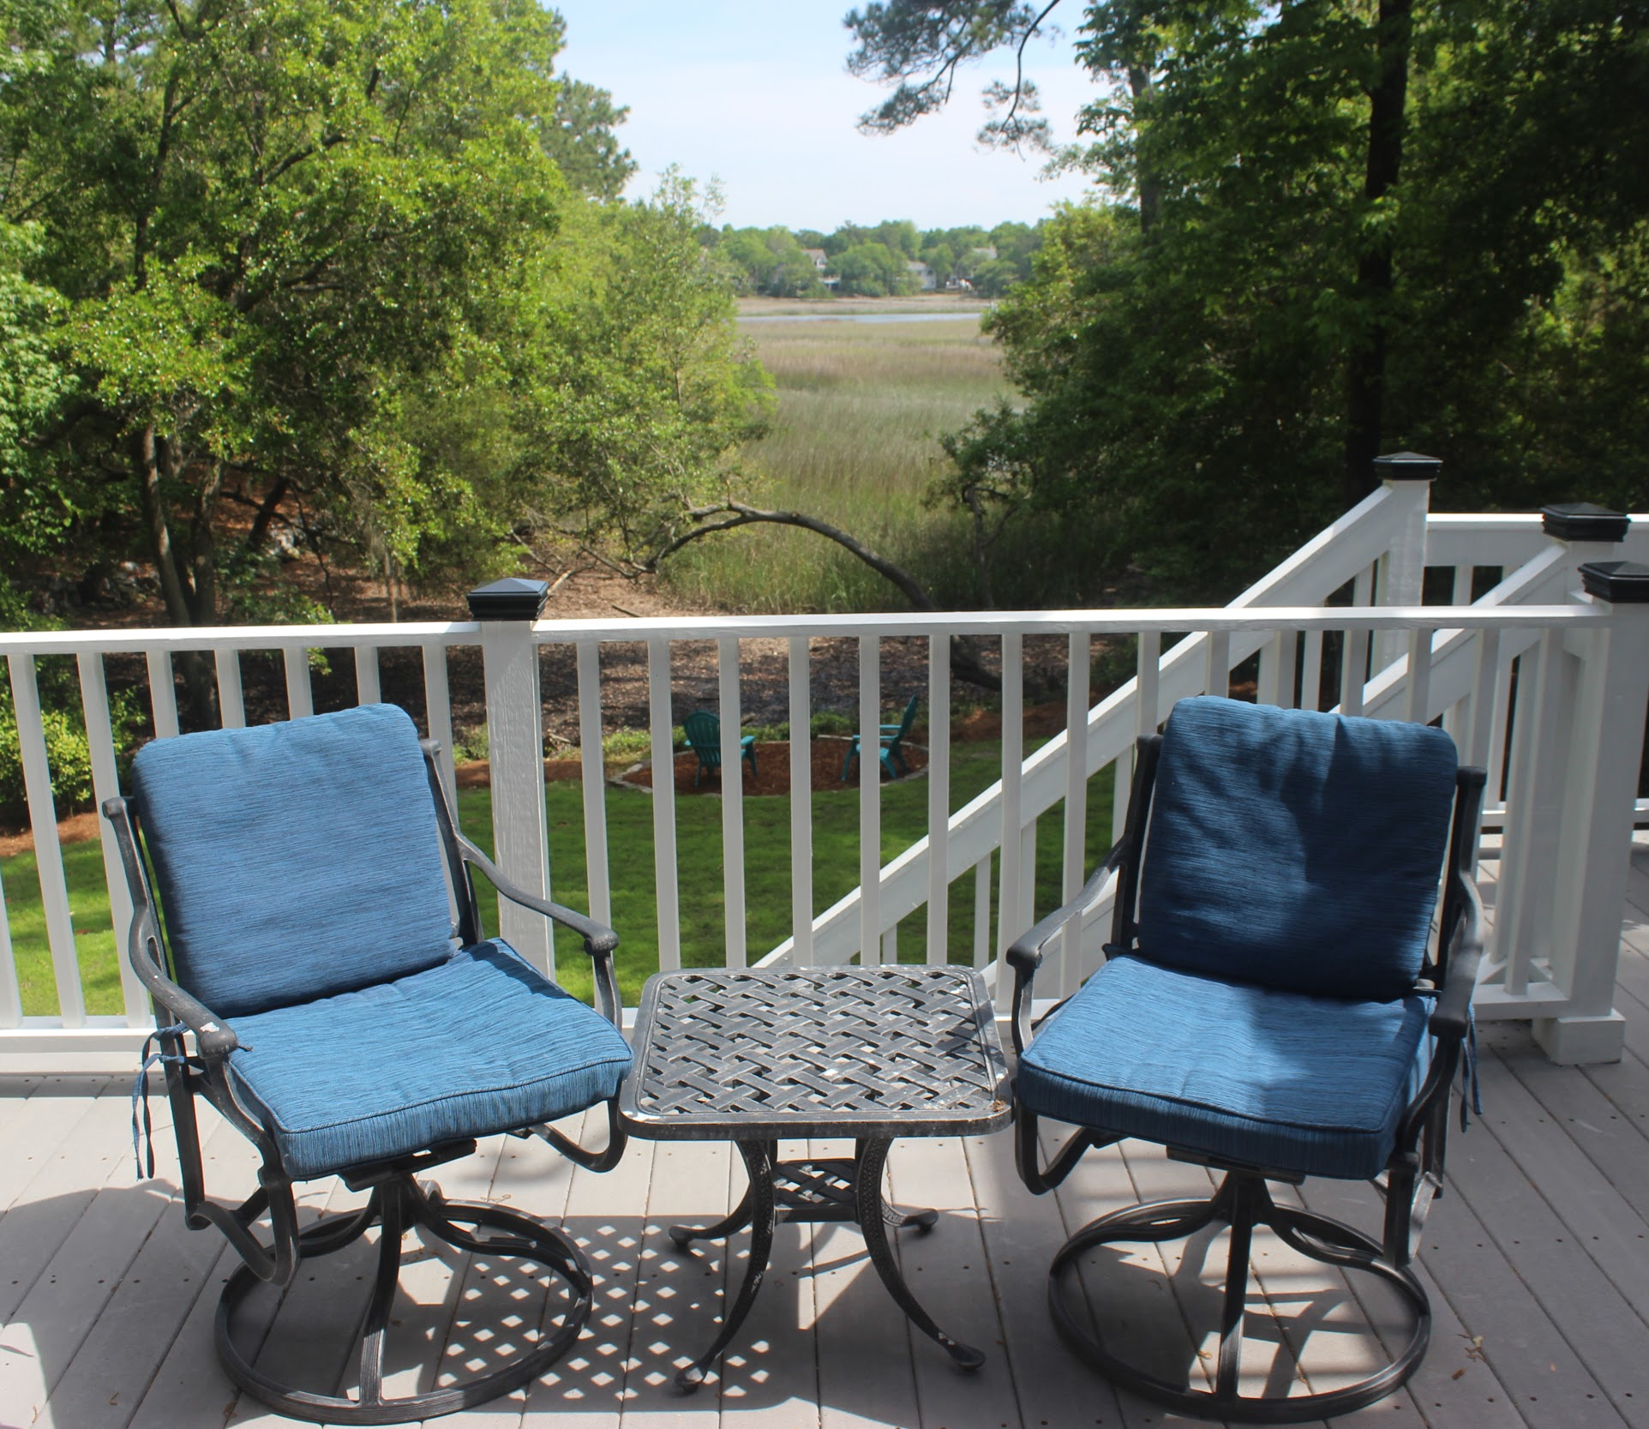

Check out available homes anytime on our website
The AgentOwned Realty Co.
824 Johnnie Dodds Blvd.
Mt. Pleasant, SC 29464
Kay E. Kennerty MBA
REALTORⓇ
843-345-5011
KKennerty@aol.com
Zeal, Integrity, Experience

