Slide 1
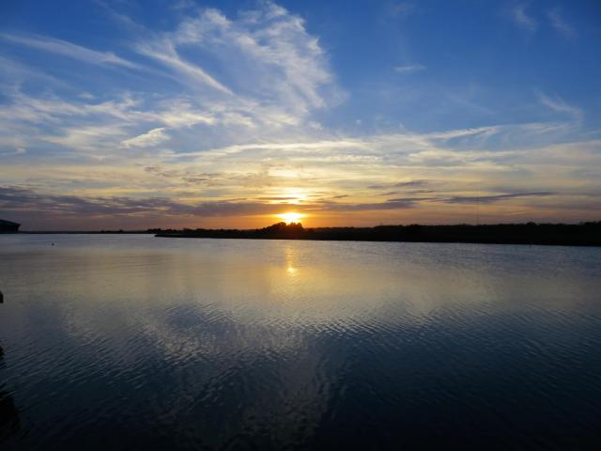
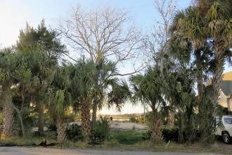
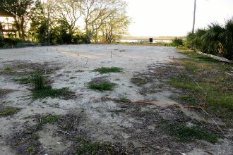
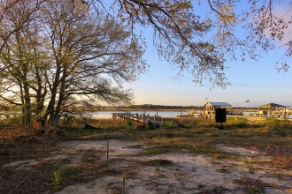
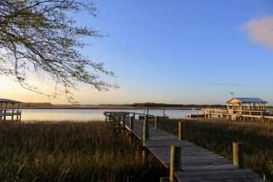
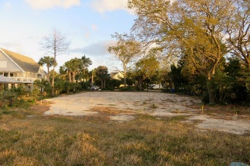
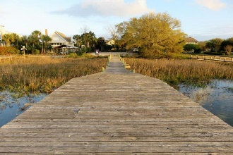
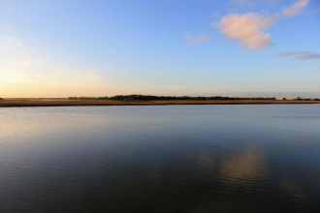
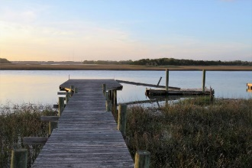


405 Merritt Boulevard Isle of Palms, SC 29451 · MLS# 17009738 · $2,100,000
One of a kind remaining deep water lot with dock located on coveted Hamlin Creek.
$550,000
This is all but a one of a kind remaining deep water lot with dock located on coveted Hamlin Creek. The almost 1/3 acre lot boast of natural Palms and Palmetto trees. The 95 feet of water frontage provides panoramic views of Hamlin Creek as well as pristine marshes and inter-coastal waterway. Located on a cul de sac off the beaten track provides unsurpassed privacy. The property has been cleared, filled and prepped for construction. Owner has paid for and has extended the sewer to the property providing the convenience of both public water and sewer. Owner has House Plans done by a renowned architectural firm which can convey, if desired. The afternoon sunsets are breath taking from the lot and/or dock locations. This is truly a rare find and will make someone's dreams come true.
Tommy Lovett Tommy - (843) 442-1276
tlovett@carolinaone.com www.tommylovettrealestate.com
Carolina One Real Estate
628 Long Point Rd.
Mt Pleasant, SC 29464-3032

