Slide 1
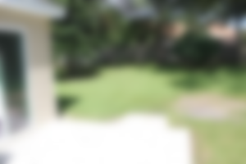
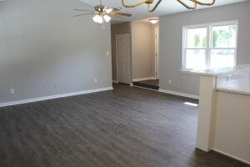
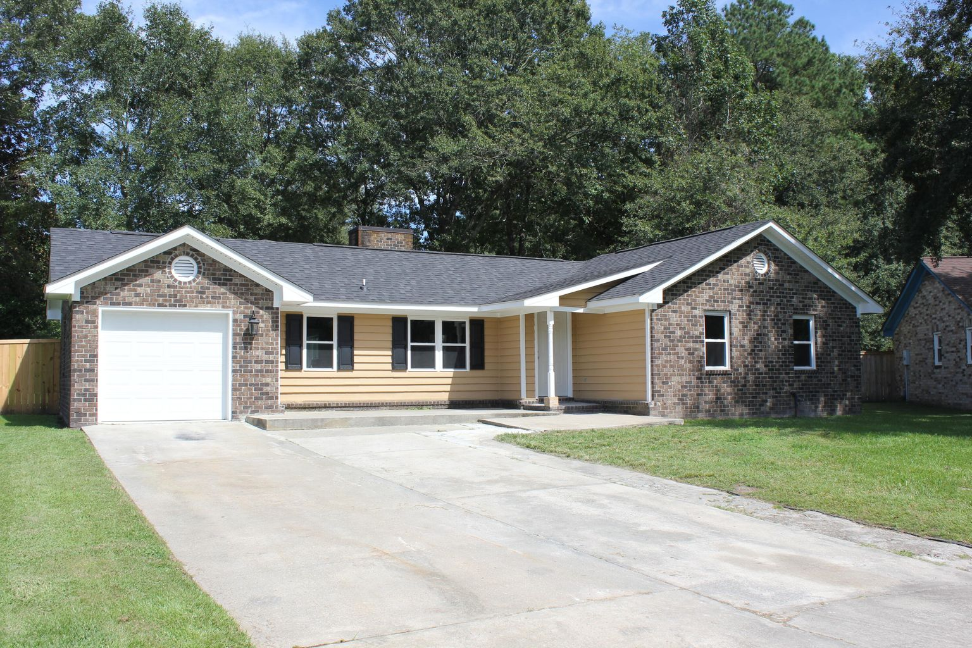
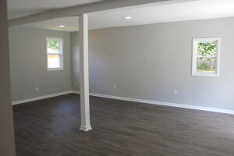
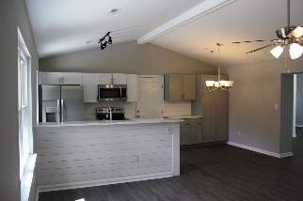
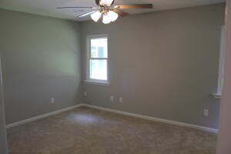
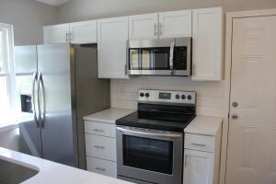
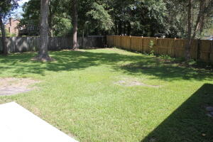

Renovated in College Park!
405 Carolina Circle
College Park | Ladson, SC 29456 | MLS# 21024406 | $299,900
Check out this beautifully renovated home in desirable College Park. This home sits on a huge lot, with a very nice back yard including a tiled patio. There is a full fence, so it would be great for kids or pets. The kitchen is completely remodeled, with brand new cabinets and stainless appliances. The upgraded quartz counters and bar top will be great for entertaining. The flooring has all been recently replaced, including LVP in the common areas, and carpet in the bedrooms. The bathrooms feature upgraded fixtures and showcase a very modern look. The potential uses for the room at the rear of the property are endless! Don't miss this great opportunity. List agent is owner.
AgentOwned Premiere Group
141 A N. Main Street
Summerville, SC 29483
Michael Marshall
843-693-5973
michaelbmarshall@gmail.com

