Slide 1
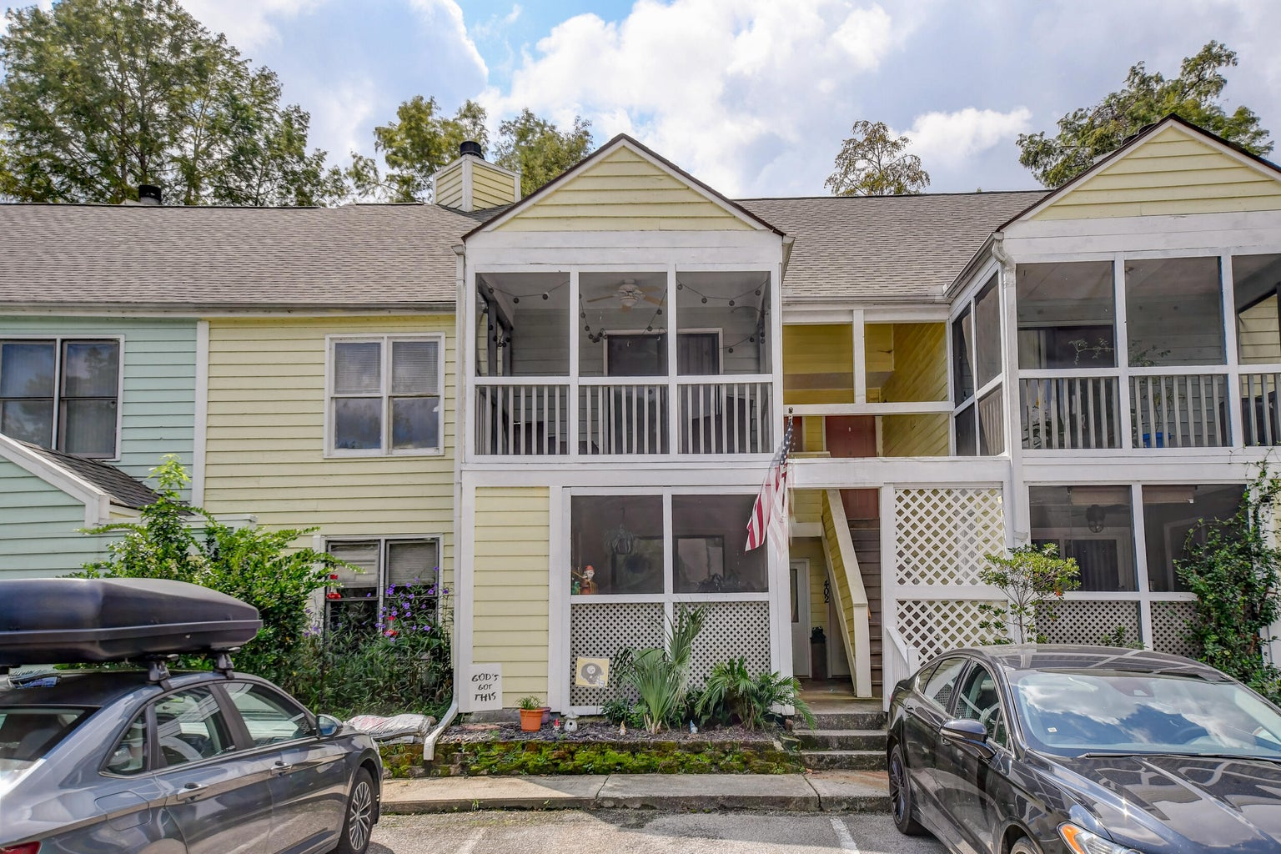



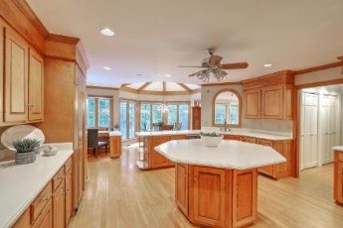
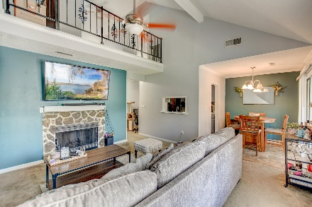



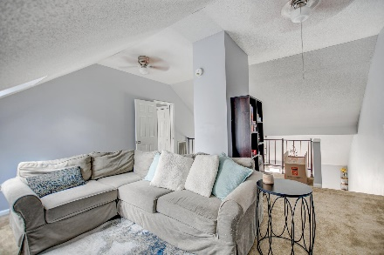

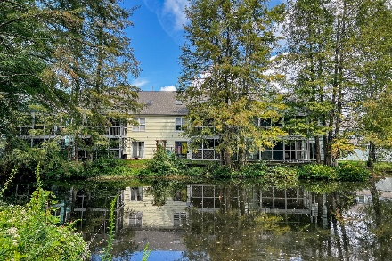
Parkshore Marshfront
Charming Pondside Condo
405 Sunnyside Way
Paradise Lakes | Summerville, SC 29485 | MLS# 23021347 | $229,000
Welcome to this charming condo in Summerville! Nestled in a convenient location, this home offers the perfect blend of comfort and style. As you enter, you'll be greeted by a bright and open floor plan that immediately sets the tone for relaxed living. The family room boasts a vaulted ceiling, creating a sense of space and airiness. It's not just a room; it's a welcoming retreat for you and your loved ones to gather and unwind. The galley-style kitchen is both functional and inviting, with plenty of counter space and cabinetry. It seamlessly opens up to an eat-in area, making meal preparation and dining a breeze. From here, you have easy access to the screened porch, where you can enjoy the outdoors without the hassle of insects. Upstairs, you'll discover a roomy loft,
offering flexible space that can be tailored to your needs. Whether you need a home office, a playroom, or a cozy reading nook, this loft has you covered. The owner's suite is a true sanctuary, complete with access to a private screened porch, where you can wake up to serene pond views and the gentle sounds of nature. The ensuite bath features a dual sink vanity and a tub/shower. Two additional bedrooms provide ample space for family members or guests, and they share a full bathroom.
This Summerville condo is not just a place to live; it's a place to create lasting memories. With its convenient location, functional layout, and lovely outdoor spaces, it offers a lifestyle that's both practical and enjoyable. Don't miss your chance to make this your new home sweet home!
3 Bed | 2 Bath | 1351 SqFt
Caroline Treece ctreece@mattoneillteam.com 843-754-0050

