Slide 1
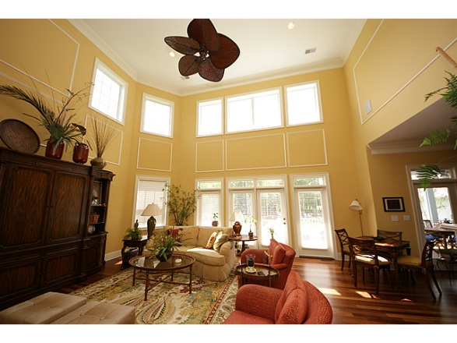
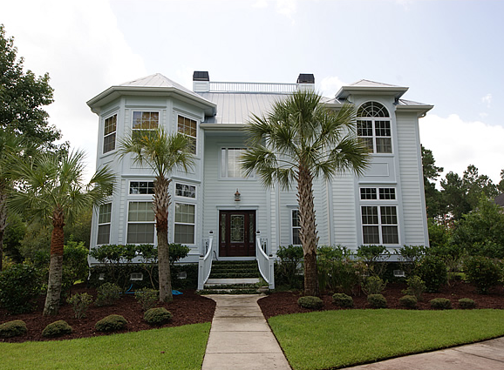
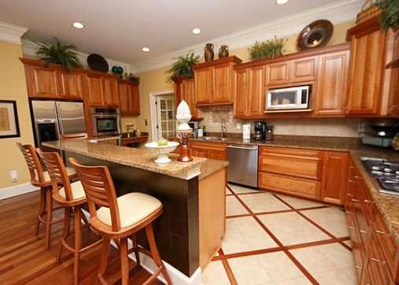
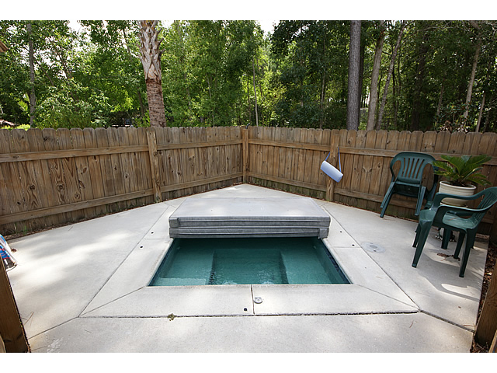
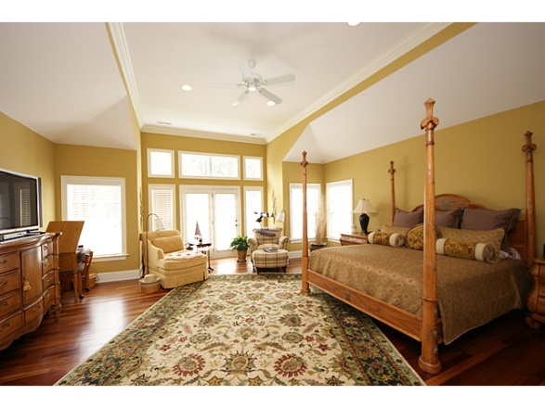



4062 Col Vanderhorst, Dunes West, Mt Pleasant
Executive home in one of Mount Pleasant's most sought after neighborhoods on over an acre estate size golf course home site.
Open floor plan with 20 ft. ceilings and entertaining space! Custom gourmet kitchen includes Jenn-Air appliances, pot filler at gas stove top, double ovens, and granite counter top. The large master suite, comes complete with tray ceiling, gas fireplace, morning kitchen and veranda/deck overlooking the back of your huge property. The master bathroom is awesome with Jacuzzi tub, marble floors and spacious steam shower.
Asking $775,000
MLS# 1309623
4,198 SqFt
5 Bed/4 Baths
Too many details to mention on this flyer…
Don Dawson
3040 Highway 17 North • Mount Pleasant, SC 29466
843-514-0452 • ddawson@carolinaone.com
www.TeamDawsonSC.com

