Slide 1
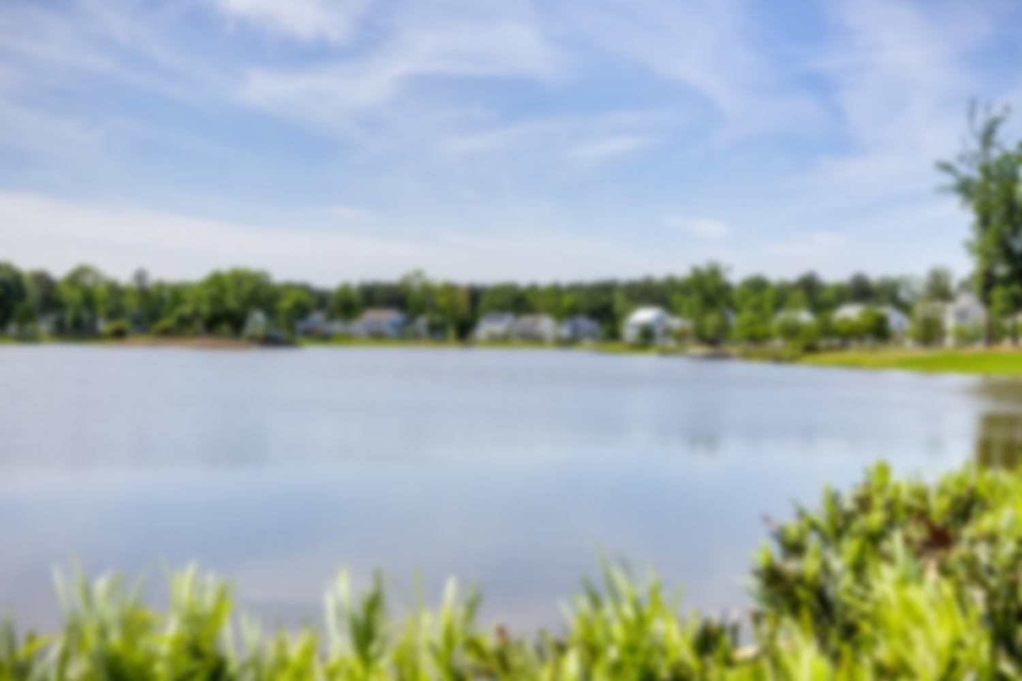
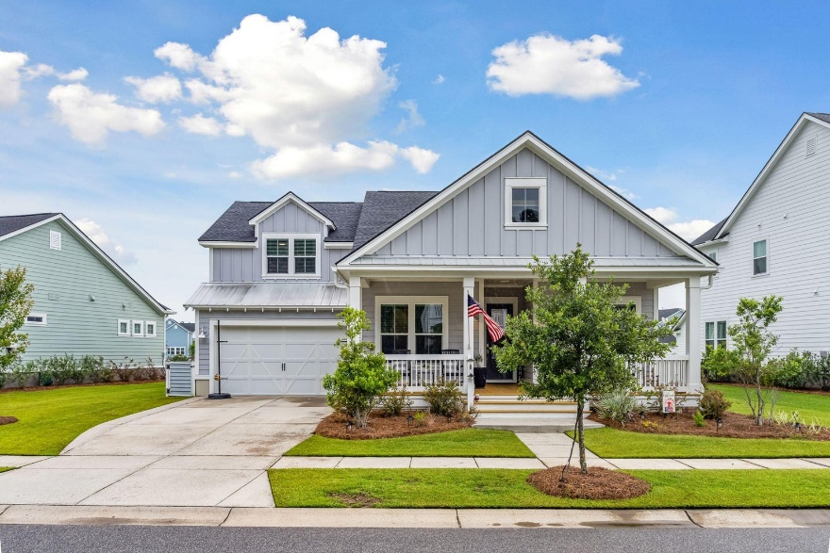
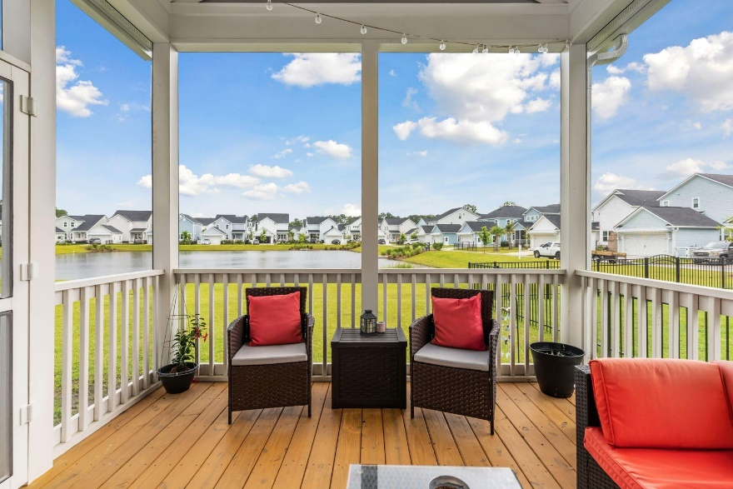
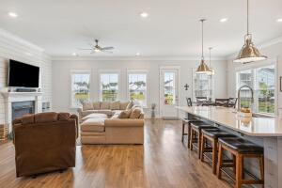
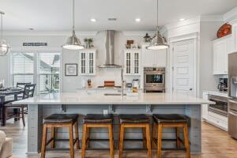
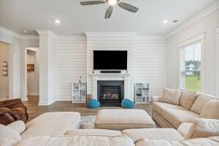
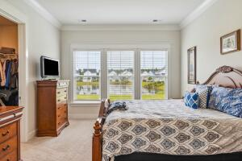
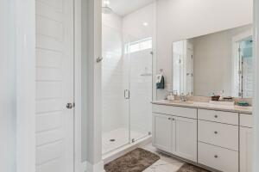
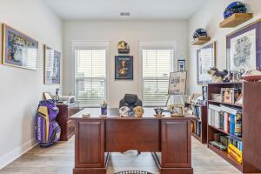
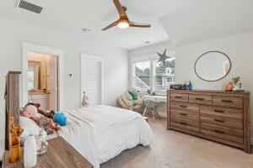
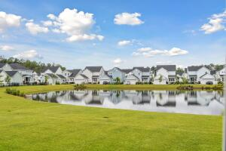
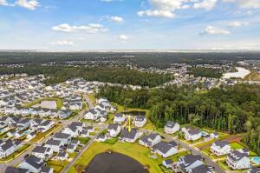
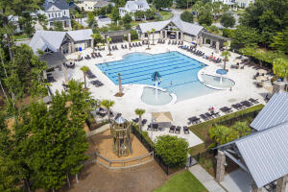


Just Listed Carolina Park
4069 Maidstone Drive
Carolina Park | Mount Pleasant, SC 29466 | MLS# 23014766 | $935,000
Welcomed by the generous front porch, perfect to enjoy a Charleston breeze, you will notice the custom features when entering this home. This popular Ranch floor-plan gives you a true sense of Lowcountry sophistication between the 10'+ ceilings, multitude of windows, upgraded moldings and shiplap, and large lot with pond views. The heart of this home is the open-concept living and dining space that includes a gourmet chef's kitchen featuring an oversized center island with upgraded quartz countertops, backsplash, double gas oven and cooktop, high end appliances, and separate dining room. Enjoy the pond view from all angles of this living space.
Step out onto the large screened in porch to enjoy your private pond view. There are two generous sized bedrooms in the front of the home downstairs that have their own walk-in closets and full upgraded bathrooms. There is an office space across from the dining room to include French doors. The master suite is also located downstairs in the back of the home that includes a pond view and a large walk-in closet. The master bathroom features his and hers sinks with quartz countertops and a large shower with floor to ceiling upgraded tiling. The laundry room is also located downstairs near the master suite and entry from the attached two car garage.
Upstairs above the garage, you will find another bedroom that includes a walk-in closet and full upgraded bathroom which is located over the garage. *Bermuda shutters have been ordered all will convey for the window over the front porch and garage*
This home is walking distance to Carolina Park's amenities which include a junior Olympic sized swimming pool, an outdoor pavilion with gas fireplace and outdoor kitchen, lighted tennis courts, playground, fenced-in dog park, and a 20- acre lake with trails, boardwalk and kayak launch. There is a second amenity center that will include a green space, parking lot, clubhouse, and swimming pool very close to the home off of Banning St which is estimated to be completed soon. Across the street, there is a walkway to get to the Carolina Park fields, which is located behind the neighborhood and is used for local recreation. Walk or ride your bike to the brand-new neighborhood library, Carolina Park Elementary School, Wando High and Oceanside Collegiate Academy; Mount Pleasant's top rated schools. Conveniently located near Costco, shopping, hospitals, dining, and beaches.
Virginia Landon
803-493-9202
virginialandon@kw.com
Keller Williams Realty | 496 Bramson Ct Ste 200 | Mt. Pleasant, SC 29464

