Slide 1
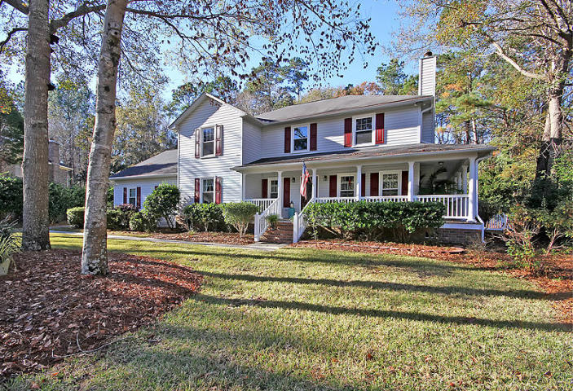
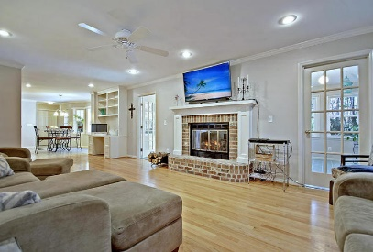
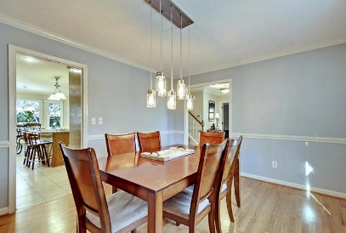
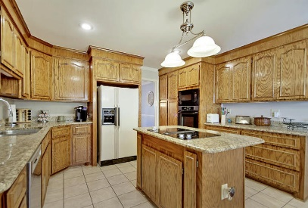
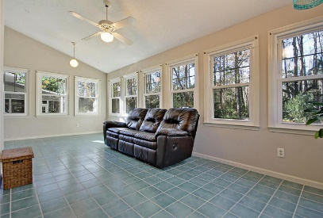
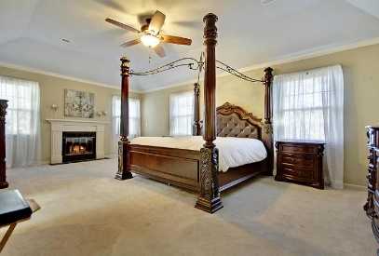
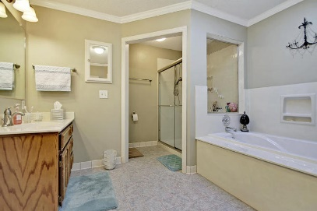
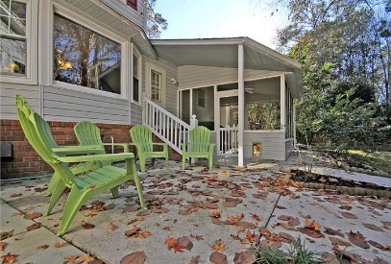
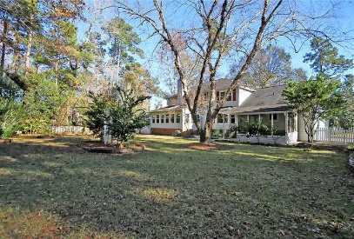


Summerville Beauty in Cul-de-Sac
406 Glouchester Ct
Ashborough East
Summerville, SC 29485
MLS# 17032738
$369,000
4 Bedrooms | 2½ Baths | 3,103 sf
Get ready to be wowed! This is a great home in a centrally located established neighborhood!! Curb appeal galore when you pull up to this cul-de-sac home! Huge wrap around porch gives you access to the family room as well as the sunroom! Upon entering, you'll immediately notice the gorgeous hardwood floors. To your right, beyond the stunning glass etched doors, is the formal living room or office with its own fireplace. To the left, is the large dining room right off the kitchen. The kitchen has ample cabinet space, island, granite countertops and large eat in area. Off the kitchen is the laundry room as well as a second staircase! From the kitchen to the family room, you have a large built in desk area offering storage. The family room, which also has its own fireplace, is a great size. When you need even more room, there's a huge sunroom located right off the family room. The backyard is an oasis! Tons of privacy, screened in porch, large patio and lovely landscaping. It's completely fenced in and has been well maintained. Back in the house, head upstairs and you'll find the enormous master suite! The master suite has a seating area as well as its own fireplace! The master bath offers dual vanities, a separate tub and shower and a large walk in closet. Down the hall from the master, you'll find another full bath, two large bedrooms, both with great closets, as well as a large FROG that is currently being used as a bedroom. This room has tons of possibilities! Ashborough East is a conveniently located neighborhood with a neighborhood pool, tennis courts, playground and walking trails. Close to Boeing, Mercedes, the airport, Bosch, this neighborhood is sought after! The neighborhood is also serviced by Dorchester District 2 schools! Come see this home today!!
Larry & Kathy Mazalatis
Larry Cell 843-693-0529
Kathy Cell 843-693-0159
Office 843-871-9133
AGENTOWNED PREMIERE GROUP | 1800 TROLLEY RD | SUMMERVILLE, SC 29485

