Slide 1
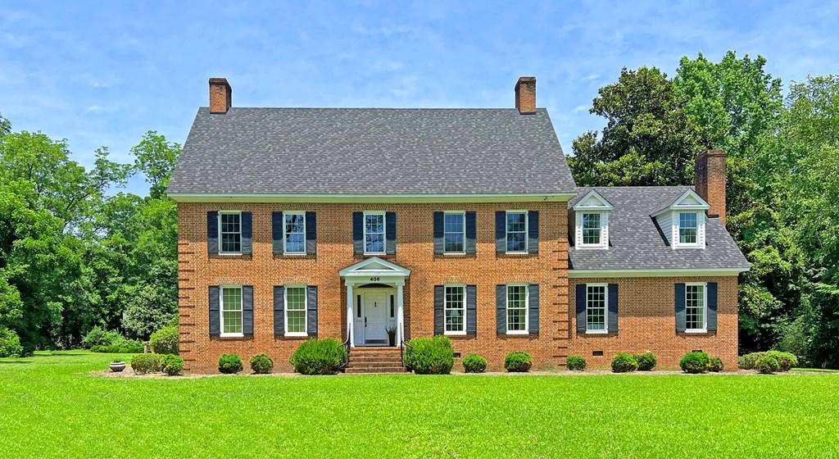
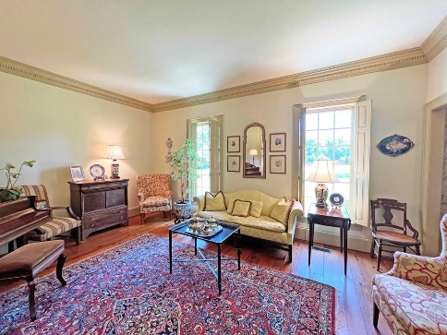
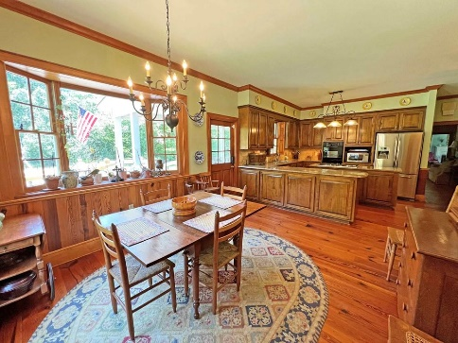
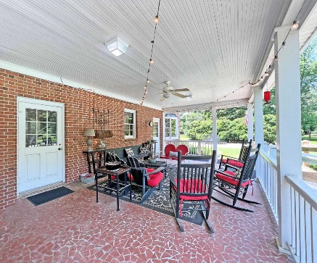
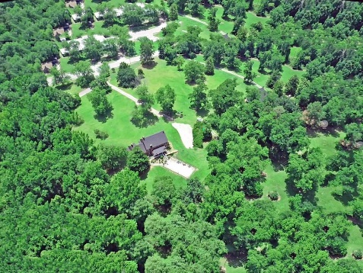

Pool & Land ~ New Price
406 Old Orangeburg Road
Cameron, SC 29030 ~ MLS# 156415 ~ $615,000
In town Cameron home sits on 5+/- ac with mature pecan trees. The Federal Style custom built home mirrors an old southern home with grand foyer, formal dinning and living rooms and large kitchen and master suite. 2 extra bedroom suites up stairs along with 2 other bedrooms sharing a jack and jill bath. The 1st floor has all hardwood floors. In ground pool makes the dog days of summer cooler or just sit and enjoy sweet tea on the large back porch. Property has several flowering trees and bushes for spring and summer along with the fall pecan harvest. Please make an appointment to see this house today. Sellers offering a 5k closing credit with accepted offer.
Lake Homes Realty, LLC
Elloree, SC 29047
www.SCLakeLife.com
Kristie Anderson
(803) 387-9459
kristie@sclakelife.com

