Slide 1
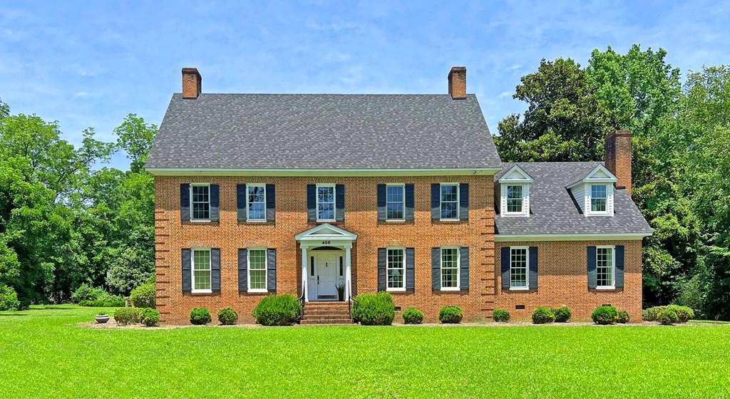
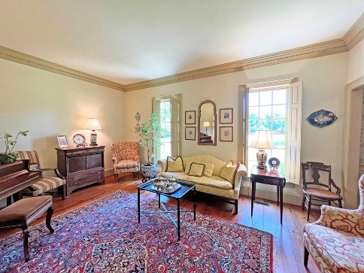
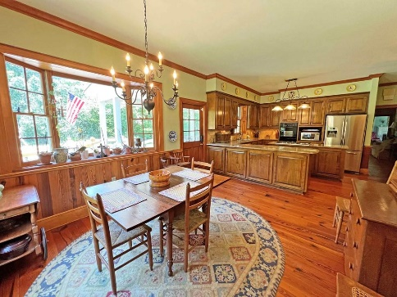
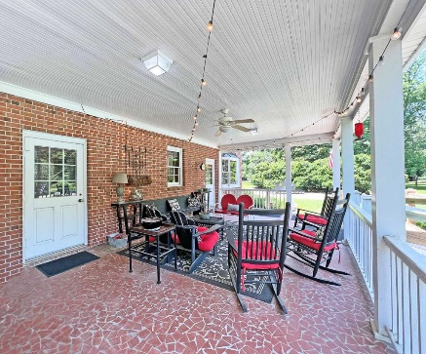
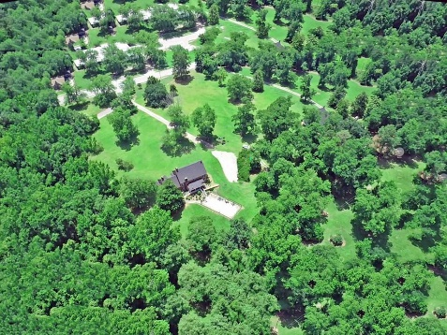

5 Acres Of Land
406 Old Orangeburg Road
Cameron, SC 29030 ~ MLS# 22015926 ~ $630,000
The home sits on 5+ ac of land in town Cameron only 10 mins off I26. This Federal Style custom built home offers 5 bedrooms, 4½ bathrooms, formal living, formal dinning, den, eat in kitchen and in ground pool. With high ceilings, beautiful trim, plank wood floors, cedar lined closets, granite counter tops, and plantation shutters this home is not missing any details. Master Suite offers his and hers walk in closets, double vanities, and fireplace all on the 1st floor. Upstairs offers 4 large bedrooms with plenty of extra storage. Cool off on those hot southern days in the pool or relaxing on the large covered porch. There are mature pecan, fig, oak and magnolia trees on the property. Detached garage used mainly for storage. Make sure you see this Calhoun county home today!!
Lake Homes Realty, LLC
Elloree, SC 29047
www.SCLakeLife.com
Kristie Anderson
(803) 387-9459
kristie@sclakelife.com

