Slide 1
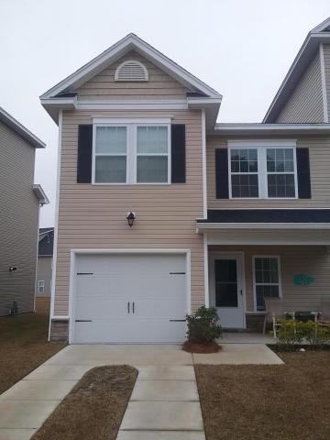
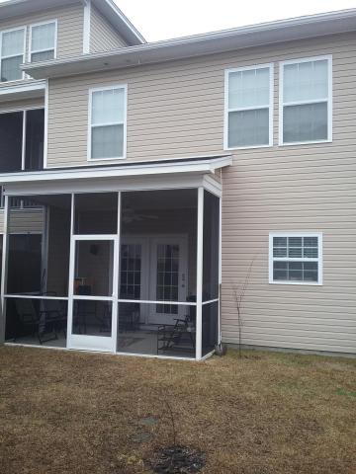

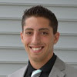

4078 Hartland Street Ashley Park Charleston, SC 29414 MLS# 18005518 $244,000
Just Listed
+
Open House
Saturday, March 3rd 12-2
Just Reduced!
The perfect home!
Immaculately maintained and cared for. Leave your worries at the door knowing that this two year old home has it all and is turn key ready. This three bedroom two and a half bathroom home boasts a layout that makes sense. Located in Ashley Park makes a convenient location and down the street from the high school. Enjoy afternoons on the oversized screened in back porch with views of the pond. Truly a spectacular place to call home.
Andrew Sorrentino
(843) 371-6218
andrew.sorrentino@agentowned.com
Kelly Rozier
(843) 209-3129
kelly.rozier@agentownedrealty.com
The AgentOwned Realty Co | 902 Savannah Hwy | Charleston, SC 29407
Real Estate • Mortgage • Insurance
www.AgentOwned.com

