Slide 1
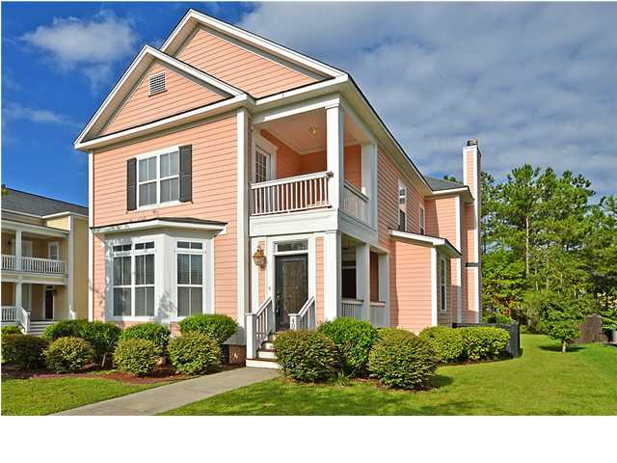
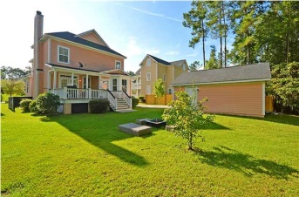
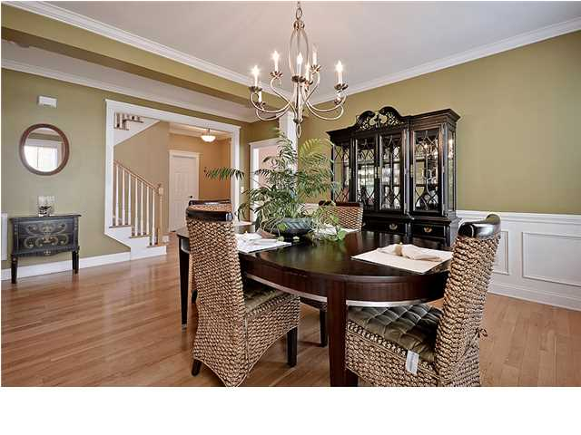
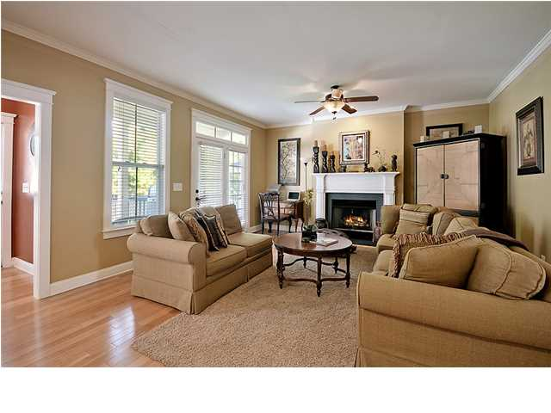
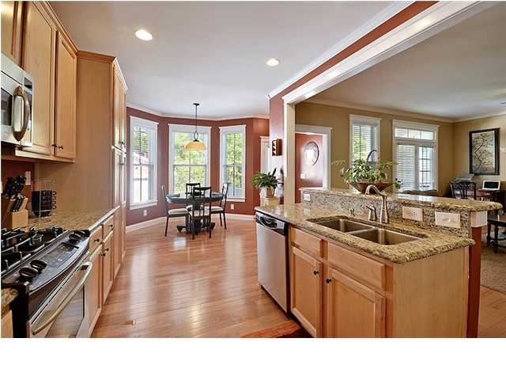
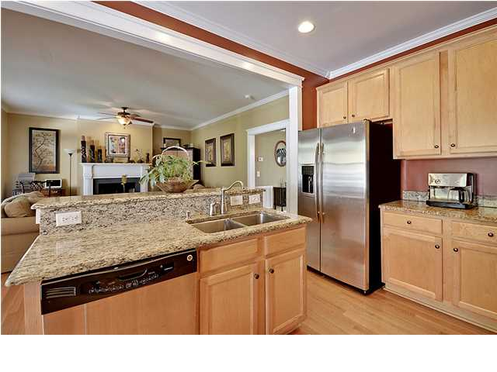
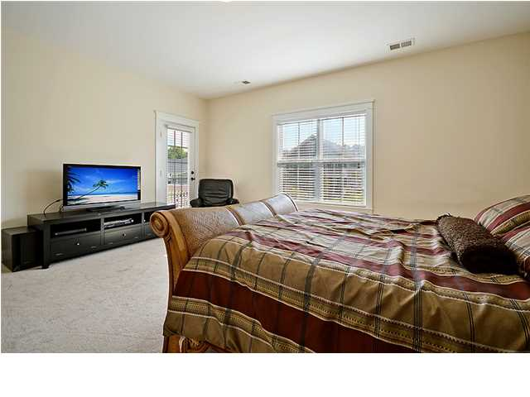
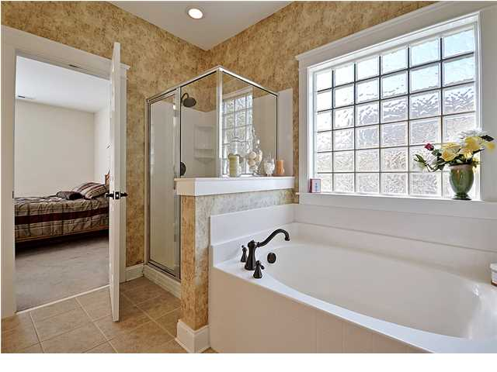
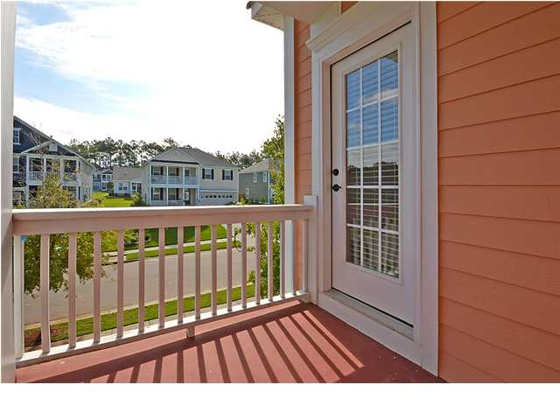
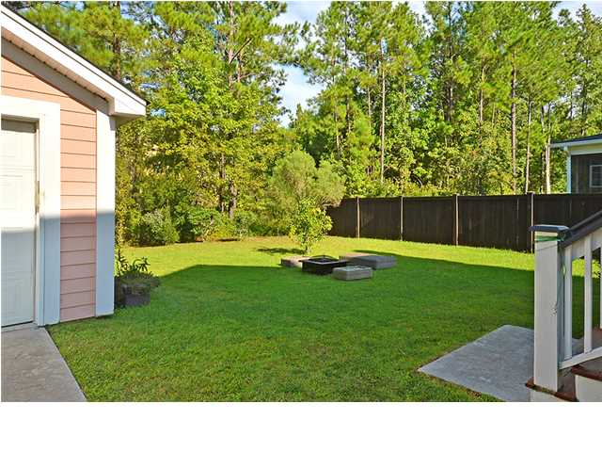

Price Reduced!
Shows Like a Model
407 Branch Creek Trl ~ Summerville ~ MLS# 1424634 ~ $295,000
You'll think you've stepped into new construction with the high ceilings, hardwood floors, top of the line finishes and 2,707 square feet of living area found in this three bedroom, two and half bath home in Branch Creek. The open concept floor plan kicks off with a spacious living room where three floor to ceiling windows at the front of the home allow sunlight to pour in. The formal dining room will make you want to start scheduling guests to come eat to admire the wainscoting and chair rail molding. The eat-in kitchen is the perfect food prep place with granite counters, oak cabinets, recessed lighting and stainless steel appliances. The kitchen opens to the family room where a cozy fireplace creates an inviting atmosphere. The owner's retreat upstairs provides a nightly getaway with its walk-in closet, access to the deck, and en-suite bath that features dual vanities, an oversized garden tub and walk-in shower. If you enjoy going green, the tankless gas hot water heater and the HVAC system are energy efficient highlights that you'll appreciate. A long driveway that leads to the detached two car garage allows plenty of space for off street parking. The porch in the back looks out to the lush lawn in the private backyard. Conveniently located to shopping, dining and schools, this quiet community is definitely the place to be. If you've been searching for a move-in ready beauty, be sure to come by today.
Call or email for details: (843) 654-7777 or Matt@MattOneillTeam.com

