Slide 1
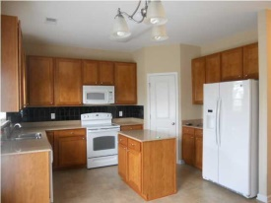
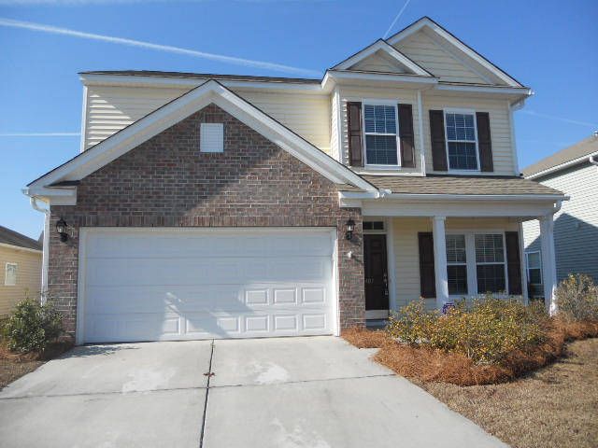
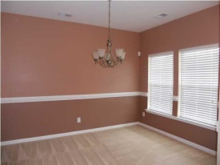
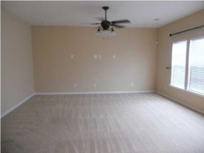
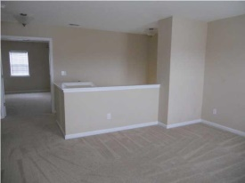
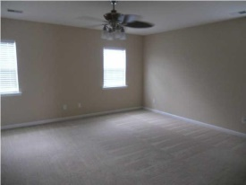
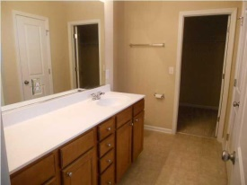
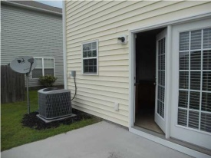

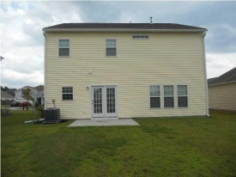
Open House Saturday
407 Pine Hill Lane
Brickhope Plantation
Goose Creek, SC 29445
MLS# 1425406 | $193,400
3 Bed / 2½ Bath
This gorgeous home is priced to sell! As close as you can get to new construction! Immediately you will notice the full front porch and brick accents when you pull into the driveway. Stepping in the door you will find a separate dining room (or office space). Continue through the foyer to the spacious, eat in kitchen and over sized family room. The kitchen has smooth top range, built in microwave, dishwasher, refrigerator custom cabinets, tile back splash and an island. Plenty of space for the chef in the family! Upstairs you will find a large open loft and three spacious bedrooms. The master suite is oversized with a large bathroom and walk in closet. This home is tastefully painted, clean and ready for a new owner. Sellers are motivated are and ready for an offer!
Connie White, Broker
C: 843-532-3356
conniesyouragent@gmail.com
Charleston Homes
111 Spring Hall Dr
Goose Creek, SC 29445

